Slide 1
UNIT 10: PAPERWORK – CASH PROJECTION

Slide 2
UNIT 10: PAPERWORK – CASH PROJECTION
Know Your Available Cash.
Use Your Income Statements.
Understand a Cash Flow Projection.
Make a Cash Flow Projection.

Slide 3
UNIT 10: PAPERWORK – CASH PROJECTION REPORT
REPORT
Last Week’s Promises:
Business Plan: Implement two ideas to improve or increase your productive assets. Consider the four loan warnings if you chose to get a loan.
Home Quality of Life Plan: Choose to improve a specific area from your Home Plan.
Savings: Save money, even just a coin or two.
ACT:
Business Spotlight presentation

Slide 4
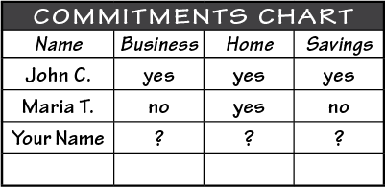
UNIT 10: PAPERWORK – CASH PROJECTION REPORT
REPORT:
DISCUSS:
What did you learn last week as you kept your promises?
What problems did you have as you tried to keep your commitments?
What can we do to help everyone keep weekly promises?

Slide 5
UNIT 10: PAPERWORK – CASH PROJECTION INTRODUCTION | LEARN
DISCUSS:
What do you see in this picture?
Have any of you ever been lost?
How does it feel to be lost?
ACT:
Apply the four principles in this unit to your business.

Slide 6
UNIT 10: PAPERWORK – CASH PROJECTION INTRODUCTION | LEARN
DISCUSS:
How could a map or compass help?
How helpful is it to get a forecast of dangerous weather, especially on a boat?
How would it be helpful to forecast what will happen with your business?

Slide 7
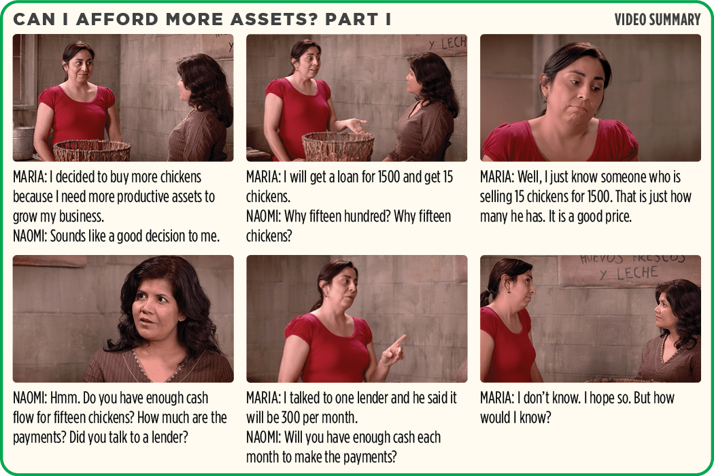
UNIT 10: PAPERWORK – CASH PROJECTION PRINCIPLE 1 | LEARN
Principle 1
KNOW YOUR AVAILABLE CASH

Slide 8
UNIT 10: PAPERWORK – CASH PROJECTION PRINCIPLE 1 | LEARN
Principle 1
KNOW YOUR AVAILABLE CASH
DISCUSS:
How can Maria find out if she will have enough cash to make her loan payment of 300 for the next six months?

Slide 9
UNIT 10: PAPERWORK – CASH PROJECTION PRINCIPLE 1 | LEARN
Principle 1
KNOW YOUR AVAILABLE CASH
CODE:
Turn to page 32 in your workbook and look at Maria’s Income & Expense Log Example for the cash balance. Or look at the next slide

Slide 10
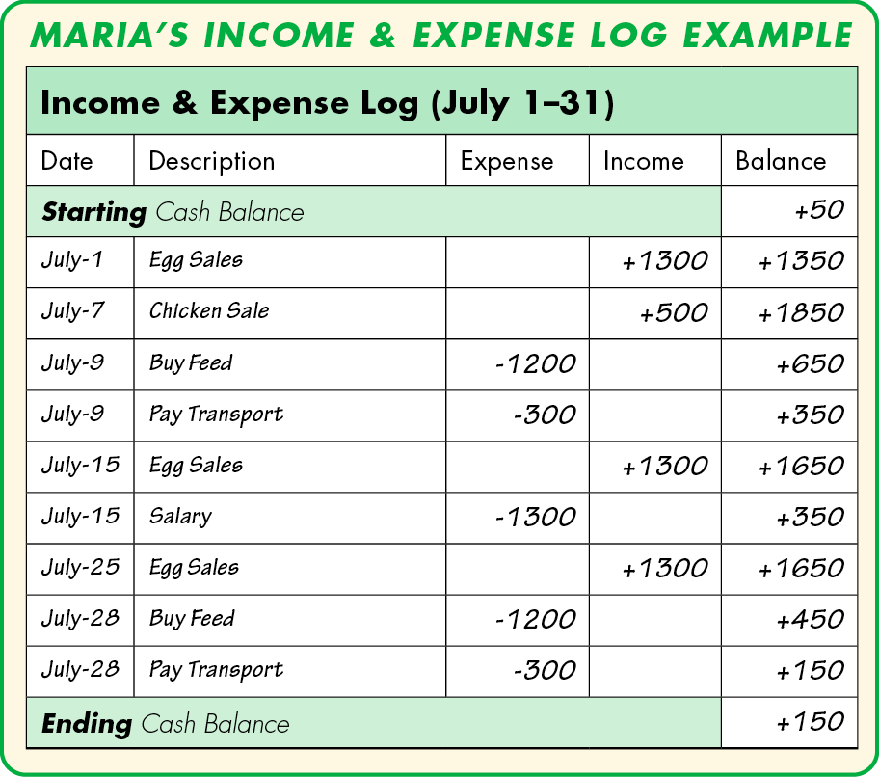
UNIT 10: PAPERWORK – CASH PROJECTION PRINCIPLE 1 | LEARN
Principle 1
KNOW YOUR AVAILABLE CASH

Slide 11
UNIT 10: PAPERWORK – CASH PROJECTION PRINCIPLE 1 | LEARN
Principle 1
KNOW YOUR AVAILABLE CASH
DISCUSS:
How much available cash does Maria have before the month starts?
What is he available cash at the end of July?
How much available cash did Maria have at the end of the day July 15?

Slide 12
UNIT 10: PAPERWORK – CASH PROJECTION PRINCIPLE 1 | LEARN
Principle 1
KNOW YOUR AVAILABLE CASH
DISCUSS:
How can you always know how much available cash you have?
What does this month of records tell Maria about her business?
ACT:
Turn to page 32 in your workbook or another notebook and answer the question.

Slide 13
UNIT 10: PAPERWORK – CASH PROJECTION PRINCIPLE 2 | LEARN
Principle 2
USE YOUR INCOME STATEMENTS
CODE:
Turn to page 33 in your workbook to see Maria’s Income & Expense Log example. Or look on the next slide and be prepared to answer some questions.

Slide 14
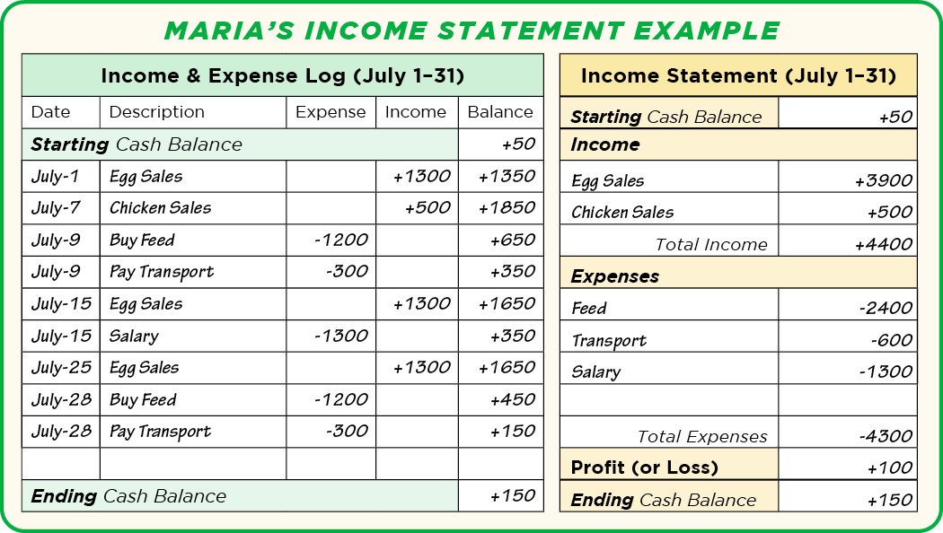
UNIT 10: PAPERWORK – CASH PROJECTION PRINCIPLE 2 | LEARN
Principle 2
USE YOUR INCOME STATEMENTS

Slide 15
UNIT 10: PAPERWORK – CASH PROJECTION PRINCIPLE 2 | LEARN
Principle 2
USE YOUR INCOME STATEMENTS
DISCUSS:
How many times did Maria buy feed for the chickens?
How much does the income statement show Maria spent for feed?
Did Maria make a profit in July?
What is the difference between an Income & Expense Log and an Income Statement?

Slide 16
UNIT 10: PAPERWORK – CASH PROJECTION PRINCIPLE 2 | LEARN
Principle 2
USE YOUR INCOME STATEMENTS
ACT:
Look at page 33 in your workbook at Practice Income & Expense Log and Income Statement. Or look on the next slide.
Now we will practice making an Income & Expense Log and an Income Statement.
If you are using another notebook, copy the next slide in order to make your own Income & Expense Log

Slide 17
UNIT 10: PAPERWORK – CASH PROJECTION PRINCIPLE 2 | LEARN
Principle 2
USE YOUR INCOME STATEMENTS
ACT:
If you are using another notebook, copy the chart on the next slide in order to make your own Income & Expense Log and Income Statement.

Slide 18
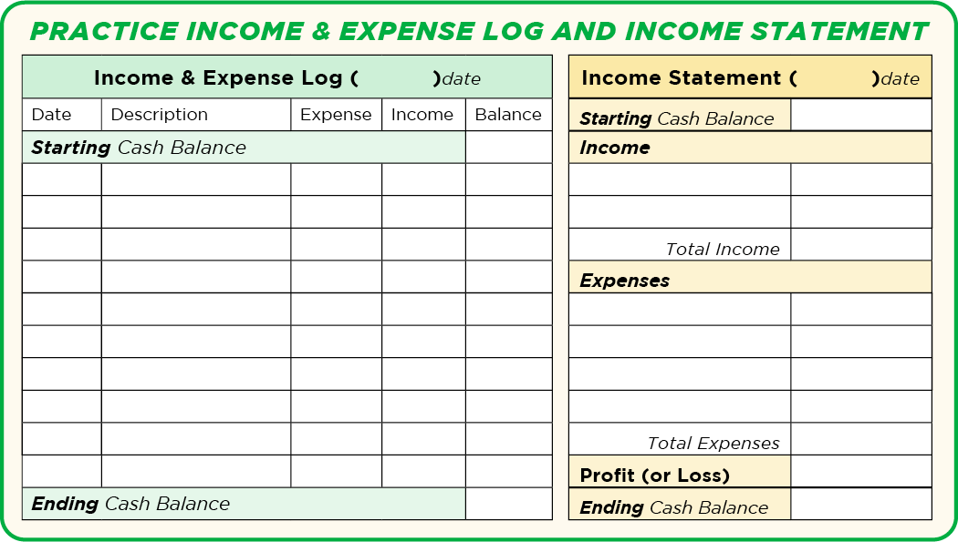
UNIT 10: PAPERWORK – CASH PROJECTION PRINCIPLE 2 | LEARN
Principle 2
USE YOUR INCOME STATEMENTS

Slide 19
UNIT 10: PAPERWORK – CASH PROJECTION PRINCIPLE 3 | LEARN
Principle 3
UNDERSTAND A CASH FLOW PROJECTION
CODE:
Turn to page 34 of Maria’s Income Statements to begin looking at and understanding Cash Flow Projections. Or look on the next slide

Slide 20
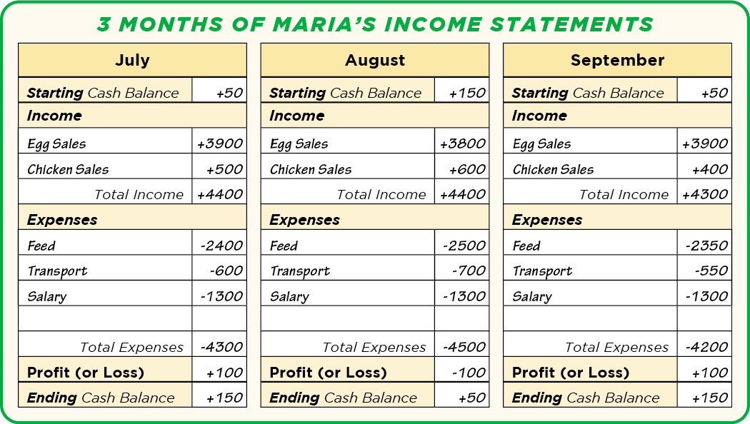
UNIT 10: PAPERWORK – CASH PROJECTION PRINCIPLE 3 | LEARN
Principle 3
UNDERSTAND A CASH FLOW PROJECTION

Slide 21
UNIT 10: PAPERWORK – CASH PROJECTION PRINCIPLE 3 | LEARN
Principle 3
UNDERSTAND A CASH FLOW PROJECTION
CODE:
What is Maria’s average Chicken Sales for the last three months?
What is her monthly salary?
The purpose of a Cash Flow Projection is to predict future income & expenses and calculate future Profit & Loss as well as cash balances.

Slide 22
UNIT 10: PAPERWORK – CASH PROJECTION PRINCIPLE 3 | LEARN
Principle 3
UNDERSTAND A CASH FLOW PROJECTION
CODE:
Turn in your workbook to page 34 to Maria’s Cash Flow Projection Example. Or look at the next slide.

Slide 23
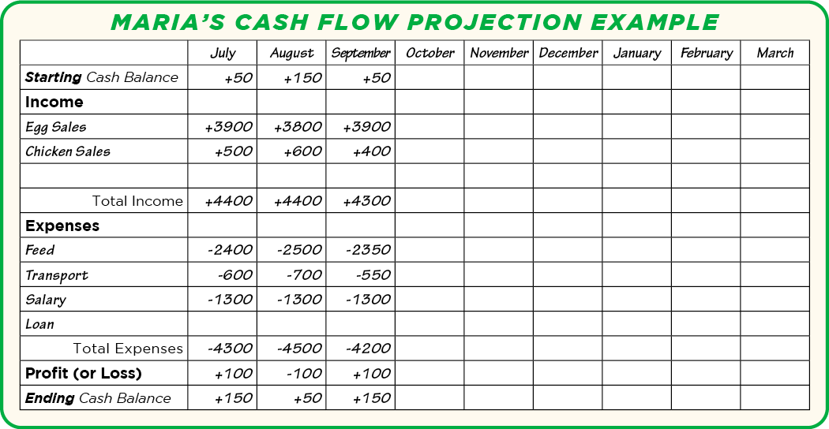
UNIT 10: PAPERWORK – CASH PROJECTION PRINCIPLE 3 | LEARN
Principle 3
UNDERSTAND A CASH FLOW PROJECTION

Slide 24
UNIT 10: PAPERWORK – CASH PROJECTION PRINCIPLE 3 | LEARN
Principle 3
UNDERSTAND A CASH FLOW PROJECTION
CODE:
Turn in your workbook to page 35 to Maria’s Cash Flow Projection Example (with no loan). Or look at the next slide.
What would happen to Maria’s cash flow if Maria doesn’t take out a loan or buy more chickens?

Slide 25
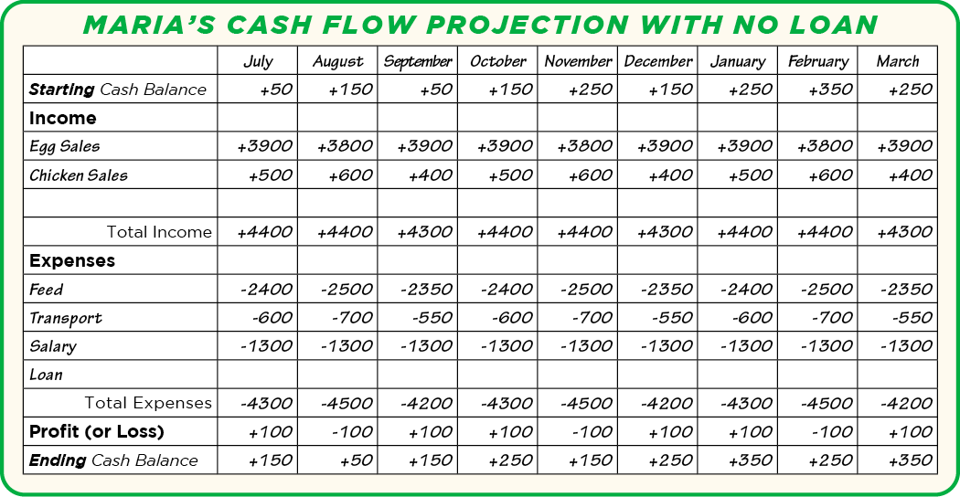
UNIT 10: PAPERWORK – CASH PROJECTION PRINCIPLE 3 | LEARN
Principle 3
UNDERSTAND A CASH FLOW PROJECTION

Slide 26
UNIT 10: PAPERWORK – CASH PROJECTION PRINCIPLE 3 | LEARN
Principle 3
UNDERSTAND A CASH FLOW PROJECTION
DISCUSS:
What would happen to Maria’s cash flow if Maria doesn’t take out a loan or buy more chickens?
CODE:
Let’s turn to page 35 in your workbook at Maria’s Cash Flow Projection For 15 Chickens. Or look at the next slide.

Slide 27
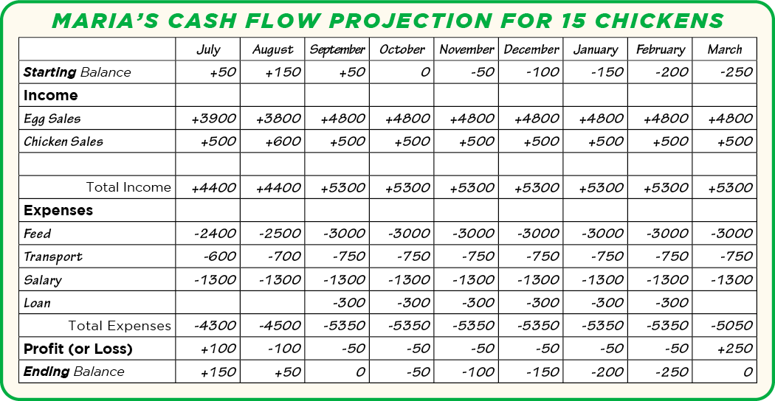
UNIT 10: PAPERWORK – CASH PROJECTION PRINCIPLE 3 | LEARN
Principle 3
UNDERSTAND A CASH FLOW PROJECTION

Slide 28
UNIT 10: PAPERWORK – CASH PROJECTION PRINCIPLE 3 | LEARN
Principle 3
UNDERSTAND A CASH FLOW PROJECTION
DISCUSS:
Does Maria have enough cash flow for loan payments of 300 per month if she starts in October?
What month will Maria make her first payment?

Slide 29
UNIT 10: PAPERWORK – CASH PROJECTION PRINCIPLE 3 | LEARN
Principle 3
UNDERSTAND A CASH FLOW PROJECTION
DISCUSS:
How much does she think her egg sales will go up?
Should Maria try a different loan amount?
Could she save up and pay cash for the chickens instead of a loan?

Slide 30
UNIT 10: PAPERWORK – CASH PROJECTION PRINCIPLE 3 | LEARN
Principle 3
UNDERSTAND A CASH FLOW PROJECTION

Slide 31
UNIT 10: PAPERWORK – CASH PROJECTION PRINCIPLE 3 | LEARN
Principle 3
UNDERSTAND A CASH FLOW PROJECTION
CODE:
Turn to page 36 in your workbook and look at Maria’s Cash Flow Projection for 8 Chickens. Or look at the next slide.

Slide 32
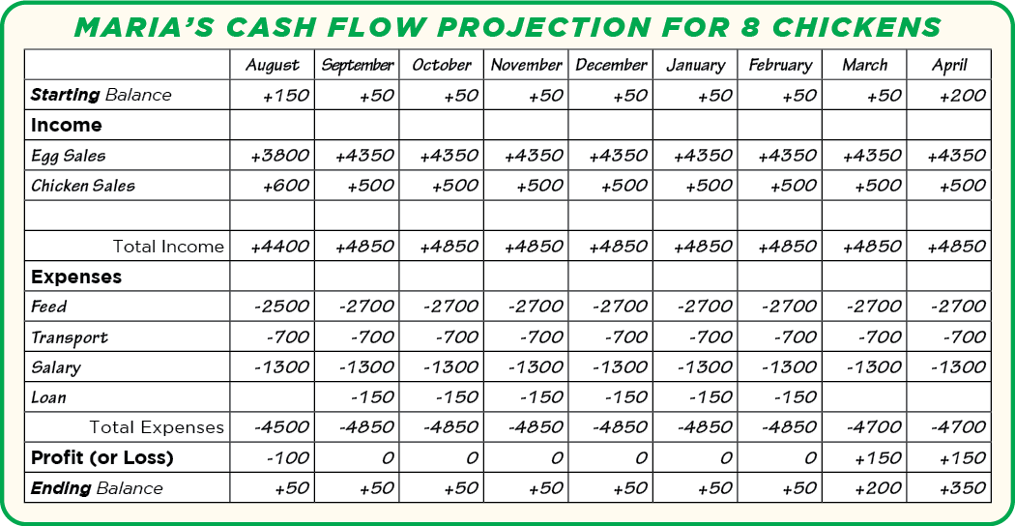
UNIT 10: PAPERWORK – CASH PROJECTION PRINCIPLE 3 | LEARN
Principle 3
UNDERSTAND A CASH FLOW PROJECTION

Slide 33
UNIT 10: PAPERWORK – CASH PROJECTION PRINCIPLE 3 | LEARN
Principle 3
UNDERSTAND A CASH FLOW PROJECTION
DISCUSS:
Does Maria have enough cash flow for a loan of 800.00 for 8 chickens?
Does Maria have enough cash flow for a loan of 1500.00 for 15 chickens?
What is a cash flow projection?
How will it help your business?

Slide 34
UNIT 10: PAPERWORK – CASH PROJECTION PRINCIPLE 3 | LEARN
Principle 3
UNDERSTAND A CASH FLOW PROJECTION
ACT:
Take time to make a cash flow projection with your business’s reports. (See next slide for details).

Slide 35
UNIT 10: PAPERWORK – CASH PROJECTION PRINCIPLE 4 | LEARN
Principle 4
MAKE A CASH FLOW PROJECTION
CODE:
It is time to practice making a cash projection for your business.
Turn to a Blank Cash Flow Projection graph on page 37 or copy in onto another notebook.
Refer to your practice Income Statement on page 33 in your workbook or notebook.

Slide 36
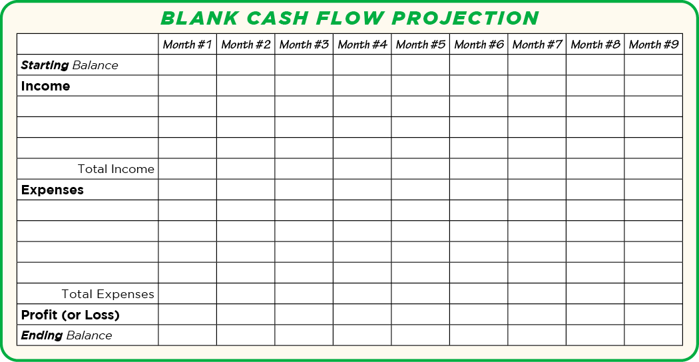
UNIT 10: PAPERWORK – CASH PROJECTION PRINCIPLE 4 | LEARN

Slide 37
UNIT 10: PAPERWORK – CASH PROJECTION PRINCIPLE 4 | LEARN
Principle 4
MAKE A CASH FLOW PROJECTION
CODE:
Please predict what you think some of income and expenses will be for the next six months.
Remember– this is just a practice. Just do the best you can.

Slide 38
UNIT 10: PAPERWORK – CASH PROJECTION PRINCIPLE 4 | LEARN
Principle 4
MAKE A CASH FLOW PROJECTION
CODE:
Share with a partner or the group some of your projections.
What will you need to do to make them happen?

Slide 39
UNIT 10: PAPERWORK – CASH PROJECTION PRINCIPLE 4 | LEARN
Principle 4
MAKE A CASH FLOW PROJECTION
CODE:
Turn to page 52 in the resource section in your workbook or create a blank Income & Expense Log in another notebook.
Now you will make a real cash projection for your business using your real income statements and paperwork.

Slide 40
UNIT 10: PAPERWORK – CASH PROJECTION PRINCIPLE 4 | LEARN
Principle 4
MAKE A CASH FLOW PROJECTION
DISCUSS:
How does knowing your available cash help you make decisions about your business?
Besides loan payments, are there other ways that knowing your cash flow can help you grow your business?

Slide 41
UNIT 10: PAPERWORK – CASH PROJECTION PRINCIPLE 4 | LEARN
Principle 4
MAKE A CASH FLOW PROJECTION
ACT:
Turn to page 39 in your workbook and read along the boxes. Or follow along on the next slide

Slide 42
UNIT 10: PAPERWORK – CASH PROJECTION PRINCIPLE 4 | LEARN

Slide 43
UNIT 10: PAPERWORK – CASH PROJECTION PRINCIPLE 4 | LEARN
Principle 4
MAKE A CASH FLOW PROJECTION
ACT:
Make a six month Cash Flow Projection for your business before the next meeting.

Slide 44
UNIT 10: PAPERWORK – CASH PROJECTION SUMMARY
PAPERWORK – CASH PROJECTION PRINCIPLES SUMMARY
Know Your Available Cash.
Use Your Income Statements.
Understand a Cash Flow Projection.
Make a Cash Flow Projection.

Slide 45
UNIT 10: PAPERWORK – CASH PROJECTION COMMIT
COMMITMENT
Business Plan Commitment:
I will use my business paperwork, both my Income & Expense Logs and my Income Statements, to make a six month Cash Flow Projection for my business.

Slide 46
UNIT 10: PAPERWORK – CASH PROJECTION COMMIT
COMMITMENT
Home Quality of Life Commitment:
I will thoughtfully choose one or two areas of my Quality of Life Wheel and write down goals to improve this week.
I will be specific with my written goals and follow through.
Savings Commitment:
I will add to my savings–even if it’s just a coin or two.

Slide 47
UNIT 10: PAPERWORK – CASH PROJECTION COMMIT
COMMITMENT
DISCUSS:
Who would like to share their Home Quality of Life Commitment this week?
Which commitment will be the easiest to keep for you this week?
Which commitment will be the hardest?

Slide 48
UNIT 10: PAPERWORK – CASH PROJECTION COMMIT
COMMITMENT
ACT:
Meet now with your Action Partner for this week. Discuss your business ideas and decide how you will contact and encourage each other during the week to keep your commitments.

Slide 49
UNIT 10: PAPERWORK – CASH PROJECTION

