Slide 1
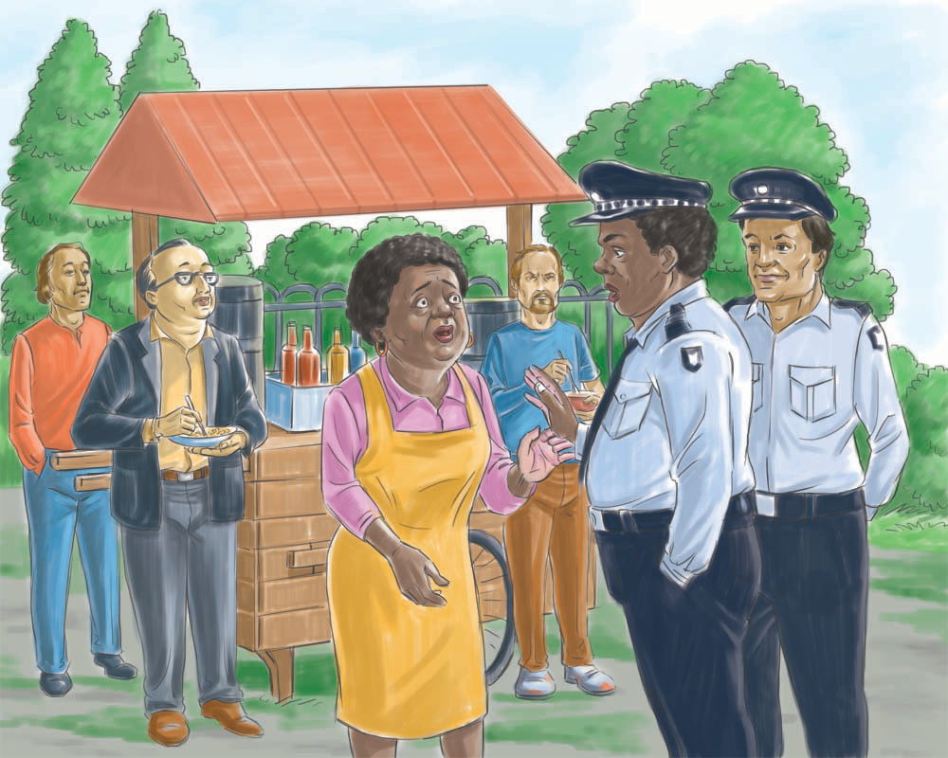
UNIT 11: PLAN – MAKE IT LEGAL

Slide 2
UNIT 11: PLAN – MAKE IT LEGAL
Know Your Legal Requirements.
Decide When to Make Your Business Legal.

Slide 3
UNIT 11: PLAN – MAKE IT LEGAL REPORT
REPORT
Last Week’s Promises:
Business Plan: Use my past records to make a six month cash flow projection for my business.
Home Quality of Life Plan: Choose to improve a specific area from your Home Plan.
Savings: Save money, even just a coin or two.
ACT:
Business Spotlight presentation

Slide 4
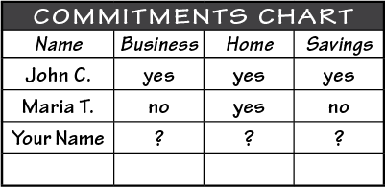
UNIT 11: PLAN – MAKE IT LEGAL REPORT
REPORT:
DISCUSS:
What did you learn last week as you kept your promises?
What problems did you have as you tried to keep your commitments?
What can we do to help everyone keep weekly promises?

Slide 5
UNIT 11: PLAN – MAKE IT LEGAL INTRODUCTION | LEARN
DISCUSS:
What was keeping Malary from getting a license?
What could she do to overcome her fears and make her business legal?
ACT:
Decide how and when you will make your business legal.

Slide 6
UNIT 11: PLAN – MAKE IT LEGAL PRINCIPLE 1 | LEARN
Principle 1
KNOW YOUR LEGAL REQUIREMENTS
CODE:
Know the laws of your area.
DISCUSS:
What are the minimal steps you can take to start to make your business legal?

Slide 7
UNIT 11: PLAN – MAKE IT LEGAL PRINCIPLE 1 | LEARN
Principle 1
KNOW YOUR LEGAL REQUIREMENTS
ACT:
Turn to page 40 in your workbook to the chart “Your Legal Requirements” or look on the next slide
Make notes in your workbook or notebook of legal requirements for businesses to meet.
What are the national, district, and local requirements for our businesses?

Slide 8
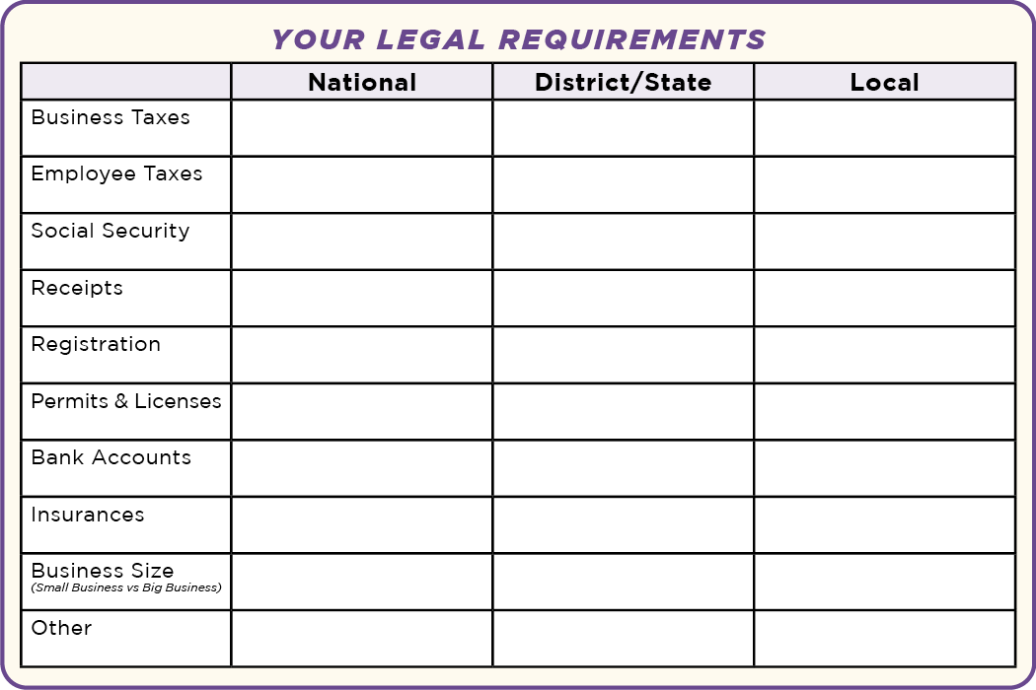
UNIT 11: PLAN – MAKE IT LEGAL PRINCIPLE 1 | LEARN
Principle 1
KNOW YOUR LEGAL REQUIREMENTS
ACT:

Slide 9
UNIT 11: PLAN – MAKE IT LEGAL PRINCIPLE 2 | LEARN
Principle 2
DECIDE WHEN TO MAKE YOUR BUSINESS LEGAL
CODE:

Slide 10
UNIT 11: PLAN – MAKE IT LEGAL PRINCIPLE 2 | LEARN
Principle 2
DECIDE WHEN TO MAKE YOUR BUSINESS LEGAL
DISCUSS:
What are some things Dario could have done differently?
When should we start to make our business legal?
Can we implement the legal requirements one step at a time?
What would be the best time for you and your business?

Slide 11
UNIT 11: PLAN – MAKE IT LEGAL PRINCIPLE 2 | LEARN
Principle 2
DECIDE WHEN TO MAKE YOUR BUSINESS LEGAL
ACT:
Turn to page 39 in your workbook or another notebook and write down how and when to make your business formal.

Slide 12
UNIT 11: PLAN – MAKE IT LEGAL SUMMARY
PLAN – MAKE IT LEGAL PRINCIPLES SUMMARY
Know Your Legal Requirements.
Decide When to Make Your Business Formal.

Slide 13
UNIT 11: PLAN – MAKE IT LEGAL COMMIT
COMMITMENT
Business Plan Commitment:
Learn the requirements to make my business legal.
Decide when to make my business legal.

Slide 14
UNIT 11: PLAN – MAKE IT LEGAL COMMIT
COMMITMENT
Home Quality of Life Commitment:
Thoughtfully choose 1-2 areas of my Quality of Life Wheel and write down goals to improve this week.
Be specific with my written goals and follow through.
Savings Commitment:
I will add to my savings–even if it’s just a coin or two.

Slide 15
UNIT 11: PLAN – MAKE IT LEGAL COMMIT
COMMITMENT
DISCUSS:
Who would like to share their Home Quality of Life Commitment for this week?
Which commitment will be the easiest to keep for you this week?
Which commitment will be the hardest?

Slide 16
UNIT 11: PLAN – MAKE IT LEGAL COMMIT
COMMITMENT
ACT:
Meet now with your Action Partner for this week. Discuss your business ideas and decide how you will contact and encourage each other during the week to keep your commitments.

Slide 17
UNIT 11: PLAN – MAKE IT LEGAL

