Slide 1
UNIT 12: KEEP GROWING

Slide 2
UNIT 12: KEEP GROWING
Set Motivating Goals.
Complete MBS Requirements.
Keep Growing as a Group.
Become a Success Ambassador.
Celebrate Success.

Slide 3
UNIT 12: KEEP GROWING REPORT
REPORT
Last Week’s Promises:
Business Plan: Learn the requirements to make your business legal. Decide when to make your business formal.
Home Quality of Life Plan: Choose to improve a specific area from your Home Plan.
Savings: Save money, even just a coin or two.

Slide 4
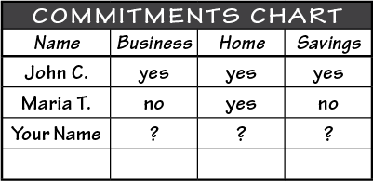
UNIT 12: KEEP GROWING REPORT
REPORT:
DISCUSS:
What did you learn last week as you kept your promises?
What problems did you have as you tried to keep your commitments?
What can we do to help everyone keep weekly promises?

Slide 5
UNIT 12: KEEP GROWING INTRODUCTION | LEARN
DISCUSS:
How will we help each other in the future?
When will we graduate?
How will we continue to progress?
ACT:
Learn how to plan for the future by learning the unit principles.

Slide 6
UNIT 12: KEEP GROWING PRINCIPLE 1 | LEARN
Principle 1
SET MOTIVATING GOALS
CODE:
Measurable: When will the goal be done and how will we know it is achieved?
Motivating: Does the goal excite you & make you want to work hard to achieve it?
Specific: Do you have a specific way that you will achieve the goal?

Slide 7
UNIT 12: KEEP GROWING PRINCIPLE 1 | LEARN
Principle 1
SET MOTIVATING GOALS
DISCUSS:
Why was one of the people in the skit happier than the other?
Why is it important to have goals?
Why are specific goals more powerful?

Slide 8
UNIT 12: KEEP GROWING PRINCIPLE 1 | LEARN
Principle 1
SET MOTIVATING GOALS
DISCUSS:
What would be a powerful goal for your home life or community service?
How do you set powerful goals?

Slide 9
UNIT 12: KEEP GROWING PRINCIPLE 1 | LEARN
Principle 1
SET MOTIVATING GOALS
ACT:
Turn to page 41 in your workbook or another notebook.
Write a powerful short term and long term goal.
Now go to page 61 in your workbook or another notebook and add these goals to your business plan.
Make sure that goals are:
Motivating
Measurable
Specific

Slide 10
UNIT 12: KEEP GROWING PRINCIPLE 2 | LEARN
Principle 2
COMPLETE YOUR MBS REQUIREMENTS
CODE:
Things to remember on My Platform:
You must finish the work on My Platform before you can receive your MBS certificate.
Make sure either you or your Success Ambassador has uploaded all of your work.
Make sure your language director approves your work.

Slide 11
UNIT 12: KEEP GROWING PRINCIPLE 2 | LEARN
Principle 2
COMPLETE YOUR MBS REQUIREMENTS
DISCUSS:
Do we know what the MBS requirements are?
How are we going to finish our MBS requirements?
Do we need help?
What questions do we have about our three plans?

Slide 12
UNIT 12: KEEP GROWING PRINCIPLE 2 | LEARN
Principle 2
COMPLETE YOUR MBS REQUIREMENTS | ACT
ACT:
Take the time now to finish the plans and/or set a time when you can meet to help each other complete your plans.
Set a powerful goal to have the plans done at a specific time so you or your Success Ambassadors can get your plans uploaded onto the Success Platform.

Slide 13
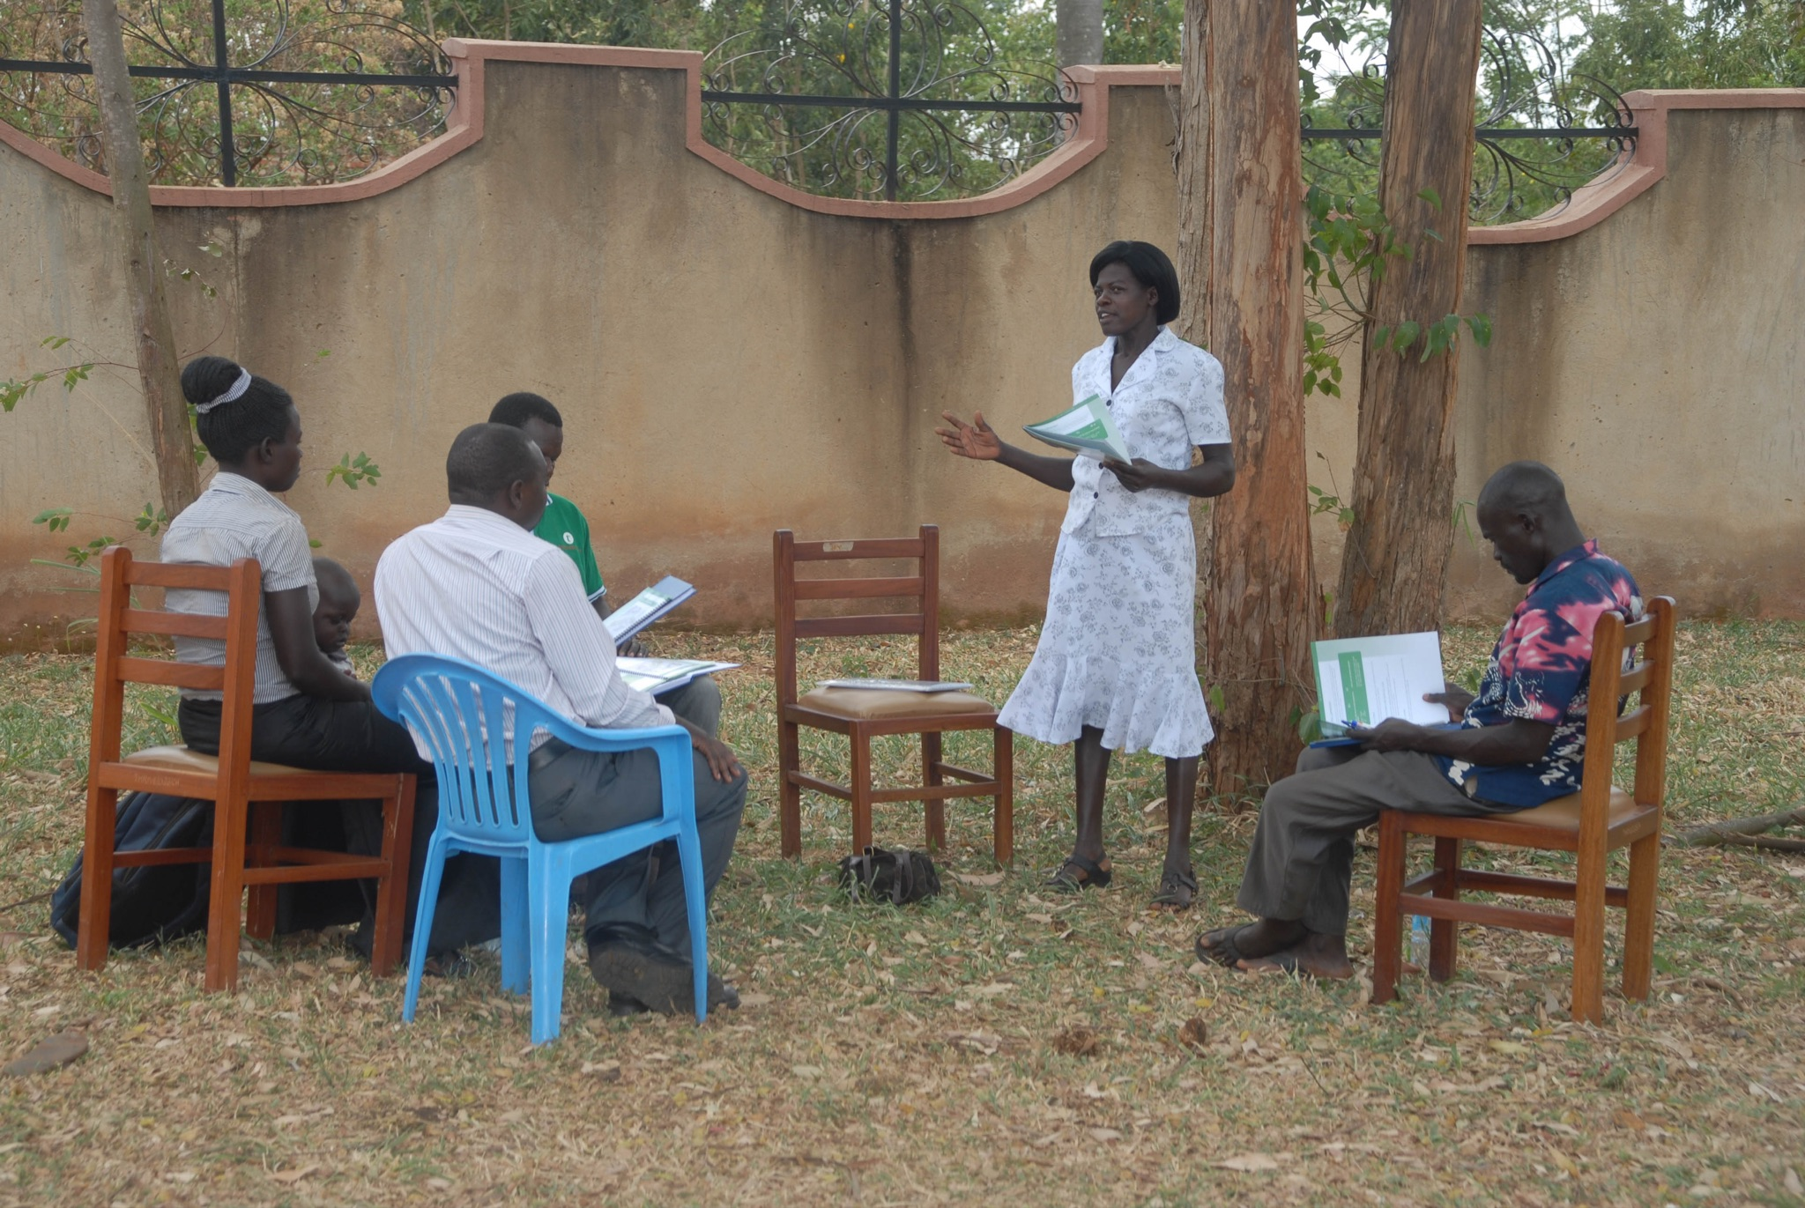
UNIT 12: KEEP GROWING PRINCIPLE 3 | LEARN
Principle 3
KEEP GROWING AS A GROUP
CODE:

Slide 14
UNIT 12: KEEP GROWING PRINCIPLE 3 | LEARN
Principle 3
KEEP GROWING AS A GROUP
DISCUSS:
How do you think continuing in a group could help you and your business?
Discuss the value of the statements listed in the Ways Groups Can Help Us Improve box on page 42 in your workbook or copy it to another notebook.

Slide 15
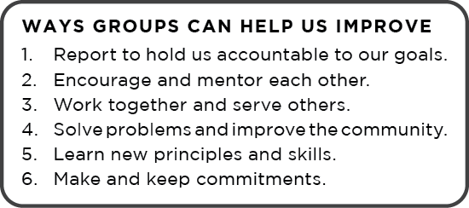
UNIT 12: KEEP GROWING PRINCIPLE 3 | LEARN
Principle 3
KEEP GROWING AS A GROUP

Slide 16
UNIT 12: KEEP GROWING PRINCIPLE 3 | LEARN
Principle 3
KEEP GROWING AS A GROUP
DISCUSS:
What are some of the specific challenges our group faces?
How can we meet those challenges?
Should we set up a WhatsApp group?
How could we help each other in the future?
ACT:
Decide when and where you are going to meet again. Coordinate with your chosen leader what you are going to discuss.

Slide 17
UNIT 12: KEEP GROWING PRINCIPLE 3 | LEARN
Principle 3
KEEP GROWING AS A GROUP

Slide 18
UNIT 12: KEEP GROWING PRINCIPLE 4 | LEARN
Principle 4
BECOME A SUCCESS AMBASSADOR
CODE:
Benefits to becoming a Success Ambassador:
Rights to print and use all of the Interweave materials
Training videos
Monthly webinar training
Support materials to market the MBS program
Templates on how to write contacts

Slide 19
UNIT 12: KEEP GROWING PRINCIPLE 4 | LEARN
Principle 4
BECOME A SUCCESS AMBASSADOR

Slide 20
UNIT 12: KEEP GROWING PRINCIPLE 4 | LEARN
Principle 4
BECOME A SUCCESS AMBASSADOR
DISCUSS:
What are some advantages of becoming a Success Ambassador?
Who would like become a Success Ambassador?
ACT:
If you are interested in being a Success Ambassador make sure to indicate that on your Participant Post Evaluation found at the back of your Participant Workbook.

Slide 21
UNIT 12: KEEP GROWING PRINCIPLE 5 | LEARN
Principle 5
CELEBRATE SUCCESS
DISCUSS:
When will all of the MBS Business plans be handed in?
Will they be submitted by you online?
Or will we scan and upload them to myPlatform?

Slide 22
UNIT 12: KEEP GROWING PRINCIPLE 5 | LEARN
Principle 5
CELEBRATE SUCCESS
DISCUSS:
When can we have the graduation?
Where will graduation be held? Will we have caps and gowns? Will there be refreshments?
ACT:
Let’s plan the graduation and set a time for the next meetings to help finish the MBS requirements if needed.

Slide 23
UNIT 12: KEEP GROWING SUMMARY
KEEP GROWING PRINCIPLES SUMMARY
Set Motivating Goals.
Complete your MBS Requirements.
Keep Growing as a Group.
Become a Success Ambassador.
Celebrate Success.

Slide 24
UNIT 12: KEEP GROWING COMMIT
COMMITMENT
Business Plan Commitment:
All paperwork for MBS requirements completed before next meeting.
All paperwork entered into Success Platform online.

Slide 25
UNIT 12: KEEP GROWING COMMIT
COMMITMENT
Home Quality of Life Commitment:
Update and turn in Quality of Life Plan for MBS req. before next meeting.
Savings Commitment:
I will keep saving!

Slide 26
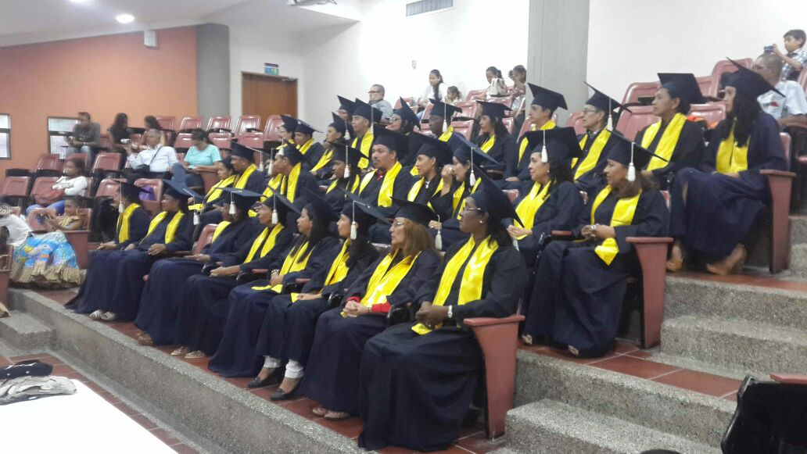
UNIT 12: KEEP GROWING COMMIT
CONGRATULATIONS
Please make sure to complete the participant post-assessment at the back of the participant manual.

Slide 27
UNIT 12: KEEP GROWING

