Slide 1
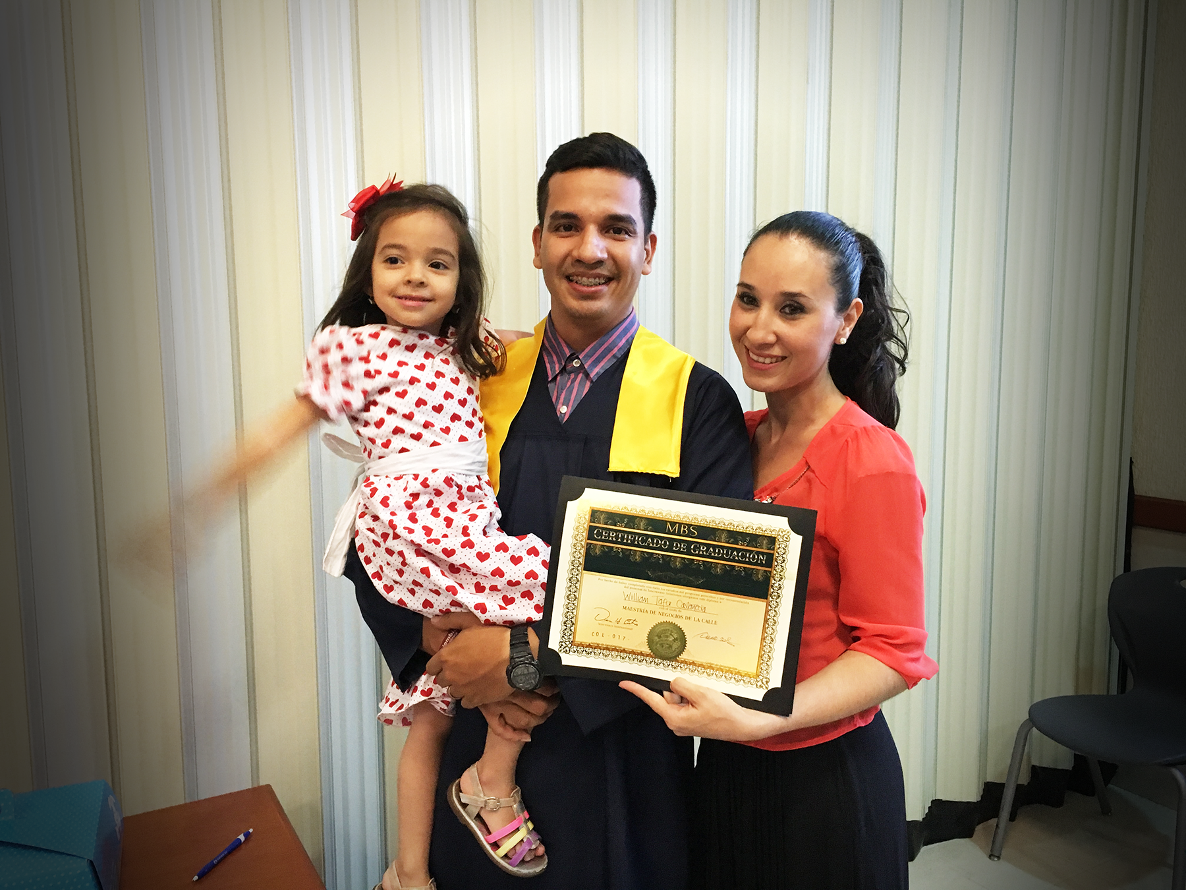
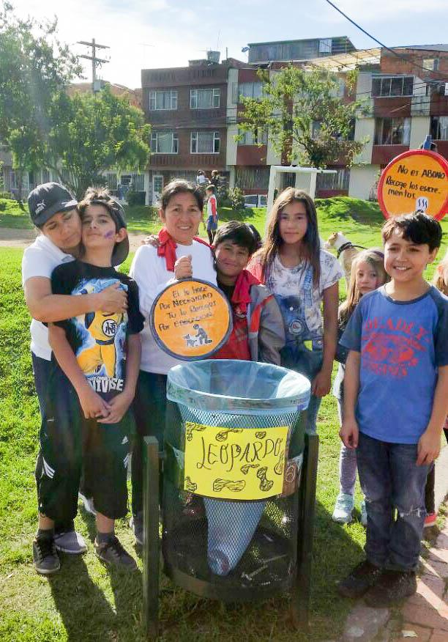
UNIT 1: YOU CAN BECOME SELF-RELIANT
SELF-RELIANCE
BUSINESS
HOME
COMMUNITY

Slide 2
UNIT 1: YOU CAN BECOME SELF-RELIANT
Groups Build Self-Reliance.
Make Three Plans for Success.
Apply the 6P’s of Business.
Improve Your Quality of Life.
Serve Your Community.
Make and Keep Commitments.

Slide 3
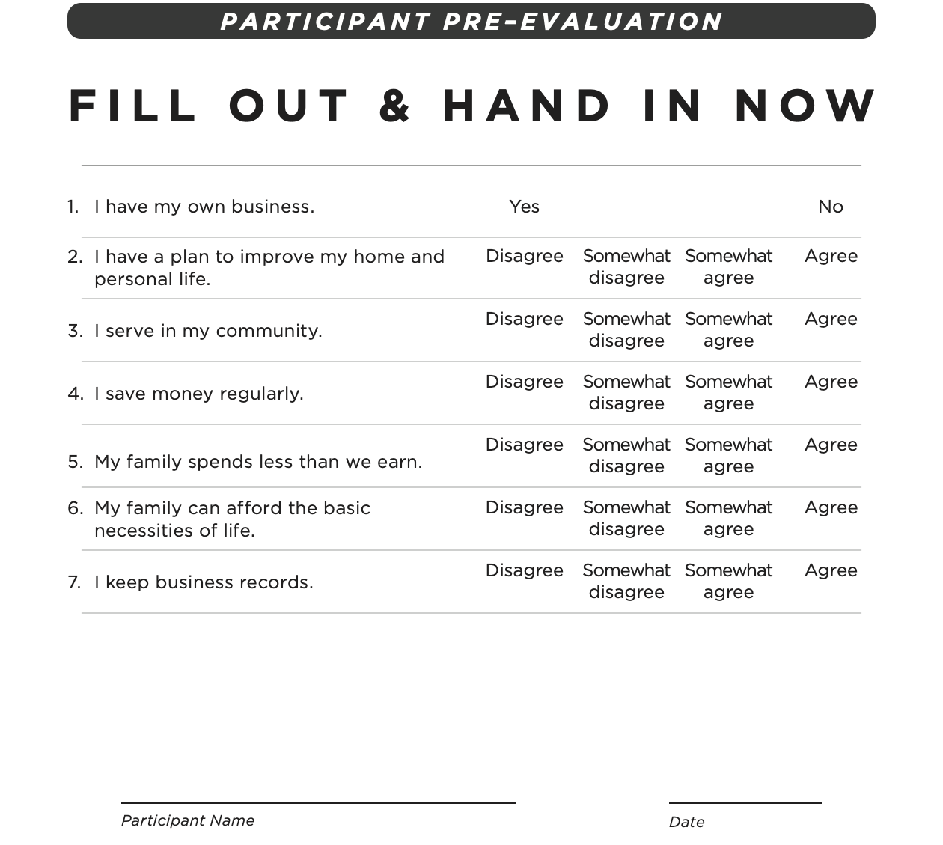
UNIT 1: YOU CAN BECOME SELF-RELIANT

Slide 4
UNIT 1: YOU CAN BECOME SELF-RELIANT PRINCIPLE 1 | LEARN
Principle 1
GROUPS BUILD SELF-RELIANCE
DISCUSS:
What do you see in these pictures?
What emotions are they expressing?
Why do you think they feel that way?

Slide 5
UNIT 1: YOU CAN BECOME SELF-RELIANT PRINCIPLE 1 | LEARN
Principle 1
GROUPS BUILD SELF-RELIANCE
DISCUSS:
Have you ever had an experience where you felt like the people in the picture?
Would you like to be a part of a group that brings you success?

Slide 6
UNIT 1: YOU CAN BECOME SELF-RELIANT PRINCIPLE 1 | LEARN
Principle 1
GROUPS BUILD SELF-RELIANCE
ACT:
Our group will help us become self-reliant. As we work together, we can find success.
Would you like to be a part of an MBS/self-reliance group?

Slide 7
UNIT 1: YOU CAN BECOME SELF-RELIANT PRINCIPLE 2 | LEARN
Principle 2
MAKE THREE PLANS FOR SUCCESS
CODE:
Turn to page 2 in your workbook and look at the four pictures again. Or look on the next slide.
Notice that each one has a title.
The first one is Self-Reliance. The other titles are the three areas of our lives that are essential to self-reliance.

Slide 8
UNIT 1: YOU CAN BECOME SELF-RELIANT PRINCIPLE 2 | LEARN
Principle 2
MAKE THREE PLANS FOR SUCCESS

Slide 9
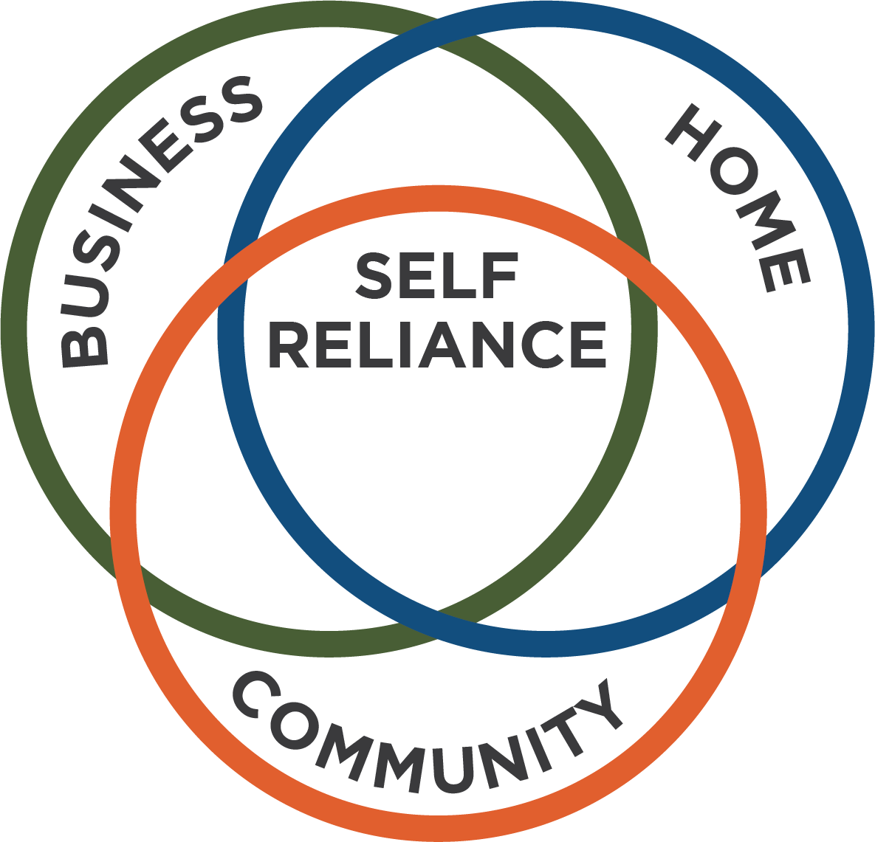
UNIT 1: YOU CAN BECOME SELF-RELIANT PRINCIPLE 2 | LEARN
Principle 2
MAKE THREE PLANS FOR SUCCESS

Slide 10
UNIT 1: YOU CAN BECOME SELF-RELIANT PRINCIPLE 2 | LEARN
Principle 2
MAKE THREE PLANS FOR SUCCESS
DISCUSS:
What are those three areas?
How do these three areas of our lives relate to each other?
How do problems at home or in the community, such as sickness, abuse or crime affect our businesses?

Slide 11
UNIT 1: YOU CAN BECOME SELF-RELIANT PRINCIPLE 2 | LEARN
Principle 2
MAKE THREE PLANS FOR SUCCESS
DISCUSS:
How does a successful business help our families and communities?
In this program you will develop three plans for self-reliance. What do you think those plans are?
Why do your plans for self-reliance need to include more than just earning money?

Slide 12
UNIT 1: YOU CAN BECOME SELF-RELIANT PRINCIPLE 2 | LEARN
Principle 2
MAKE THREE PLANS FOR SUCCESS
ACT:
Through these three plans, you’ll become more self-reliant and find greater success in all aspects of your life.
Are you willing to create three plans to become more self-reliant?

Slide 13
UNIT 1: YOU CAN BECOME SELF-RELIANT PRINCIPLE 3 | LEARN
Principle 3
APPLY THE 6P’S OF BUSINESS
CODE:
6P’s of Business

Slide 14
UNIT 1: YOU CAN BECOME SELF-RELIANT PRINCIPLE 3 | LEARN
Principle 3
APPLY THE 6P’S OF BUSINESS
CODE:
Can everyone guess what the 6P’s are?
(Remember: these are words that begin with the letter P that are important in a business).

Slide 15
UNIT 1: YOU CAN BECOME SELF-RELIANT PRINCIPLE 3 | LEARN
Principle 3
APPLY THE 6P’S OF BUSINESS

Slide 16
UNIT 1: YOU CAN BECOME SELF-RELIANT PRINCIPLE 3 | LEARN
Principle 3
APPLY THE 6P’S OF BUSINESS
CODE:
Look on page 3 of your workbook for the list of the 6P’s of Business or on the next slide.
Let’s read together what each of the 6P’s means:

Slide 17
UNIT 1: YOU CAN BECOME SELF-RELIANT PRINCIPLE 3 | LEARN
Principle 3
APPLY THE 6P’S OF BUSINESS
CODE:
Plan – The steps you need to make your business succeed.
Product – The item or service you sell.
Paperwork – Your income, expenses, and goals in writing.
Promotion – How you sell your product or service.
Price – What you charge for your product or service.
Process – How you create your product and get it to customers.

Slide 18
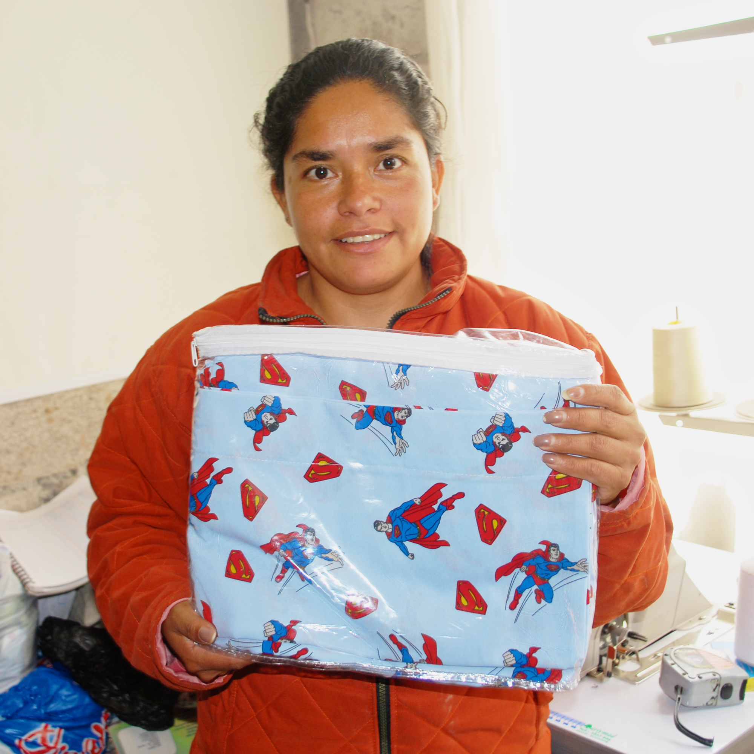
UNIT 1: YOU CAN BECOME SELF-RELIANT PRINCIPLE 3 | LEARN
Principle 3
APPLY THE 6P’S OF BUSINESS

Slide 19
UNIT 1: YOU CAN BECOME SELF-RELIANT PRINCIPLE 3 | LEARN
Principle 3
APPLY THE 6P’S OF BUSINESS
DISCUSS:
What happened to Sofia?
How did joining a self-reliance group help Sofia?
How did she apply the 6P’s to her business?
How do you think applying the 6P’s might help your business?

Slide 20
UNIT 1: YOU CAN BECOME SELF-RELIANT PRINCIPLE 3 | LEARN
Principle 3
APPLY THE 6P’S OF BUSINESS
ACT:
Turn to page 44 in your workbook to the resource section or look on the next slide and note The 6P’s Business Checklist.
You will use this checklist for your homework assignment this week.
Visit three businesses, observe and write down how they apply the 6P’s

Slide 21
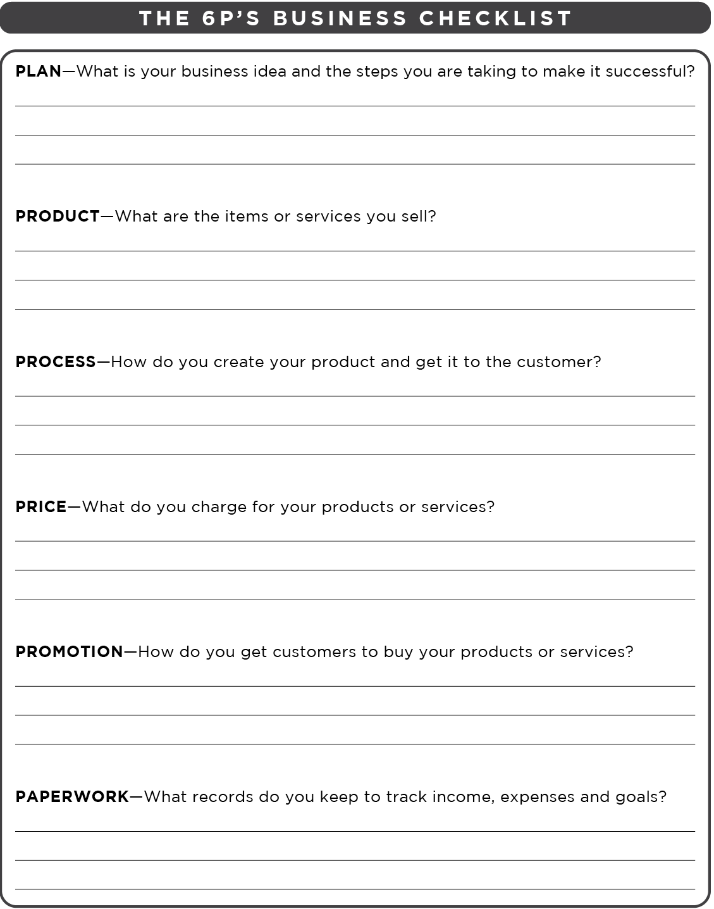
UNIT 1: YOU CAN BECOME SELF-RELIANT PRINCIPLE 3 | LEARN
Principle 3
APPLY THE 6P’S OF BUSINESS

Slide 22
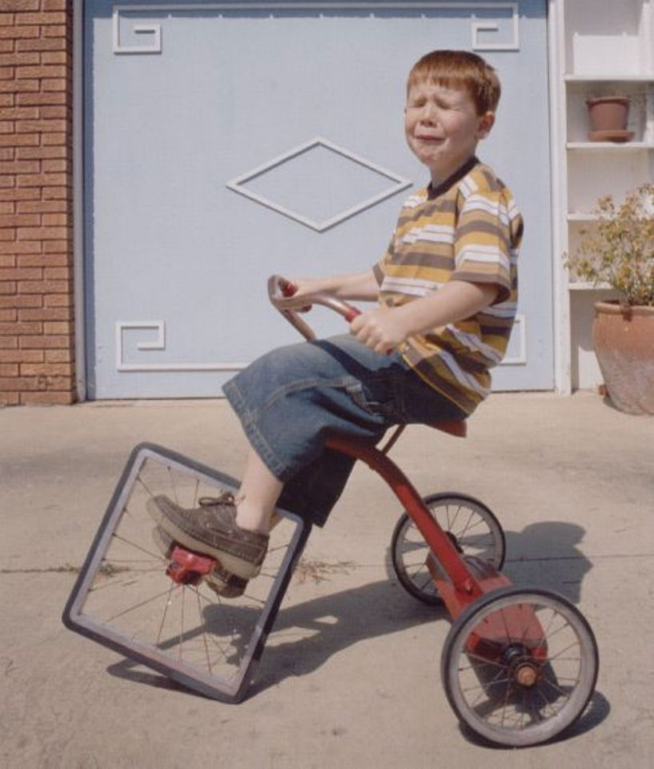
UNIT 1: YOU CAN BECOME SELF-RELIANT PRINCIPLE 4 | LEARN
Principle 4
IMPROVE YOUR QUALITY OF LIFE
DISCUSS:
What do you see in this photo?
How is the boy feeling?

Slide 23
UNIT 1: YOU CAN BECOME SELF-RELIANT PRINCIPLE 4 | LEARN
Principle 4
IMPROVE YOUR QUALITY OF LIFE
ACT:
This is a Sample Quality of Life Wheel to help create your Home Plan.
To start your plan, turn to page 4 in your workbook and choose eight areas of life that are important to you. Or look on the next slide.

Slide 24
UNIT 1: YOU CAN BECOME SELF-RELIANT PRINCIPLE 4 | LEARN
Principle 4
IMPROVE YOUR QUALITY OF LIFE

Slide 25
UNIT 1: YOU CAN BECOME SELF-RELIANT PRINCIPLE 4 | LEARN
Principle 4
IMPROVE YOUR QUALITY OF LIFE

Slide 26
UNIT 1: YOU CAN BECOME SELF-RELIANT PRINCIPLE 4 | LEARN
Principle 4
IMPROVE YOUR QUALITY OF LIFE

Slide 27
UNIT 1: YOU CAN BECOME SELF-RELIANT PRINCIPLE 5 | LEARN
Principle 5
SERVE YOUR COMMUNITY

Slide 28
UNIT 1: YOU CAN BECOME SELF-RELIANT PRINCIPLE 5 | LEARN
Principle 5
SERVE YOUR COMMUNITY
DISCUSS:
The picture on the left shows some businesses with problems. What problems do you see?
How are the people in these scenes feeling?

Slide 29
UNIT 1: YOU CAN BECOME SELF-RELIANT PRINCIPLE 5 | LEARN
Principle 5
SERVE YOUR COMMUNITY
DISCUSS:
What do you see in the right picture?
How are these people feeling?
How can people working together solve tough problems?

Slide 30
UNIT 1: YOU CAN BECOME SELF-RELIANT PRINCIPLE 5 | LEARN
Principle 5
SERVE YOUR COMMUNITY
DISCUSS:
Do we have problems like crime, sickness, garbage or abuse in our neighborhood that could hurt our businesses?
How could our group work together to solve problems like these?
How could doing service to help each other or our neighborhood unite our group?

Slide 31
UNIT 1: YOU CAN BECOME SELF-RELIANT PRINCIPLE 5 | LEARN
Principle 5
SERVE YOUR COMMUNITY
ACT:
As a group we’ll develop our own community service plan, with service projects to help others in need, reduce neighborhood problems and strengthen our group.
In the coming weeks we’ll want to name our group and possibly form committees

Slide 32
UNIT 1: YOU CAN BECOME SELF-RELIANT PRINCIPLE 5 | LEARN
Principle 5
SERVE YOUR COMMUNITY
ACT:
We may decide to keep meeting together after we finish the lessons in this manual.
Some groups find other ways to unite such as T-shirts, songs and slogans.
What are some things we might want to do together?

Slide 33
UNIT 1: YOU CAN BECOME SELF-RELIANT PRINCIPLE 6 | LEARN
Principle 6
MAKE AND KEEP COMMITMENTS

Slide 34
UNIT 1: YOU CAN BECOME SELF-RELIANT PRINCIPLE 6 | LEARN
Principle 6
MAKE AND KEEP COMMITMENTS
DISCUSS:
Have you ever climbed a long staircase or crossed a long space? Where? How?
Would it be possible to go from the bottom to the top in one step?
Can you reach your long-term goals without short-term commitments?

Slide 35
UNIT 1: YOU CAN BECOME SELF-RELIANT PRINCIPLE 6 | LEARN
Principle 6
MAKE AND KEEP COMMITMENTS
DISCUSS:
Do you think running a successful business will be easy?
Why is each step important?

Slide 36
UNIT 1: YOU CAN BECOME SELF-RELIANT PRINCIPLE 6 | LEARN
Principle 6
MAKE AND KEEP COMMITMENTS
ACT:
At every session we’ll introduce three short-term commitments:
An assigned Business Plan Commitment found in the workbook based on the content of the lesson, to help advance your business.

Slide 37
UNIT 1: YOU CAN BECOME SELF-RELIANT PRINCIPLE 6 | LEARN
Principle 6
MAKE AND KEEP COMMITMENTS
ACT:
2. A Home Quality of Life Commitment that reflects your individual priorities and goals.
3. A Savings Commitment that helps you identify how much money you can save each week to improve family and business finances.

Slide 38
UNIT 1: YOU CAN BECOME SELF-RELIANT PRINCIPLE 6 | LEARN
Principle 6
MAKE AND KEEP COMMITMENTS
ACT:
How do you think that making and keeping these three commitments will help you succeed?

Slide 39
UNIT 1: YOU CAN BECOME SELF-RELIANT PRINCIPLE 6 | LEARN
Principle 6
MAKE AND KEEP COMMITMENTS
ACT:
Each meeting we will draw a commitment chart on the board or paper.
As each person enters the room next week they will write yes or no under each of the commitments to report whether they kept their commitments or not.

Slide 40
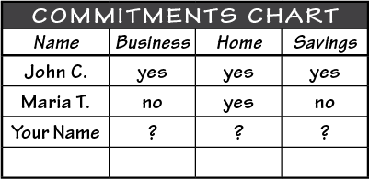
UNIT 1: YOU CAN BECOME SELF-RELIANT PRINCIPLE 6 | LEARN
Principle 6
MAKE AND KEEP COMMITMENTS
ACT:
This reporting activity will be done at the beginning of every meeting.

Slide 41
UNIT 1: YOU CAN BECOME SELF-RELIANT PRINCIPLE 6 | LEARN
BUSINESS SPOTLIGHT
BUSINESS SPOTLIGHT:
Turn in your workbook to the resource section on page 44.
Each week, one of you will take a few minutes to show your product or service and talk about your business.
Who will do our spotlight presentation next week?

Slide 42
UNIT 1: YOU CAN BECOME SELF-RELIANT PRINCIPLE 6 | LEARN
ACTION PARTNERS
ACTION PARTNERS:
At the end of each class you will pair up with someone from the group.
Choose someone who is not a family member.
This will be your action partner for the week.

Slide 43
UNIT 1: YOU CAN BECOME SELF-RELIANT PRINCIPLE 6 | LEARN
MBS REQUIREMENTS
MBS REQUIREMENTS:
Turn to page 66 in your resource section of your workbook or on the next slide.
These are the certificate requirements. Each week you should add to your business plan. Look over the MBS Requirements and see what you need to do.
Set the goal to grow your business, home and community.

Slide 44
UNIT 1: YOU CAN BECOME SELF-RELIANT SUMMARY
PRINCIPLES SUMMARY
Groups Build Self-Reliance.
Make Three Plans for Success.
Apply the 6P’s of Business.
Improve Your Quality of Life.
Serve Your Community.
Make & Keep Commitments

Slide 45
UNIT 1: YOU CAN BECOME SELF-RELIANT COMMIT
COMMITMENT
Business Plan Commitment:
I will visit three businesses and write down in my workbook how they use the 6P’s of Business.
I will use The 6P’s Business Checklist.

Slide 46
UNIT 1: YOU CAN BECOME SELF-RELIANT COMMIT
COMMITMENT
Home Quality of Life Commitment
I will thoughtfully choose one or two areas of my Quality of Life Wheel and write down goals to improve this week.
I will be specific with my written goals and follow through.
Savings Commitment
I will add to my savings – even if it’s just a coin or two

Slide 47
UNIT 1: YOU CAN BECOME SELF-RELIANT COMMIT
COMMITMENT
DISCUSS:
Who would like to share their Home Quality of Life Commitment this week?
Which commitment will be the easiest to keep for you this week?
Which commitment will be the hardest?

Slide 48
UNIT 1: YOU CAN BECOME SELF-RELIANT COMMIT
COMMITMENT
ACT:
Meet now with your Action Partner for this week. Discuss your business ideas and decide how you will contact and encourage each other during the week to keep your commitments. Say your commitments out loud.

Slide 49
UNIT 1: YOU CAN BECOME SELF-RELIANT
SELF-RELIANCE
BUSINESS
HOME
COMMUNITY

