Slide 1
UNIT 2: PRODUCT

Slide 2
UNIT 2: PRODUCT
Know You Are Worthy to Succeed.
Know Yourself.
Know What Sells.
Know the Competition.
Know & Value Your Customers.

Slide 3
UNIT 2: PRODUCT REPORT
REPORT
Last Week’s Promises:
Business Plan: Visit at least three businesses and write down how they use the 6P’s of Business, using the 6P’s Business Checklist.
Home Quality of Life Plan: Choose to improve a specific area from your Home Plan.
Savings: Save money, even just a coin or two.
ACT:
Business Spotlight presentation

Slide 4
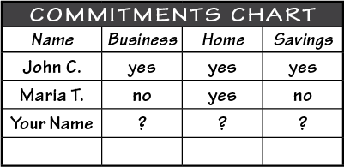
UNIT 2: PRODUCT REPORT
REPORT:
DISCUSS:
What did you learn last week as you kept your promises?
What problems did you have as you tried to keep your commitments?
What can we do to help everyone keep weekly promises?

Slide 5
UNIT 2: PRODUCT INTRODUCTION | LEARN
DISCUSS:
How did Susana apply the five principles of Product?
ACT:
After completing your commitments and considering the five principles in this unit, you will choose a product or service.

Slide 6
UNIT 2: PRODUCT PRINCIPLE 1 | LEARN
Principle 1
KNOW YOU ARE WORTHY TO SUCCEED

Slide 7
UNIT 2: PRODUCT PRINCIPLE 1 | LEARN
Principle 1
KNOW YOU ARE WORTHY TO SUCCEED
DISCUSS:
How many babies do you see?
Which of these babies is not worthy of attention, love, or success?
Which of these babies will be the most successful or happy?

Slide 8
UNIT 2: PRODUCT PRINCIPLE 1 | LEARN
Principle 1
KNOW YOU ARE WORTHY TO SUCCEED
DISCUSS:
Were any of us born to be less successful in life?
Do events in your past or differences in your family situation ensure that you will succeed or fail in life?

Slide 9
UNIT 2: PRODUCT PRINCIPLE 1 | LEARN
Principle 1
KNOW YOU ARE WORTHY TO SUCCEED
ACT:
Remember, each of us is worthy to succeed in business.

Slide 10
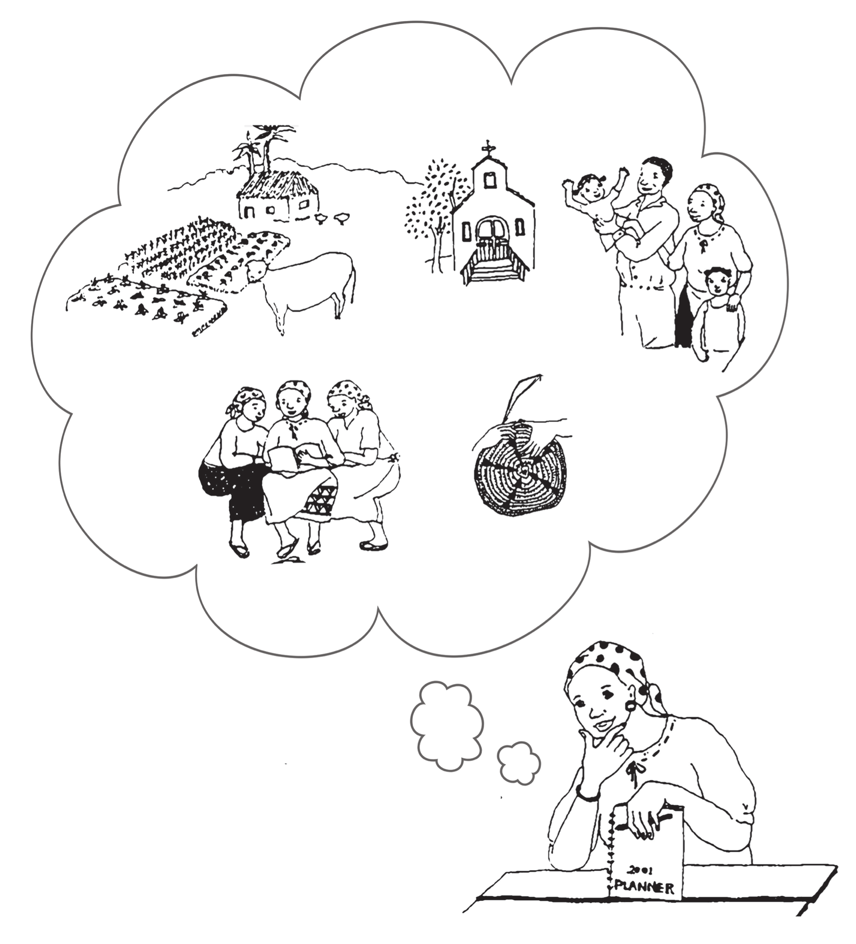
UNIT 2: PRODUCT PRINCIPLE 2 | LEARN
Principle 2
KNOW YOURSELF

Slide 11
UNIT 2: PRODUCT PRINCIPLE 2 | LEARN
Principle 2
KNOW YOURSELF
DISCUSS:
What talents or resources do you see in this picture?
What businesses can she create using the talents or resources she has?
How could your talents and resources help you to choose a product or service?

Slide 12
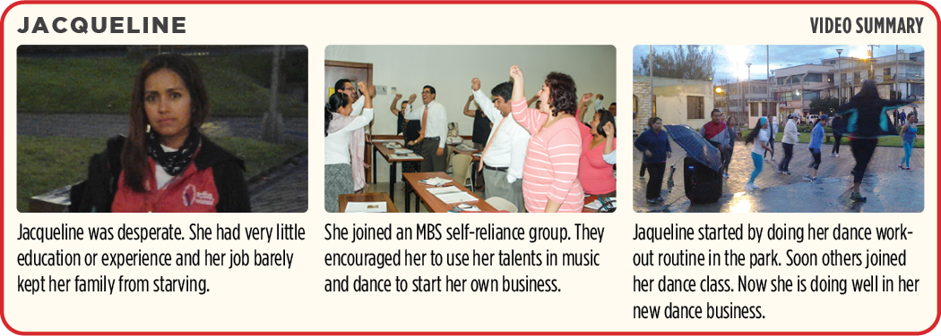
UNIT 2: PRODUCT PRINCIPLE 2 | LEARN
Principle 2
KNOW YOURSELF

Slide 13
UNIT 2: PRODUCT PRINCIPLE 2 | LEARN
Principle 2
KNOW YOURSELF
DISCUSS:
What are the resources Jacqueline used to start her business?
What are some talents and resources you have that can be used in a business?
ACT:
On page 7 of your workbook or another notebook, write down some talents and resources that YOU have. Be sure to be creative.

Slide 14
UNIT 2: PRODUCT PRINCIPLE 3 | LEARN
Principle 3
KNOW WHAT SELLS

Slide 15
UNIT 2: PRODUCT PRINCIPLE 3 | LEARN
Principle 3
KNOW WHAT SELLS
DISCUSS:
Would eggs, ice cream, pet clothes or a ceramic horse sell here?
Why or why not?

Slide 16
UNIT 2: PRODUCT PRINCIPLE 3 | LEARN
Principle 3
KNOW WHAT SELLS
DISCUSS:
What kind of products or services would people buy in our area?
How can we find out which products or services sell best in our area?

Slide 17
UNIT 2: PRODUCT PRINCIPLE 3 | LEARN
Principle 3
KNOW WHAT SELLS
ACT:
Turn to page 8 in your workbook and find the Product or Service Ideas list or look at the next slide.
Let’s quickly take turns explaining your product or business idea to your partner.

Slide 18
UNIT 2: PRODUCT PRINCIPLE 3 | LEARN
Principle 3
KNOW WHAT SELLS
ACT:
Ask each other these three questions:
How often would you buy my product or service?
How would you improve my product or service?
How much would you pay for my product or service?

Slide 19
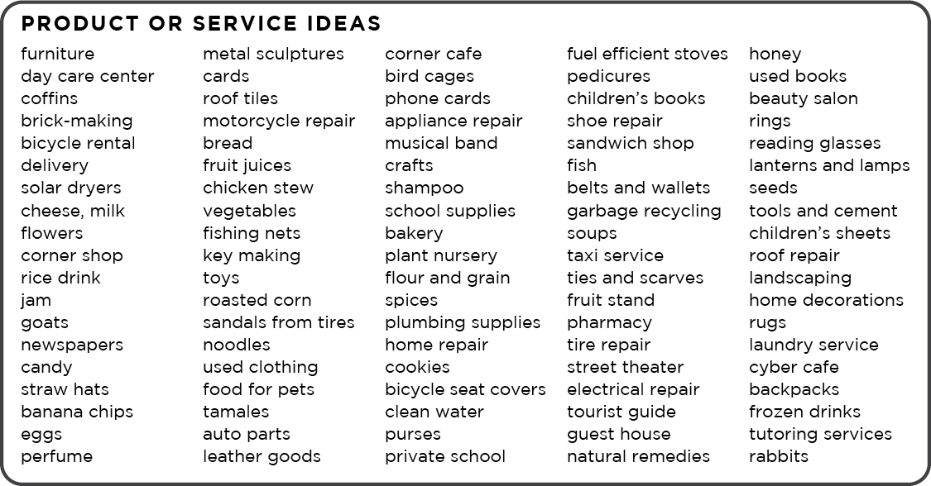
UNIT 2: PRODUCT PRINCIPLE 3 | LEARN
Principle 3
KNOW WHAT SELLS

Slide 20
UNIT 2: PRODUCT PRINCIPLE 3 | LEARN
Principle 3
KNOW WHAT SELLS
WARNING:
You may have a talent to make dolls or ceramic horses but if it won’t sell where you live, you will need to pick another product to be successful.

Slide 21
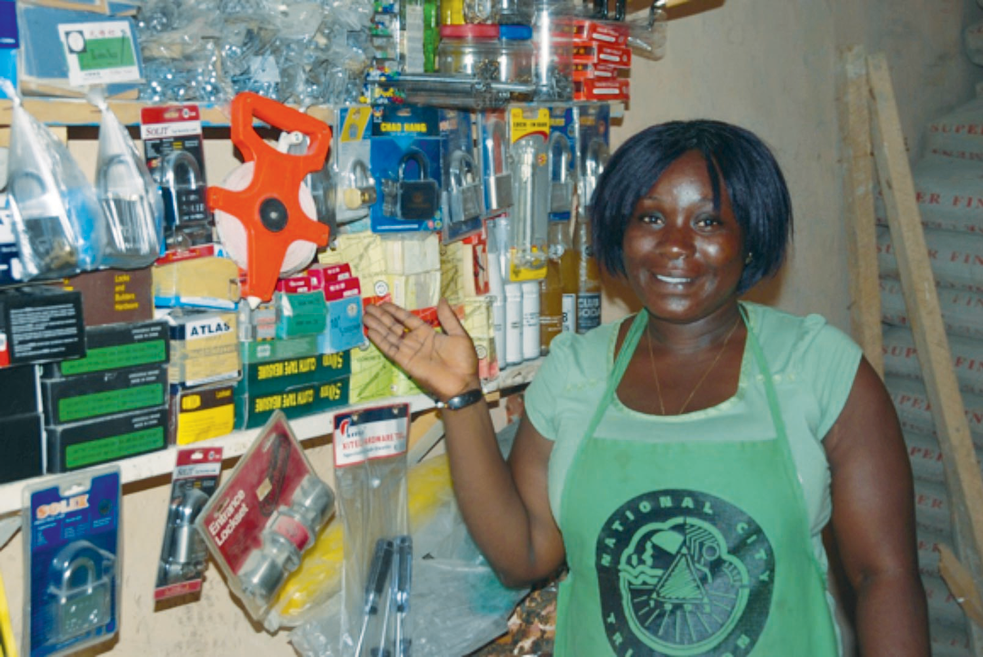
UNIT 2: PRODUCT PRINCIPLE 4 | LEARN
Principle 4
KNOW THE COMPETITION

Slide 22
UNIT 2: PRODUCT PRINCIPLE 4 | LEARN
Principle 4
KNOW THE COMPETITION
DISCUSS:
What did Joyce learn by visiting the three stores?
How could Joyce use this knowledge in her business?
How can you learn from your competitors?

Slide 23
UNIT 2: PRODUCT PRINCIPLE 4 | LEARN
Principle 4
KNOW THE COMPETITION
ACT:
Turn to page 8 in your workbook or on the next slide, read the Questions for Competitors list or brainstorm a list of questions you could ask the competition.

Slide 24
UNIT 2: PRODUCT PRINCIPLE 4 | LEARN
Principle 4
KNOW THE COMPETITION
ACT:
Questions for the competition:
What are the best selling items?
What are your best times of day to sell?
How do you set your price?
How do you promote your business?
What are your greatest challenges?

Slide 25
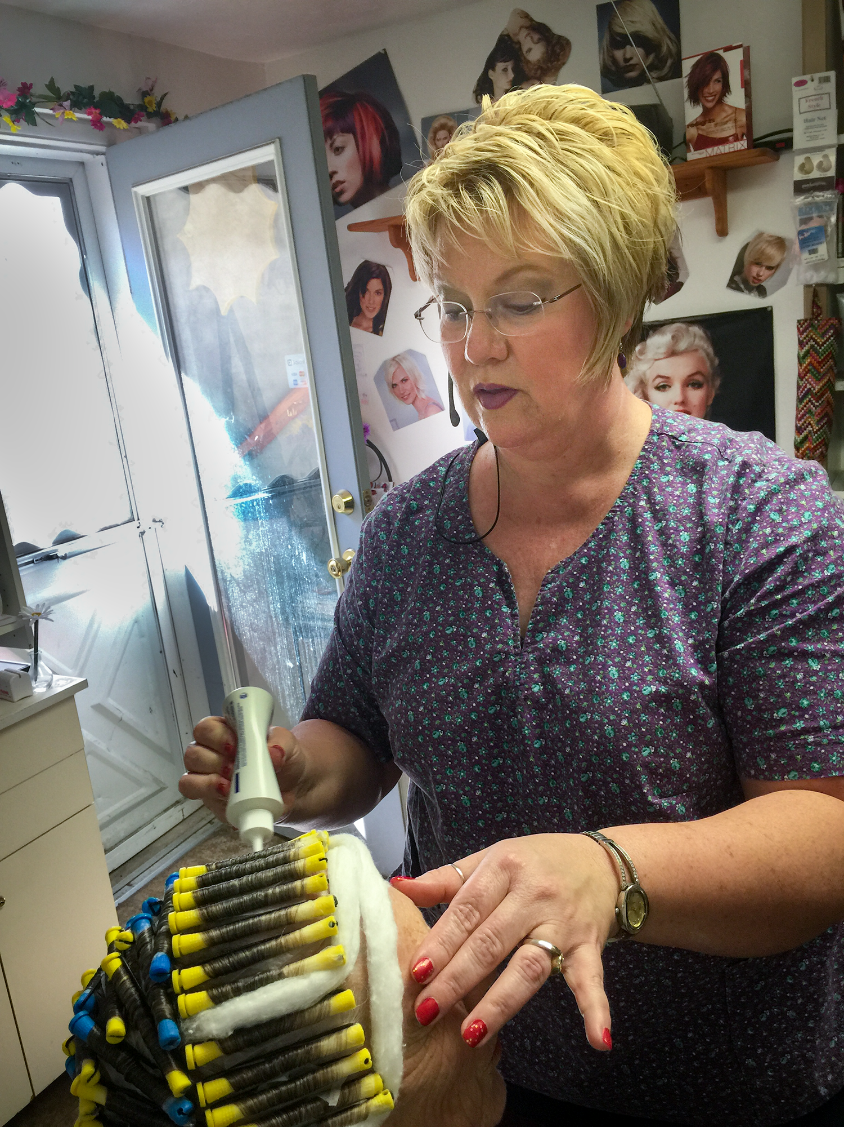
UNIT 2: PRODUCT PRINCIPLE 5 | LEARN
Principle 5
KNOW & VALUE YOUR CUSTOMERS

Slide 26
UNIT 2: PRODUCT PRINCIPLE 5 | LEARN
Principle 5
KNOW & VALUE YOUR CUSTOMERS
DISCUSS:
What are some of the ways Karla helps her customers feel valued?
Have you ever felt like you were a valued customer? Why?
Why is, “Who will be my customers?” such an important question?

Slide 27
UNIT 2: PRODUCT PRINCIPLE 5 | LEARN
Principle 5
KNOW & VALUE YOUR CUSTOMERS
ACT:
Write down your product or service on page 9 in your workbook or in another notebook.
If you haven’t decided on a product yet, choose one right now. Have a product in mind for each unit.

Slide 28
UNIT 2: PRODUCT PRINCIPLE 5 | LEARN
Principle 5
KNOW & VALUE YOUR CUSTOMERS
ACT:
Make a list of all the possible customers for this product you can think of. Be sure to consider the following questions:
How often will the customers you’ve listed buy your product?
What could you do to encourage them to buy your product or service more than once?

Slide 29
UNIT 2: PRODUCT SUMMARY
PRODUCT PRINCIPLES SUMMARY
Know You Are Worthy to Succeed.
Know Yourself.
Know What Sells.
Know the Competition.
Know & Value Your Customers.

Slide 30
UNIT 2: PRODUCT COMMIT
COMMITMENT
Business Plan Commitment:
I will talk to at least six customers or competitors this week.
I will choose my product or service after considering the five principles in this unit.

Slide 31
UNIT 2: PRODUCT COMMIT
COMMITMENT
Home Quality of Life Commitment
I will thoughtfully choose one or two areas of my Quality of Life Wheel and write down goals to improve this week.
I will be specific with my written goals and follow through.
Savings Commitment
I will add to my savings – even if it’s just a coin or two.

Slide 32
UNIT 2: PRODUCT COMMIT
COMMITMENT
DISCUSS:
Who would like to share their Home Quality of Life Commitment this week?
Which commitment will be the easiest to keep for you this week?
Which commitment will be the hardest?

Slide 33
UNIT 2: PRODUCT COMMIT
COMMITMENT
ACT:
Meet now with your Action Partner for this week. Discuss your business ideas and decide how you will contact and encourage each other during the week to keep your commitments. Share your commitments out loud.

Slide 34
UNIT 2: PRODUCT

