Slide 1

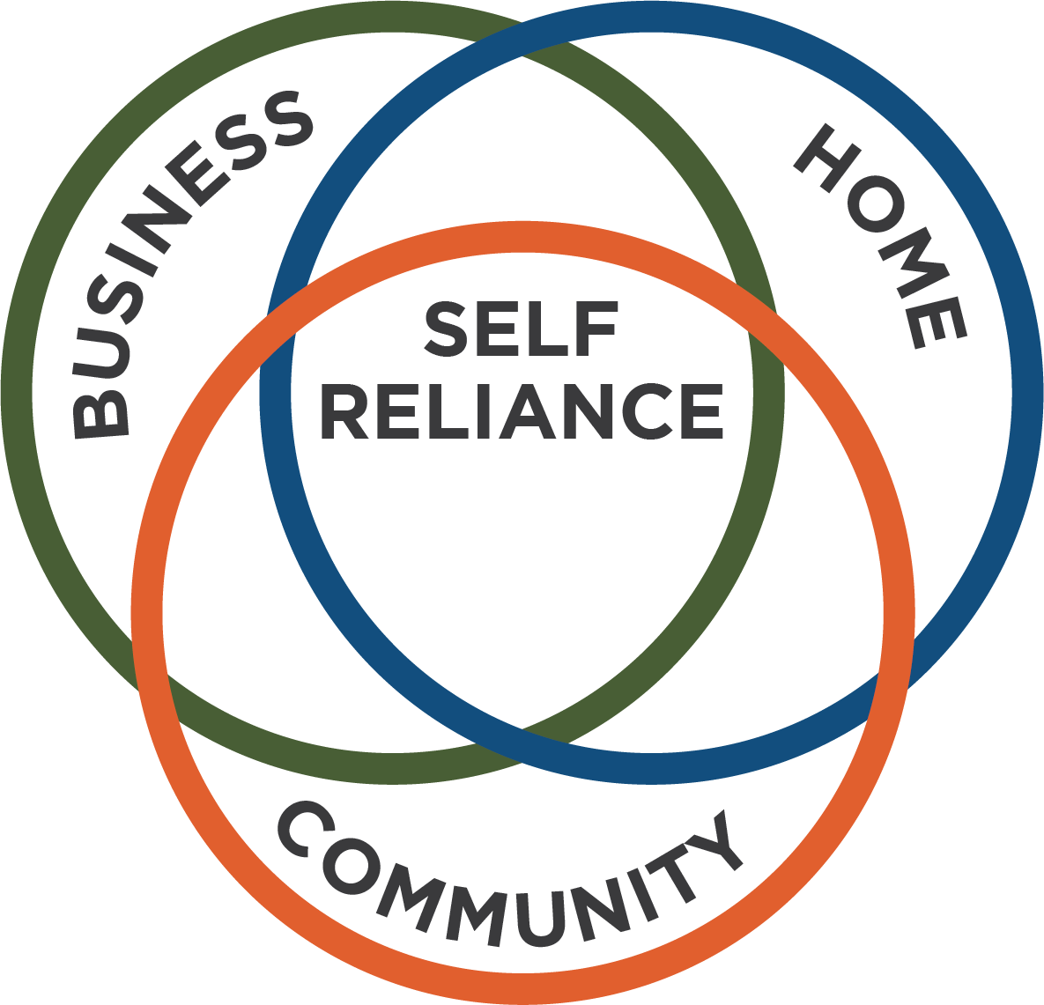

UNIT 3: PLAN

Slide 2
UNIT 3: PLAN
THREE PLANS
Plan for Business.
Plan for Home.
Plan to Serve the Community.

Slide 3
UNIT 3: PLAN REPORT
REPORT
Last Week’s Promises:
Business Plan: Choose your product or service for your business. Talk to at least 6 customers or competitors.
Home Quality of Life Plan: Choose to improve a specific area from your Home Plan.
Savings: Save money, even just a coin or two.
ACT:
Business Spotlight presentation

Slide 4
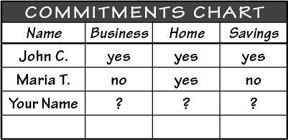
UNIT 3: PLAN REPORT
REPORT:
DISCUSS:
What did you learn last week as you kept your promises?
What problems did you have as you tried to keep your commitments?
What can we do to help everyone keep weekly promises?

Slide 5
UNIT 3: PLAN INTRODUCTION | LEARN
“When We Fail to Plan, We Plan to Fail.”
CODE:
What do you think this statement means?
Why are plans necessary to achieve self-reliance?

Slide 6
UNIT 3: PLAN INTRODUCTION | LEARN
DISCUSS:
What do you see in this image?
Today we will learn how to develop three plans for self-reliance. As a reminder, what are those three plans?

Slide 7
UNIT 3: PLAN INTRODUCTION | LEARN
DISCUSS:
Why do you think we need to develop home and community plans and not just a business plan to become self-reliant?
How do problems in the home or community such as crime, sickness, or contention affect your business?

Slide 8
UNIT 3: PLAN INTRODUCTION | LEARN
ACT:
Learn how to implement the 3 plans for the MBS requirements.
THREE PLANS
Plan for Business.
Plan for Home.
Plan to Serve the Community.

Slide 9
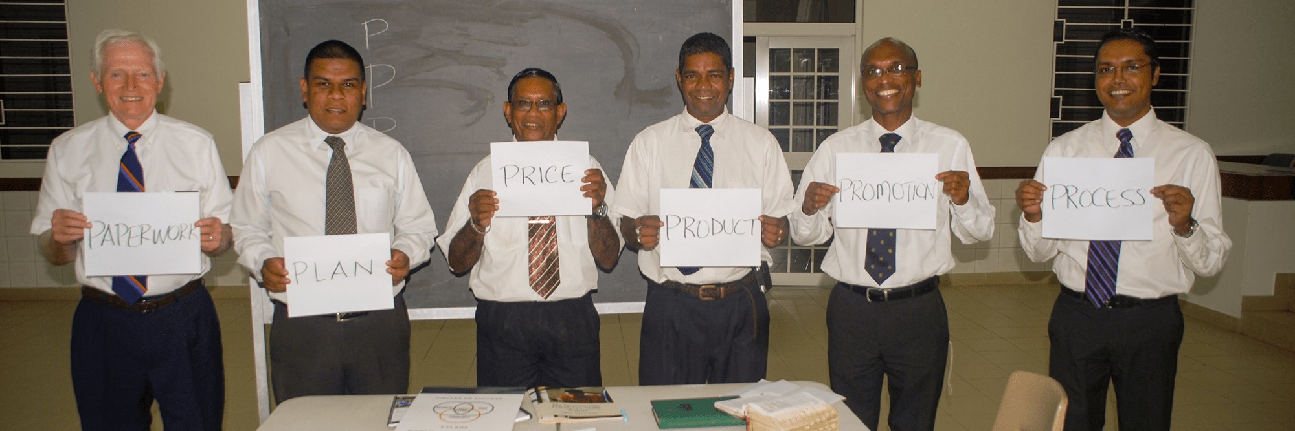
UNIT 3: PLAN PRINCIPLE 1 | LEARN
Principle 1
PLAN FOR BUSINESS

Slide 10
UNIT 3: PLAN PRINCIPLE 1 | LEARN
Principle 1
PLAN FOR BUSINESS
CODE:
Turn to page 56 in the resource section of your workbook or the next slides.
This is a sample business plan based on the 6P’s.
In order to certify or earn an MBS Certificate, you will need to complete a similar plan for your own business online via myPlatform

Slide 11
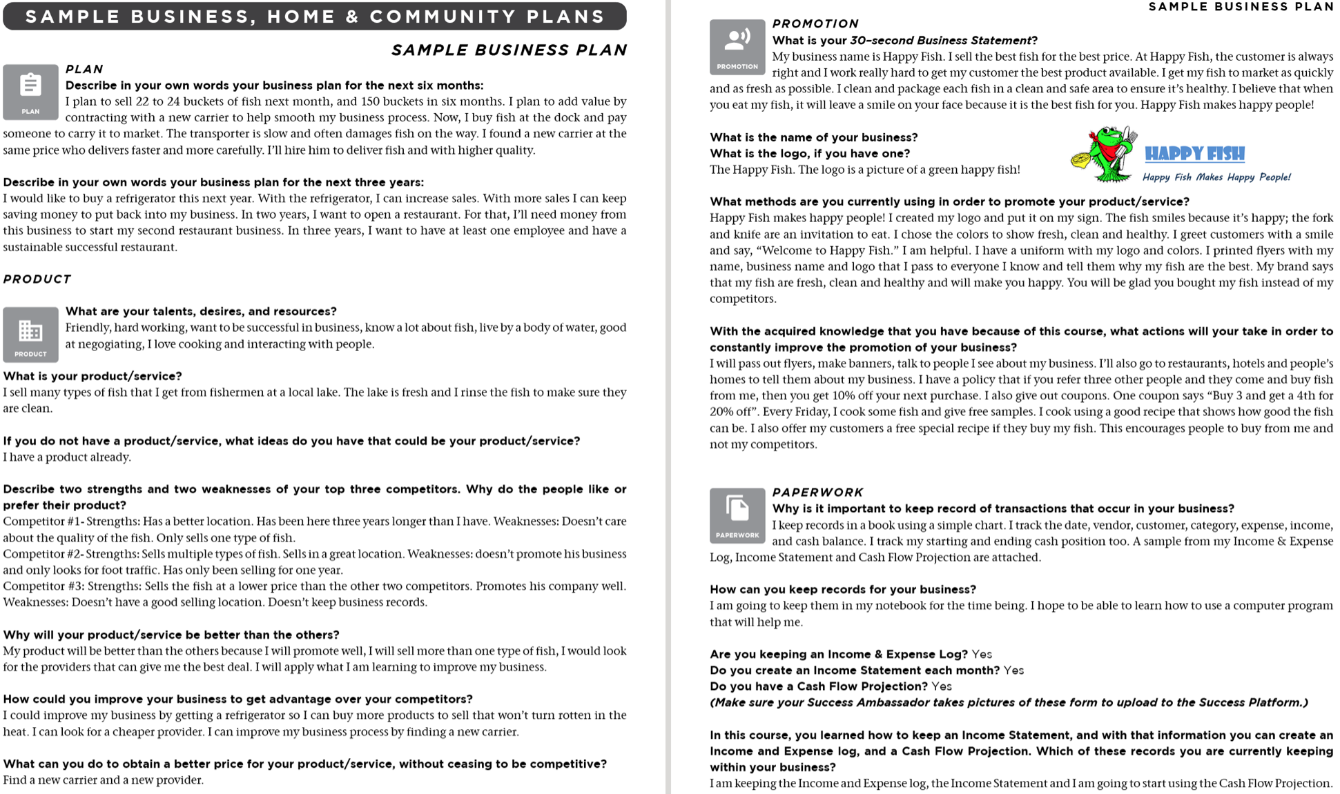
UNIT 3: PLAN PRINCIPLE 1 | LEARN

Slide 12
UNIT 3: PLAN PRINCIPLE 1 | LEARN
Principle 1
PLAN FOR BUSINESS
PLAN:

Slide 13
UNIT 3: PLAN PRINCIPLE 1 | LEARN
Principle 1
PLAN FOR BUSINESS
PRODUCT:

Slide 14
UNIT 3: PLAN PRINCIPLE 1 | LEARN
Principle 1
PLAN FOR BUSINESS
PROMOTION:

Slide 15
UNIT 3: PLAN PRINCIPLE 1 | LEARN
Principle 1
PLAN FOR BUSINESS
PAPERWORK:

Slide 16
UNIT 3: PLAN PRINCIPLE 1 | LEARN
Principle 1
PLAN FOR BUSINESS
DISCUSS:
How could these questions help to develop your business?
What are some way applying the 6P’s of Business will help your business grow?
ACT:
Set a time to work on your blank business plan on page 61 or in your notebook.

Slide 17
UNIT 3: PLAN PRINCIPLE 2 | LEARN
Principle 2
PLAN FOR HOME
CODE:
Turn to page 4 in your workbook to Unit 1 or the next slide.
Look at the list of Your Life Areas that you filled out. Now you will be filling in your Quality of Life Plan.

Slide 18
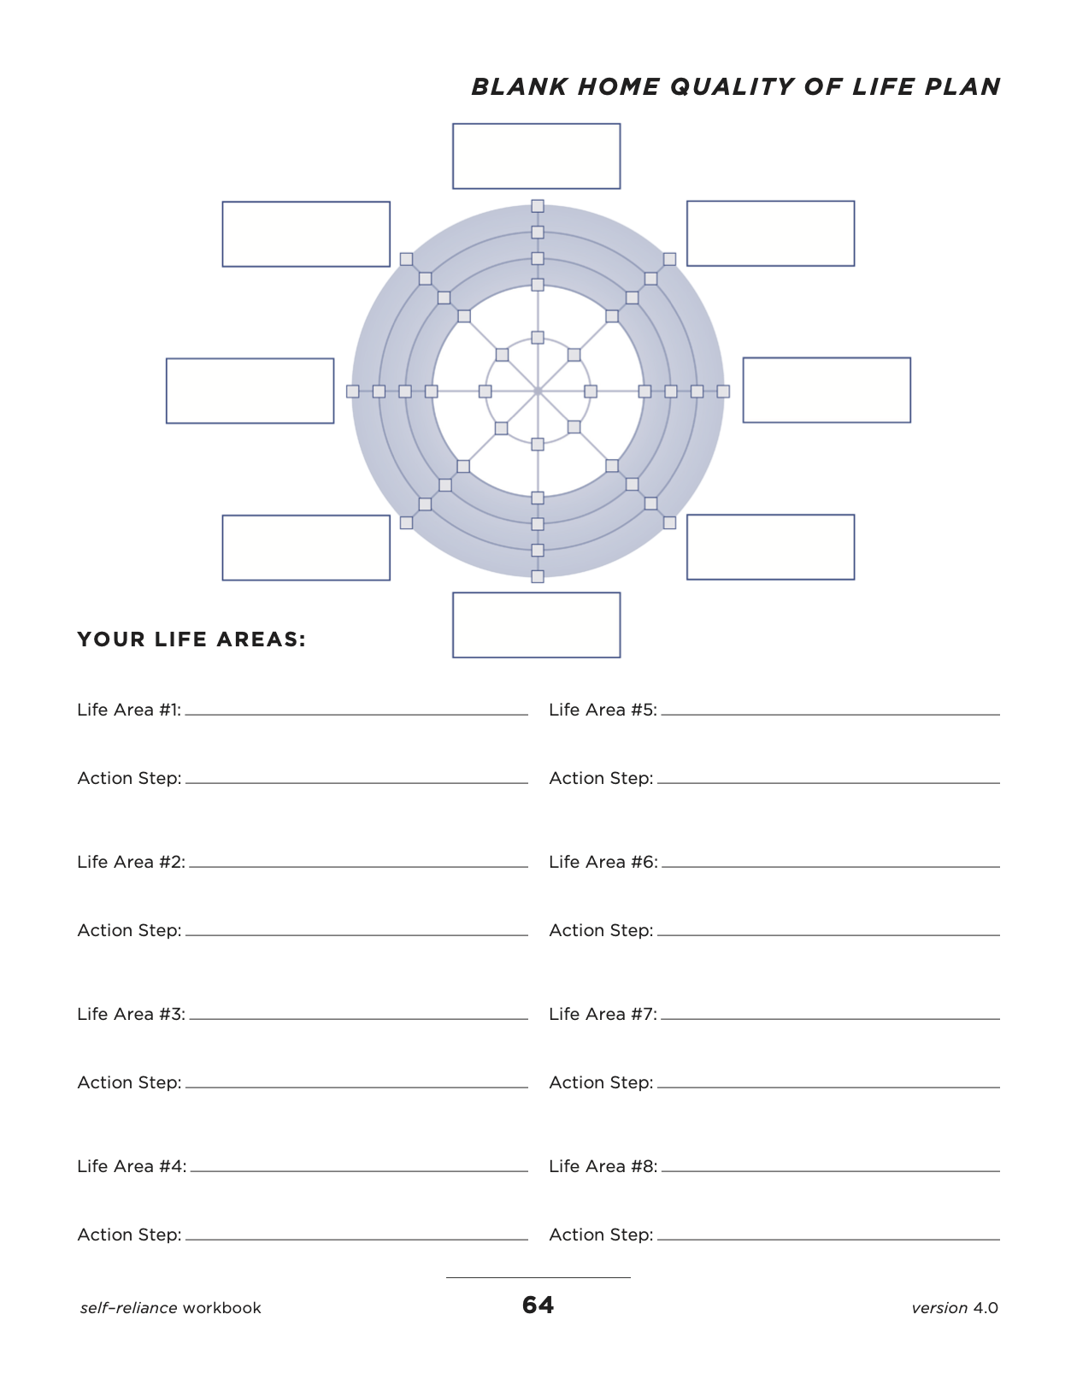
UNIT 3: PLAN PRINCIPLE 2 | LEARN
Principle 2
PLAN FOR HOME

Slide 19
UNIT 3: PLAN PRINCIPLE 2 | LEARN
Principle 2
PLAN FOR HOME
CODE:
Turn to page 10 in your workbook, or on the next slide and look at the image of two bicycles.

Slide 20

UNIT 3: PLAN PRINCIPLE 2 | LEARN
Principle 2
PLAN FOR HOME

Slide 21
UNIT 3: PLAN PRINCIPLE 2 | LEARN
Principle 2
PLAN FOR HOME
DISCUSS:
What do you see?
If you tried to ride the bicycle on the left what would happen?
If a wheel isn’t round and balanced, can it roll forward?
Why does a well-rounded wheel work better than one that is out of balance?
Either wheel above could represent your life. What kind of wheel do you think you would like?

Slide 22
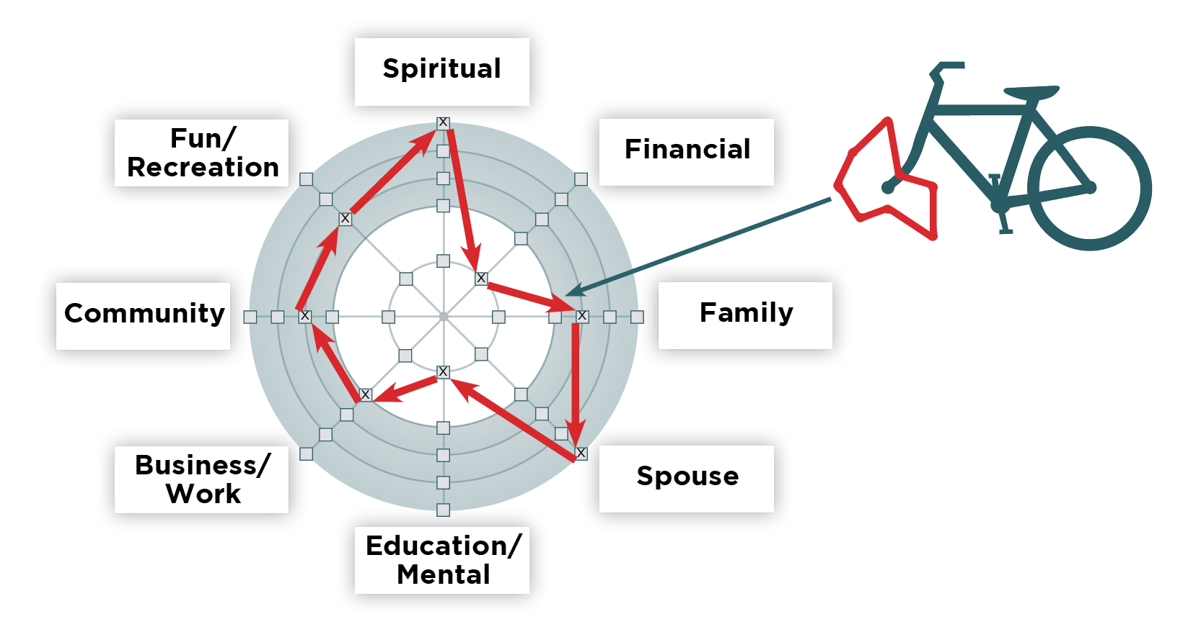
UNIT 3: PLAN PRINCIPLE 2 | LEARN
Principle 2
PLAN FOR HOME

Slide 23
UNIT 3: PLAN PRINCIPLE 2 | LEARN
Principle 2
PLAN FOR HOME
CODE:
Turn to page 11 in your workbook, or to the next slide to the blank wheel.

Slide 24

UNIT 3: PLAN PRINCIPLE 2 | LEARN
Principle 2
PLAN FOR HOME

Slide 25
UNIT 3: PLAN PRINCIPLE 2 | LEARN
Principle 2
PLAN FOR HOME
CODE:
5 box = I am very happy with this area of my life.
4 box = I am usually happy with this area of my life.
3 box = I am occasionally happy with the area of my life.
2 box = Sometimes I am unhappy with this area of my life.
1 box = I am unhappy with this area in my life.

Slide 26
UNIT 3: PLAN PRINCIPLE 2 | LEARN
Principle 2
PLAN FOR HOME
CODE:
(Insert blank Quality of Life Wheel)

Slide 27
UNIT 3: PLAN PRINCIPLE 2 | LEARN
Principle 2
PLAN FOR HOME
CODE:
Look again at the sample life wheel on the bottom of page 10 of your workbook, or the next slide.

Slide 28
UNIT 3: PLAN PRINCIPLE 2 | LEARN
Principle 2
PLAN FOR HOME

Slide 29
UNIT 3: PLAN PRINCIPLE 2 | LEARN
Principle 2
PLAN FOR HOME
ACT:
Connect the marks on your Quality of Life Wheel.
What shape does your connected line make?
If the wheel of your bicycle was the shape of your connected line, would you be smiling and having fun?

Slide 30
UNIT 3: PLAN PRINCIPLE 2 | LEARN
Principle 2
PLAN FOR HOME
ACT:
After you write and score the eight important areas in your Quality of Life Plan, choose an area you want to work on first and think of an action step to improve that area.
In the workbook box titled Your Life Areas write action step goals for each area. (On the next slide is an example)

Slide 31
UNIT 3: PLAN PRINCIPLE 2 | LEARN
Principle 2
PLAN FOR HOME
ACT:
Here’s an example:
Life Area #3: Financial – Action Step: Save a set amount each week.
Life Area #7: Family – Action Step: Have a weekly family night.

Slide 32
UNIT 3: PLAN PRINCIPLE 2 | LEARN
Principle 2
PLAN FOR HOME
ACT:
Write action steps for each of these eight areas.
These action steps are goals for you to achieve balance and improve your quality of life.
These personal long-term life goals will be your Home Plan.
  We sometimes also call this a Quality of Life Plan.

Slide 33
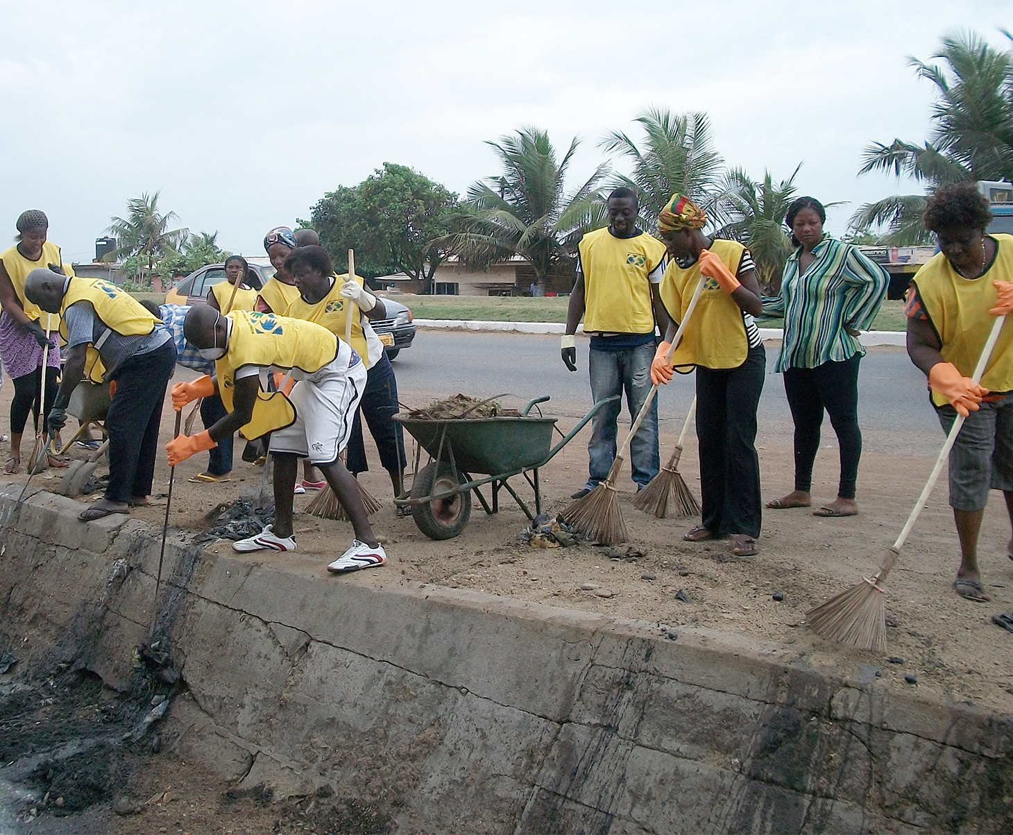
UNIT 3: PLAN PRINCIPLE 3 | LEARN
Principle 3
PLAN TO SERVE THE COMMUNITY

Slide 34
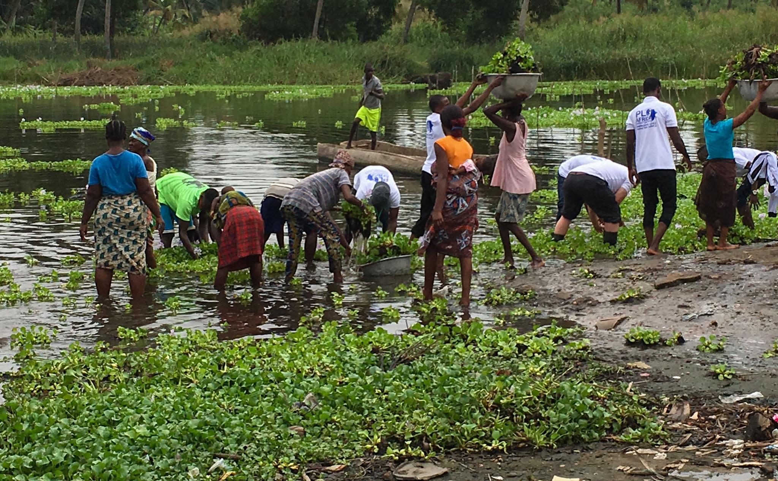
UNIT 3: PLAN PRINCIPLE 3 | LEARN
Principle 3
PLAN TO SERVE THE COMMUNITY

Slide 35
UNIT 3: PLAN PRINCIPLE 3 | LEARN
Principle 3
PLAN TO SERVE THE COMMUNITY
DISCUSS:
What do you see in these images?
Why do you think they chose to do service when they could have been doing something else?
How do you think these group service projects helped their communities, home and businesses?
How could giving service help our group and help others?

Slide 36
UNIT 3: PLAN PRINCIPLE 3 | LEARN
Principle 3
PLAN TO SERVE THE COMMUNITY
DISCUSS:
This group in Benin organized a project to clean the weeds and debris from the local lake, thus clearing paths for transportation and improving the environment.

Slide 37
UNIT 3: PLAN PRINCIPLE 3 | LEARN
Principle 3
PLAN TO SERVE THE COMMUNITY
DISCUSS:
How long would it have taken one person to collect all the weeds?

Slide 38
UNIT 3: PLAN PRINCIPLE 3 | LEARN
Principle 3
PLAN TO SERVE THE COMMUNITY
DISCUSS:
This group is cleaning up the streets near the market area where members sell their products.
How do you think the group members are feeling?

Slide 39
UNIT 3: PLAN PRINCIPLE 3 | LEARN
Principle 3
PLAN TO SERVE THE COMMUNITY
DISCUSS:
This group has spent days preparing a dance and presentation for the local care center facility for the elderly. Here they are performing their dance.

Slide 40
UNIT 3: PLAN PRINCIPLE 3 | LEARN
Principle 3
PLAN TO SERVE THE COMMUNITY
ACT:
Let’s start making our community service plan.
What are some problems or needs in our community?
Is there a problem or need our group could help solve?
What is something we could do as a group service project that might help solve this problem?
Would each of you be willing to support a service project?

Slide 41
UNIT 3: PLAN PRINCIPLE 3 | LEARN
Principle 3
PLAN TO SERVE THE COMMUNITY
ACT:
As a group answer the following questions and list the answers on page 12 of your workbook or another notebook.
What do we want to do for a group service project?
When? Where? What’s your part?
Have fun and get it done!

Slide 42
UNIT 3: PLAN SUMMARY
PLAN PRINCIPLES SUMMARY
Plan for Business.
Plan for Home.
Plan to Serve the Community.

Slide 43
UNIT 3: PLAN COMMIT
COMMITMENT
Business Plan Commitment:
I will complete my Quality of Life Wheel (Home Plan) and consider how I can improve each area of my life.
I will plan a Community Service Project with the group.

Slide 44
UNIT 3: PLAN COMMIT
COMMITMENT
Home Quality of Life Commitment:
I will thoughtfully choose one or two areas of my Quality of Life Wheel and write down goals to improve this week.
I will be specific with my written goals and follow through.
Savings Commitment:
I will add to my savings – even if it’s just a coin or two.

Slide 45
UNIT 3: PLAN COMMIT
COMMITMENT
DISCUSS:
Who would like to share their Home Quality of Life Commitment this week?
Which commitment will be the easiest to keep for you this week?
Which commitment will be the hardest?

Slide 46
UNIT 3: PLAN COMMIT
COMMITMENT
ACT:
Meet now with your Action Partner for this week. Discuss your business ideas and decide how you will contact and encourage each other during the week to keep your commitments.

Slide 47
UNIT 3: PLAN

