Slide 1
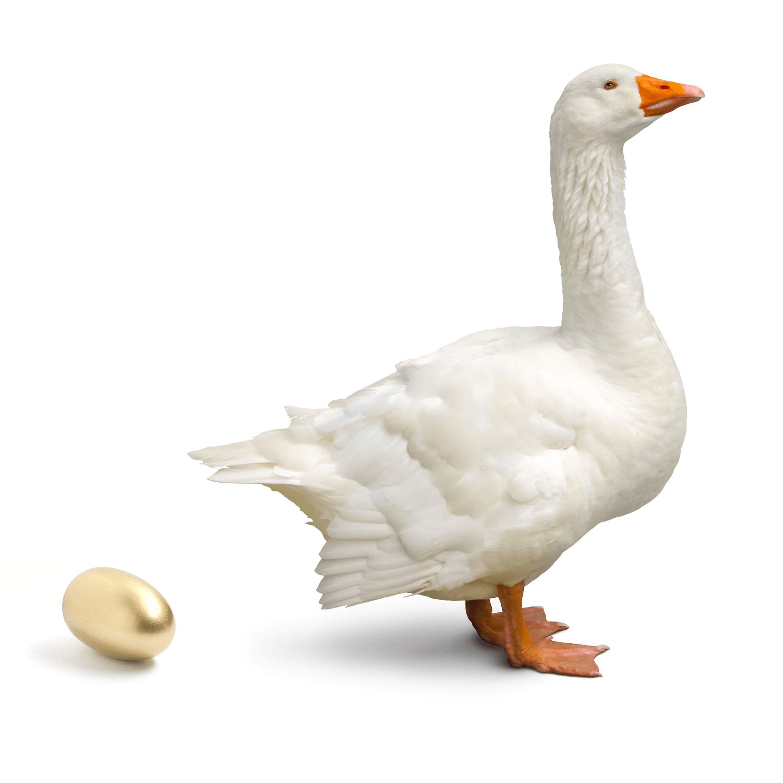
UNIT 4: PAPERWORK–HOME BUDGETING

Slide 2
UNIT 4: PAPERWORK – HOME BUDGETING
Separate Business & Personal Money.
Pay Yourself a Salary or Commission.
Don’t Steal from Your Business.
Save Regularly.
Make & Follow a Personal Budget.

Slide 3
UNIT 4: PAPERWORK – HOME BUDGETING REPORT
REPORT
Last Week’s Promises:
Business Plan: Complete your Quality of Life Wheel and plan a Community Service Project.
Home Quality of Life Plan: Choose to improve a specific area from your Home Plan.
Savings: Save money, even just a coin or two.
ACT:
Business Spotlight presentation

Slide 4
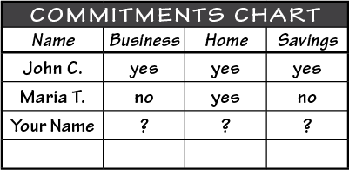
UNIT 4: PAPERWORK – HOME BUDGETING REPORT
REPORT:
DISCUSS:
What did you learn last week as you kept your promises?
What problems did you have as you tried to keep your commitments?
What can we do to help everyone keep weekly promises?

Slide 5
UNIT 4: PAPERWORK – HOME BUDGETING INTRODUCTION | LEARN
DISCUSS:
What happened when the farmer wanted more than the goose could give?
If your business is the goose, what are some of the things you could do to kill your business?
ACT:
Today we will discuss important principles so that you won’t kill your business. That way it keeps laying golden eggs (making a profit).

Slide 6
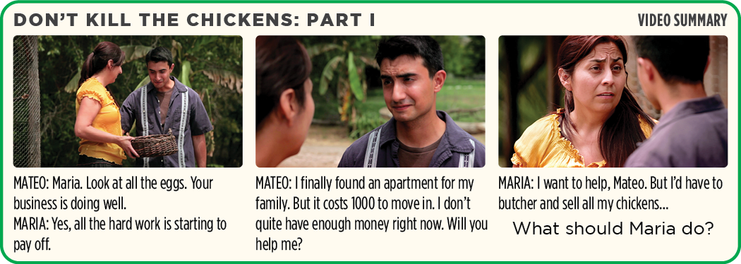
UNIT 4: PAPERWORK – HOME BUDGETING PRINCIPLE 1 | LEARN
Principle 1
SEPARATE BUSINESS & PERSONAL MONEY

Slide 7
UNIT 4: PAPERWORK – HOME BUDGETING PRINCIPLE 1 | LEARN
Principle 1
SEPARATE BUSINESS & PERSONAL MONEY
DISCUSS:
What would you do?
Have friends or family ever asked for money from your business?
Maria’s brother wants some money, but if she gives it to him it will hurt her business. What should Maria do?

Slide 8
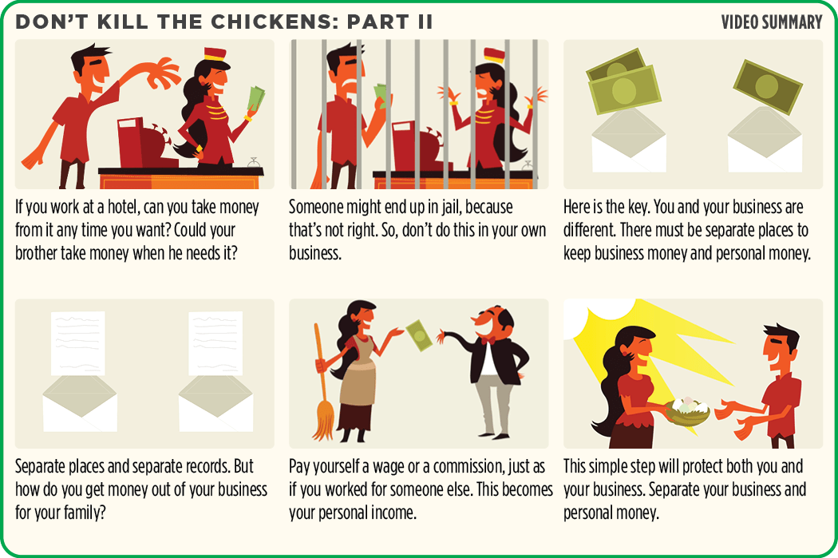
UNIT 4: PAPERWORK – HOME BUDGETING PRINCIPLE 1 | LEARN
Principle 1
SEPARATE BUSINESS & PERSONAL MONEY

Slide 9
UNIT 4: PAPERWORK – HOME BUDGETING PRINCIPLE 1 | LEARN
Principle 1
SEPARATE BUSINESS & PERSONAL MONEY
DISCUSS:
When friends or family need money, like Maria’s brother, what should we do?
Why is it important to separate your business and personal money?
How are you going to separate your business and personal finances?

Slide 10
UNIT 4: PAPERWORK – HOME BUDGETING PRINCIPLE 1 | LEARN
Principle 1
SEPARATE BUSINESS & PERSONAL MONEY
ACT:
Decide what you will do to separate your business and personal money.

Slide 11
UNIT 4: PAPERWORK – HOME BUDGETING PRINCIPLE 2 | LEARN
Principle 2
PAY YOURSELF A SALARY OR COMMISSION

Slide 12
UNIT 4: PAPERWORK – HOME BUDGETING PRINCIPLE 2 | LEARN
Principle 2
PAY YOURSELF A SALARY OR COMMISSION
DISCUSS:
Why is sharing from her personal savings better for Maria than taking from the business?
ACT:
Write or draw in your workbook on page 14 or another notebook how you will pay yourself a salary or commission. Share with the group what you wrote.

Slide 13
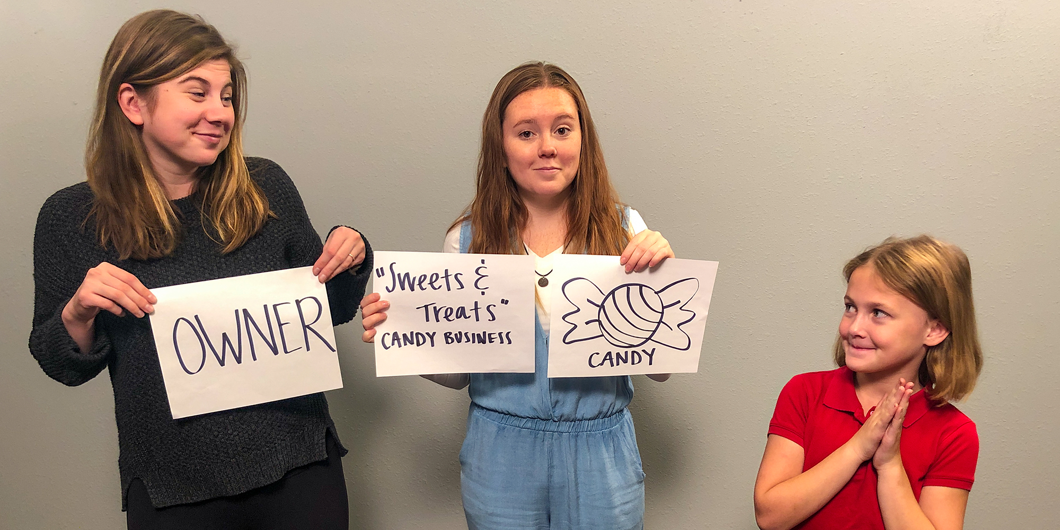
UNIT 4: PAPERWORK – HOME BUDGETING PRINCIPLE 3 | LEARN
Principle 3
DON’T STEAL FROM YOUR BUSINESS

Slide 14
UNIT 4: PAPERWORK – HOME BUDGETING PRINCIPLE 3 | LEARN
Principle 3
DON’T STEAL FROM YOUR BUSINESS
DISCUSS:
Why is it so important not to give away your product even to family?
What can the owner do if they let their child have some candy?
ACT:
In your workbook on page 14 or another notebook write or draw how you will avoid stealing from your business.

Slide 15
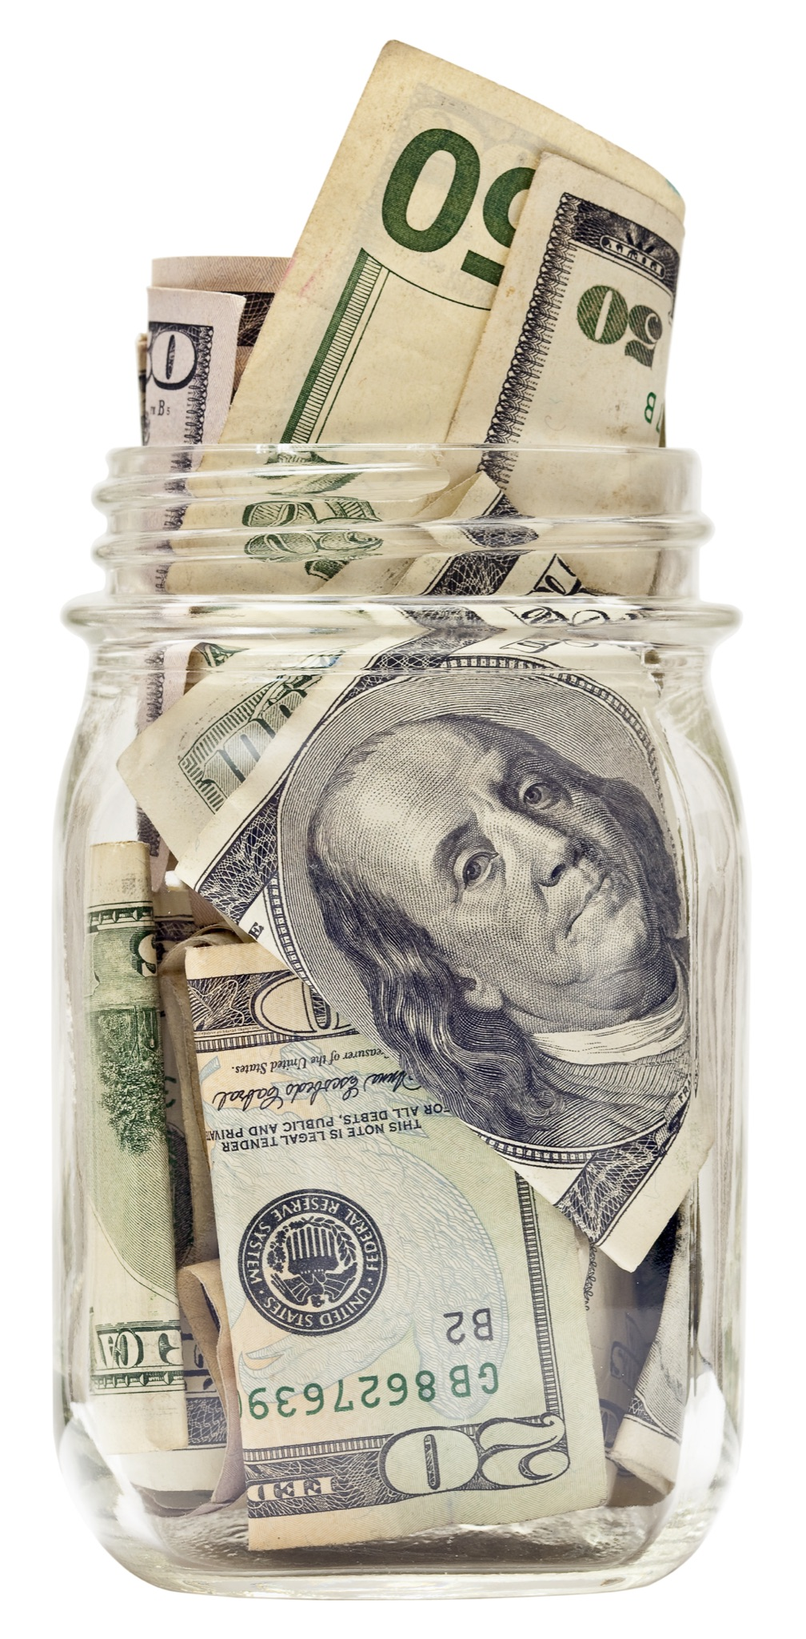
UNIT 4: PAPERWORK – HOME BUDGETING PRINCIPLE 4 | LEARN
Principle 4
SAVE REGULARLY

Slide 16
UNIT 4: PAPERWORK – HOME BUDGETING PRINCIPLE 4 | LEARN
Principle 4
SAVE REGULARLY
DISCUSS:
What have you done so far to save?
How can you make it a habit to save?
ACT:
In your workbook on page 14 or another notebook write or draw the things you will do to make a habit to save. Decide where you will keep your savings.

Slide 17
UNIT 4: PAPERWORK – HOME BUDGETING PRINCIPLE 5 | LEARN
Principle 5
MAKE & FOLLOW A PERSONAL BUDGET
CODE:
Turn to page 15 in your workbook and follow along as you read aloud about Maria’s budget or look on the next slide.

Slide 18
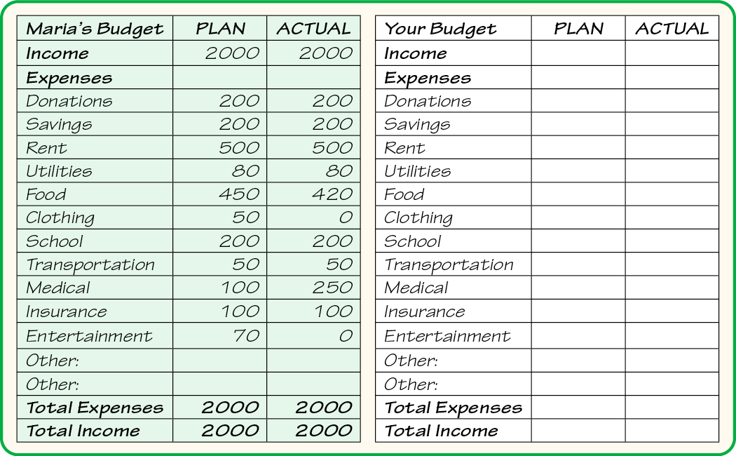
UNIT 4: PAPERWORK – HOME BUDGETING PRINCIPLE 5 | LEARN
Principle 5
MAKE & FOLLOW A PERSONAL BUDGET

Slide 19
UNIT 4: PAPERWORK – HOME BUDGETING PRINCIPLE 5 | LEARN
Principle 5
MAKE & FOLLOW A PERSONAL BUDGET
DISCUSS:
How did Maria do in the month of January?
How did she adjust her plan?
Why is it important to have a personal budget?

Slide 20
UNIT 4: PAPERWORK – HOME BUDGETING PRINCIPLE 5 | LEARN
Principle 5
MAKE & FOLLOW A PERSONAL BUDGET
ACT:
Write your planned budget for next month. Turn to page 46 in your workbook or the next slide and take time now to write down what you plan to spend next month.
Then, during the month, keep track of what you earn and spend, and see how well you did.

Slide 21
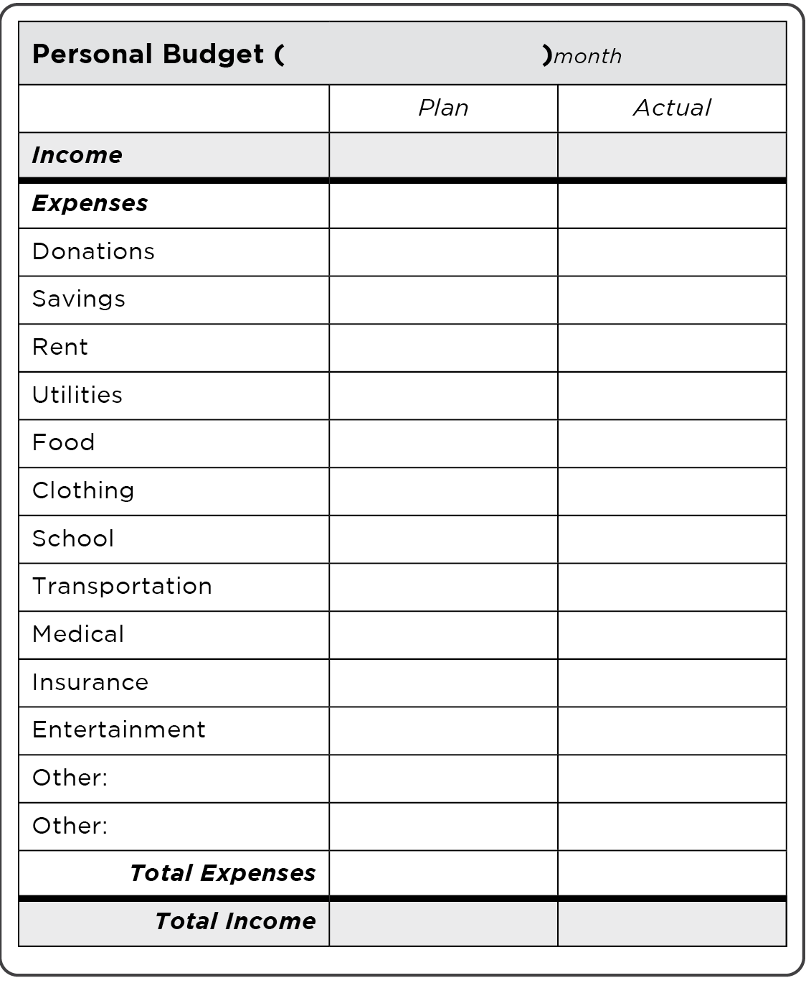
UNIT 4: PAPERWORK – HOME BUDGETING PRINCIPLE 5 | LEARN
Principle 5
MAKE & FOLLOW A PERSONAL BUDGET

Slide 22
UNIT 4: PAPERWORK – HOME BUDGETING SUMMARY
PAPERWORK – HOME BUDGETING PRINCIPLES SUMMARY
Separate Business & Personal Money.
Pay Yourself a Salary or Commission.
Don’t Steal from Your Business.
Save Regularly.
Make & Follow a Personal Budget.

Slide 23
UNIT 4: PAPERWORK – HOME BUDGETING COMMIT
COMMITMENT
Business Plan Commitment:
I will separate my personal and business money.
I will create a personal budget and follow it.

Slide 24
UNIT 4: PAPERWORK – HOME BUDGETING COMMIT
COMMITMENT
Home Quality of Life Commitment:
I will thoughtfully choose one or two areas of my Quality of Life Wheel and write down goals to improve this week.
I will be specific with my written goals and follow through.
Savings Commitment:
I will add to my savings–even if it’s just a coin or two.

Slide 25
UNIT 4: PAPERWORK – HOME BUDGETING COMMIT
COMMITMENT
DISCUSS:
How will you keep your personal records?
Will anyone share their quality of life commitment?
Which commitment will be the easiest to keep for you this week?
Which commitment will be the hardest?

Slide 26
UNIT 4: PAPERWORK – HOME BUDGETING COMMIT
COMMITMENT
ACT:
Meet now with your Action Partner for this week. Discuss your business ideas and decide how you will contact and encourage each other during the week to keep your commitments.

Slide 27
UNIT 4: PAPERWORK–HOME BUDGETING

