Slide 1
UNIT 5: PAPERWORK – BUSINESS

Slide 2
UNIT 5: PAPERWORK – BUSINESS
Keep Records.
Record Income & Expenses at the Point of Sale.
Make an Income & Expense Log.
Create an Income Statement.
Avoid Selling on Credit.

Slide 3
UNIT 5: PAPERWORK – BUSINESS REPORT
REPORT
Last Week’s Promises:
Business Plan: I will separate my personal and business money. I will create and keep a personal budget.
Home Quality of Life Plan: Choose to improve a specific area from your Home Plan.
Savings: Save money, even just a coin or two.
ACT:
Business Spotlight presentation

Slide 4
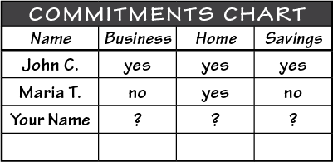
UNIT 5: PAPERWORK – BUSINESS REPORT
REPORT:
DISCUSS:
What did you learn last week as you kept your promises?
What problems did you have as you tried to keep your commitments?
What can we do to help everyone keep weekly promises?

Slide 5
UNIT 5: PAPERWORK – BUSINESS INTRODUCTION | LEARN
DISCUSS:
What do you see in this picture?
Is this boat going to float?
ACT:
Learn the five principles of Paperwork for Business.

Slide 6
UNIT 5: PAPERWORK – BUSINESS INTRODUCTION | LEARN
DISCUSS:
Would you feel comfortable with this boat in the middle of the ocean?
What would you need to know before taking this boat on a long journey?

Slide 7
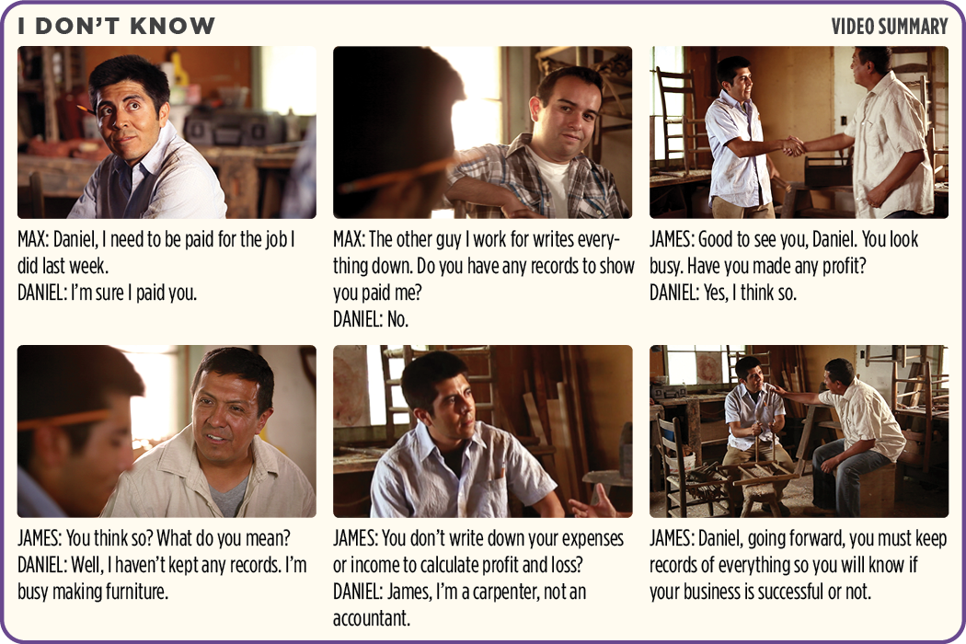
UNIT 5: PAPERWORK – BUSINESS PRINCIPLE 1 | LEARN
Principle 1
KEEP RECORDS
CODE:

Slide 8
UNIT 5: PAPERWORK – BUSINESS PRINCIPLE 1 | LEARN
Principle 1
KEEP RECORDS
DISCUSS:
How could records help Daniel know if had paid Max or not?
How could Daniel keep track of what style, color and number of chairs a customer wanted and when they were going to pick them up?
What are some other records that would be helpful for a carpenter to keep?
What are some records your business should keep?

Slide 9
UNIT 5: PAPERWORK – BUSINESS PRINCIPLE 1 | LEARN
Principle 1
KEEP RECORDS
ACT:
Turn to page 21 in your workbook or another notebook.
Write or draw at least three things your business should record.
Decide how you will keep track of those three things and where you are going to keep those records so you can always use them.

Slide 10
UNIT 5: PAPERWORK – BUSINESS PRINCIPLE 2 | LEARN
Principle 2
RECORD INCOME & EXPENSES AT THE POINT OF SALE
CODE:
Ways to record income at the point of sale:
Make a product list and make tally marks during every sale and expense.
Keep your Income and Expense log at the point of sale and record all sales.

Slide 11
UNIT 5: PAPERWORK – BUSINESS PRINCIPLE 2 | LEARN
Principle 2
RECORD INCOME & EXPENSES AT THE POINT OF SALE
CODE:
Ways to record income at the point of sale:
Have an app or cash register that tracks all sales and expenses
Keep paper receipts of all sales and purchases. Total them up at the end of the day and enter them into your Income and Expense log.

Slide 12
UNIT 5: PAPERWORK – BUSINESS PRINCIPLE 2 | LEARN
Principle 2
RECORD INCOME & EXPENSES AT THE POINT OF SALE
DISCUSS:
How would having a list of all of the products and marking the sales help the store owner keep track of what she sold?
What is the advantage of knowing what you sold and spent each day?
What is the best way for you to keep records at the point of sale?

Slide 13
UNIT 5: PAPERWORK – BUSINESS PRINCIPLE 2 | LEARN
Principle 2
RECORD INCOME & EXPENSES AT THE POINT OF SALE
ACT:
On page 16 in your workbook or another notebook write how you will keep records at the point of sale.

Slide 14
UNIT 5: PAPERWORK – BUSINESS PRINCIPLE 3 | LEARN
Principle 3
MAKE AN INCOME & EXPENSE LOG
CODE:
Turn to page 17 in your workbook or on the next slide to the example of Carl’s Tree Trimming Business.
The purpose of an Income & Expense log is to know our Cash Balance by tracking all money coming in and money going out.

Slide 15
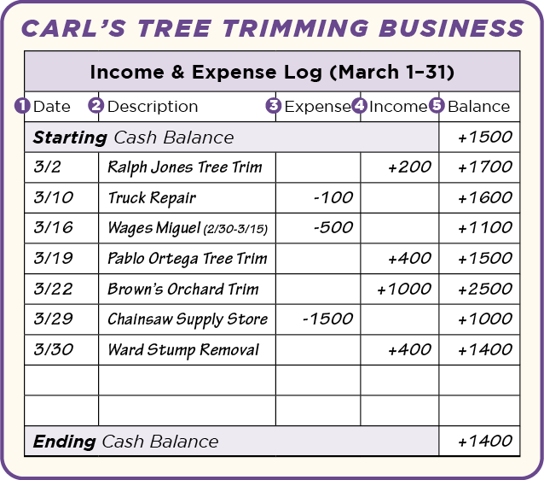
UNIT 5: PAPERWORK – BUSINESS PRINCIPLE 3 | LEARN
Principle 3
MAKE AN INCOME & EXPENSE LOG

Slide 16
UNIT 5: PAPERWORK – BUSINESS PRINCIPLE 3 | LEARN
Principle 3
MAKE AN INCOME & EXPENSE LOG
CODE:
Date – The date we received or spent the money.
Description – How we earned money or who we paid money to.
Expense – The amount we spent, putting a minus sign in front of the number helps us to remember to subtract that amount from the cash balance.

Slide 17
UNIT 5: PAPERWORK – BUSINESS PRINCIPLE 3 | LEARN
Principle 3
MAKE AN INCOME & EXPENSE LOG
CODE:
Income – The amount we received, we add this to the cash balance.
Balance – The amount we have in our cash box or business bank account.

Slide 18
UNIT 5: PAPERWORK – BUSINESS PRINCIPLE 3 | LEARN
Principle 3
MAKE AN INCOME & EXPENSE LOG

Slide 19
UNIT 5: PAPERWORK – BUSINESS PRINCIPLE 3 | LEARN
Principle 3
MAKE AN INCOME & EXPENSE LOG
DISCUSS:
How much cash did Carl start with?
How much did that effect Carl’s Cash Balance?
On March 16 how much did Carl pay Miguel?
Why did Carl pay Miguel?

Slide 20
UNIT 5: PAPERWORK – BUSINESS PRINCIPLE 3 | LEARN
Principle 3
MAKE AN INCOME & EXPENSE LOG
DISCUSS:
What is his cash balance at the end of the day?
What day did Carl buy a new chainsaw?
How much did it cost?
Carl wrote -1500 in the expense column. What was his cash balance before he bought the chainsaw?
What was his balance after he bought the chainsaw?

Slide 21
UNIT 5: PAPERWORK – BUSINESS PRINCIPLE 3 | LEARN
Principle 3
MAKE AN INCOME & EXPENSE LOG
DISCUSS:
How much was Carl’s beginning cash balance?
What is Carl’s cash balance at the end of March?
Does Carl have more money or less money than when he started the month?
Is Carl’s business sinking or floating?

Slide 22
UNIT 5: PAPERWORK – BUSINESS PRINCIPLE 3 | LEARN
Principle 3
MAKE AN INCOME & EXPENSE LOG
DISCUSS:
From what we have discussed so far would you say Carl is ready to said his business boat into deeper water?
Why or why not?
How will you keep your Income & Expense log?

Slide 23
UNIT 5: PAPERWORK – BUSINESS PRINCIPLE 3 | LEARN
Principle 3
MAKE AN INCOME & EXPENSE LOG
ACT:
Write in your workbook how you will keep your Income & Expense log.
Look in your workbook on page 48 or on the next slide at the blank Income & Expense log.
You can use this blank form to start keeping records.

Slide 24
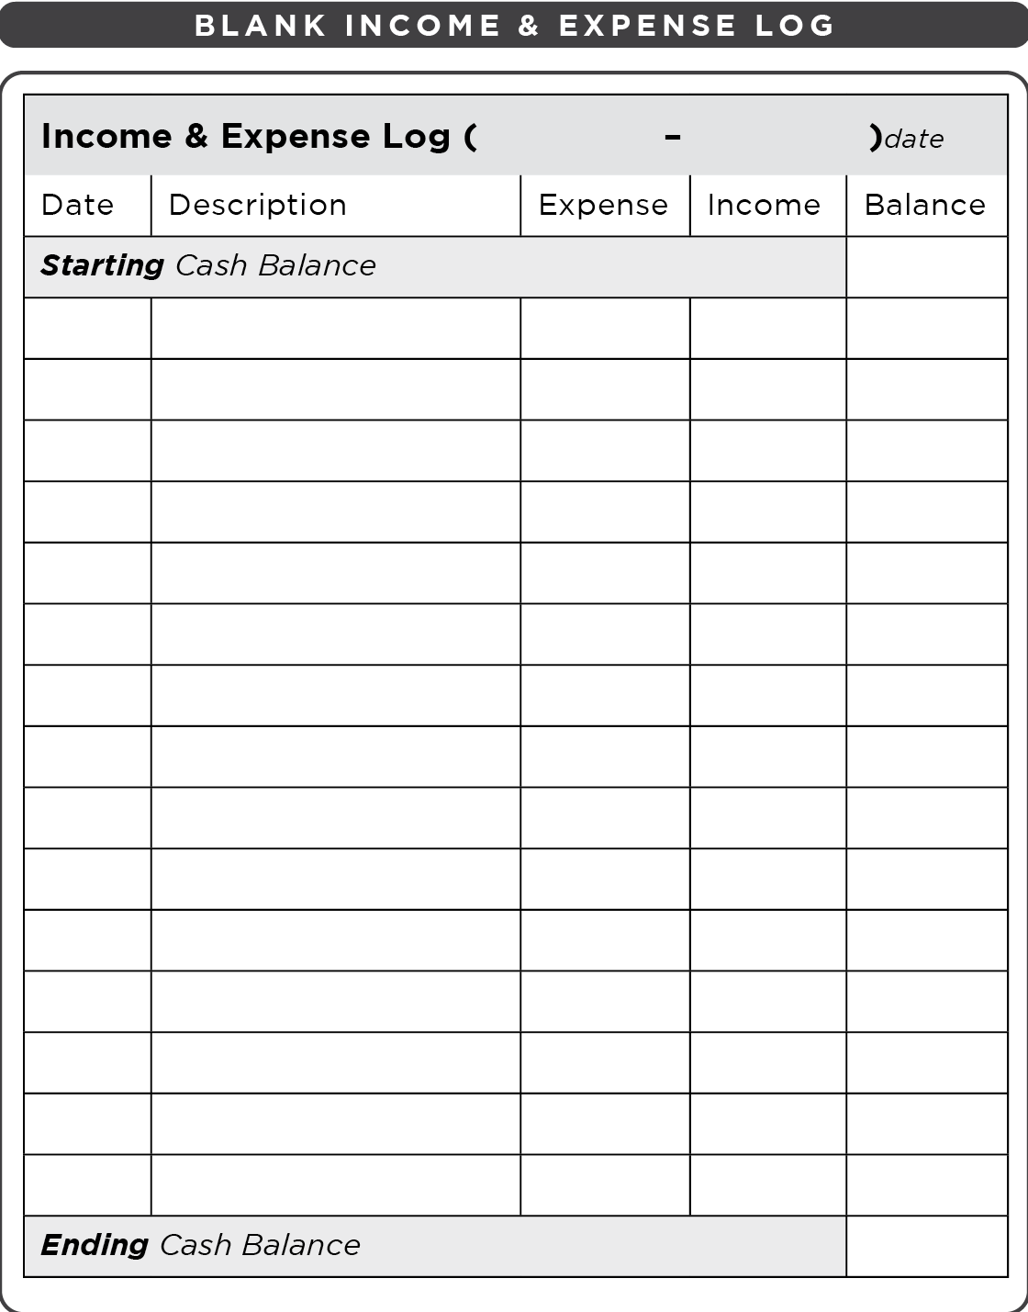
UNIT 5: PAPERWORK – BUSINESS PRINCIPLE 3 | LEARN
Principle 3
MAKE AN INCOME & EXPENSE LOG

Slide 25
UNIT 5: PAPERWORK – BUSINESS PRINCIPLE 4 | LEARN
Principle 4
CREATE AN INCOME STATEMENT
CODE:
Income Statement: It takes all of the income and expenses from a month, quarter or year to determine if you made a profit during that time period.
The purpose of an Income Statement is to see if the business made a Profit or experienced a Loss.

Slide 26
UNIT 5: PAPERWORK – BUSINESS PRINCIPLE 4 | LEARN
Principle 4
CREATE AN INCOME STATEMENT
CODE:
Turn to page 18 in your workbook or on the next slide.and look at the Income Statement for Carl’s Tree Trimming Business.

Slide 27
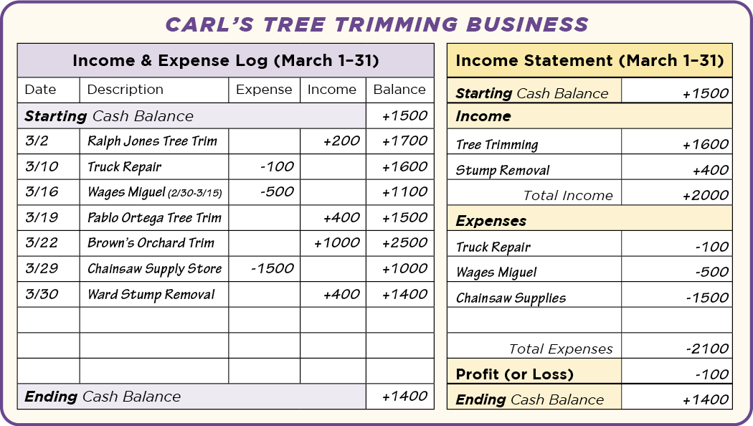
UNIT 5: PAPERWORK – BUSINESS PRINCIPLE 4 | LEARN
Principle 4
CREATE AN INCOME STATEMENT

Slide 28
UNIT 5: PAPERWORK – BUSINESS PRINCIPLE 4 | LEARN
Principle 4
CREATE AN INCOME STATEMENT
DISCUSS:
How much did Carl pay to get his truck fixed this month?
How much did Carl earn trimming trees this month?
What was the total income Carl earned from March 1 to March 31?
What were Carl’s total expenses?
How much more did Carl spend than he earned?

Slide 29
UNIT 5: PAPERWORK – BUSINESS PRINCIPLE 4 | LEARN
Principle 4
CREATE AN INCOME STATEMENT
ACT:
Make a Practice Income & Expense Log and Income Statement.
Turn to page 18 in your workbook or to the next slide to the blank practice Income & Expense Log and Income Statement
Remember, this is only a practice.

Slide 30
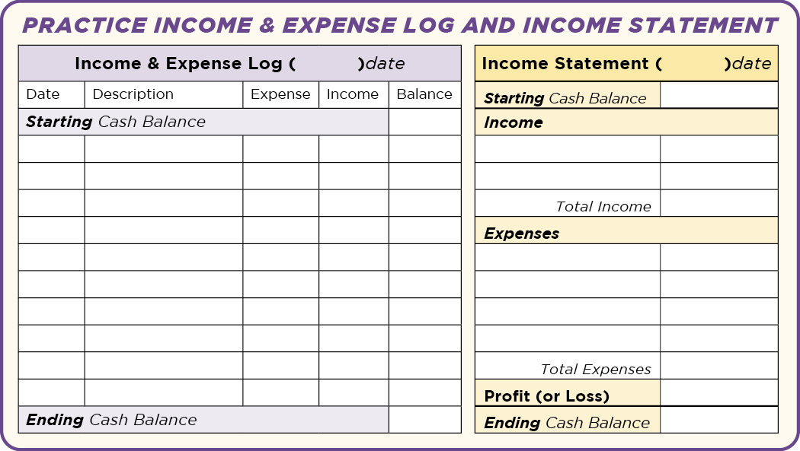
UNIT 5: PAPERWORK – BUSINESS PRINCIPLE 4 | LEARN
Principle 4
CREATE AN INCOME STATEMENT

Slide 31
UNIT 5: PAPERWORK – BUSINESS PRINCIPLE 4 | LEARN
Principle 4
CREATE AN INCOME STATEMENT
ACT:
Did you make a profit on your practice Income Statement?
Usually income statements are made monthly. Why would it be helpful to have an income statement each month?
What will be your greatest challenge in keeping an Income and Expense Log and making an Income Statement monthly?
How can we help each other keep these records in your own business?

Slide 32
UNIT 5: PAPERWORK – BUSINESS PRINCIPLE 5 | LEARN
Principle 5
AVOID SELLING ON CREDIT

Slide 33
UNIT 5: PAPERWORK – BUSINESS PRINCIPLE 5 | LEARN
Principle 5
AVOID SELLING ON CREDIT
DISCUSS:
What is credit?
Are there times we should offer credit? When and why?
ACT:
On page 19 of your workbook or another notebook write or draw your policy on credit for your business.

Slide 34
UNIT 5: PAPERWORK – BUSINESS PRINCIPLE 5 | LEARN
Principle 5
AVOID SELLING ON CREDIT
ACT:
On page 19 of your workbook or another notebook write or draw your policy on credit for your business.

Slide 35
UNIT 5: PAPERWORK – BUSINESS SUMMARY
PAPERWORK – BUSINESS PRINCIPLES SUMMARY
Keep Records.
Record Income & Expenses at the Point of Sale.
Make an Income & Expense Log.
Create an Income Statement.
Avoid Selling on Credit.

Slide 36
UNIT 5: PAPERWORK – BUSINESS COMMIT
COMMITMENT
Business Plan Commitment:
I will develop a pan to record sales at the point of sale.
I will keep an Income & Expense Log for my business.
I will create an Income Statement for my business from last month.

Slide 37
UNIT 5: PAPERWORK – BUSINESS COMMIT
COMMITMENT
Home Quality of Life Commitment
I will thoughtfully choose one or two areas of my Quality of Life Wheel and write down goals to improve this week.
I will be specific with my written goals and follow through.
Savings Commitment
I will add to my savings – even if it’s just a coin or two

Slide 38
UNIT 5: PAPERWORK – BUSINESS COMMIT
COMMITMENT
DISCUSS:
Who would like to share their Home Quality of Life Commitment this week?
Which commitment will be the easiest to keep for you this week?
Which commitment will be the hardest?

Slide 39
UNIT 5: PAPERWORK – BUSINESS COMMIT
COMMITMENT
ACT:
Meet now with your Action Partner for this week. Discuss your business ideas and decide how you will contact and encourage each other during the week to keep your commitments. Say your commitments out loud.

Slide 40
UNIT 5: PAPERWORK – BUSINESS

