Slide 1
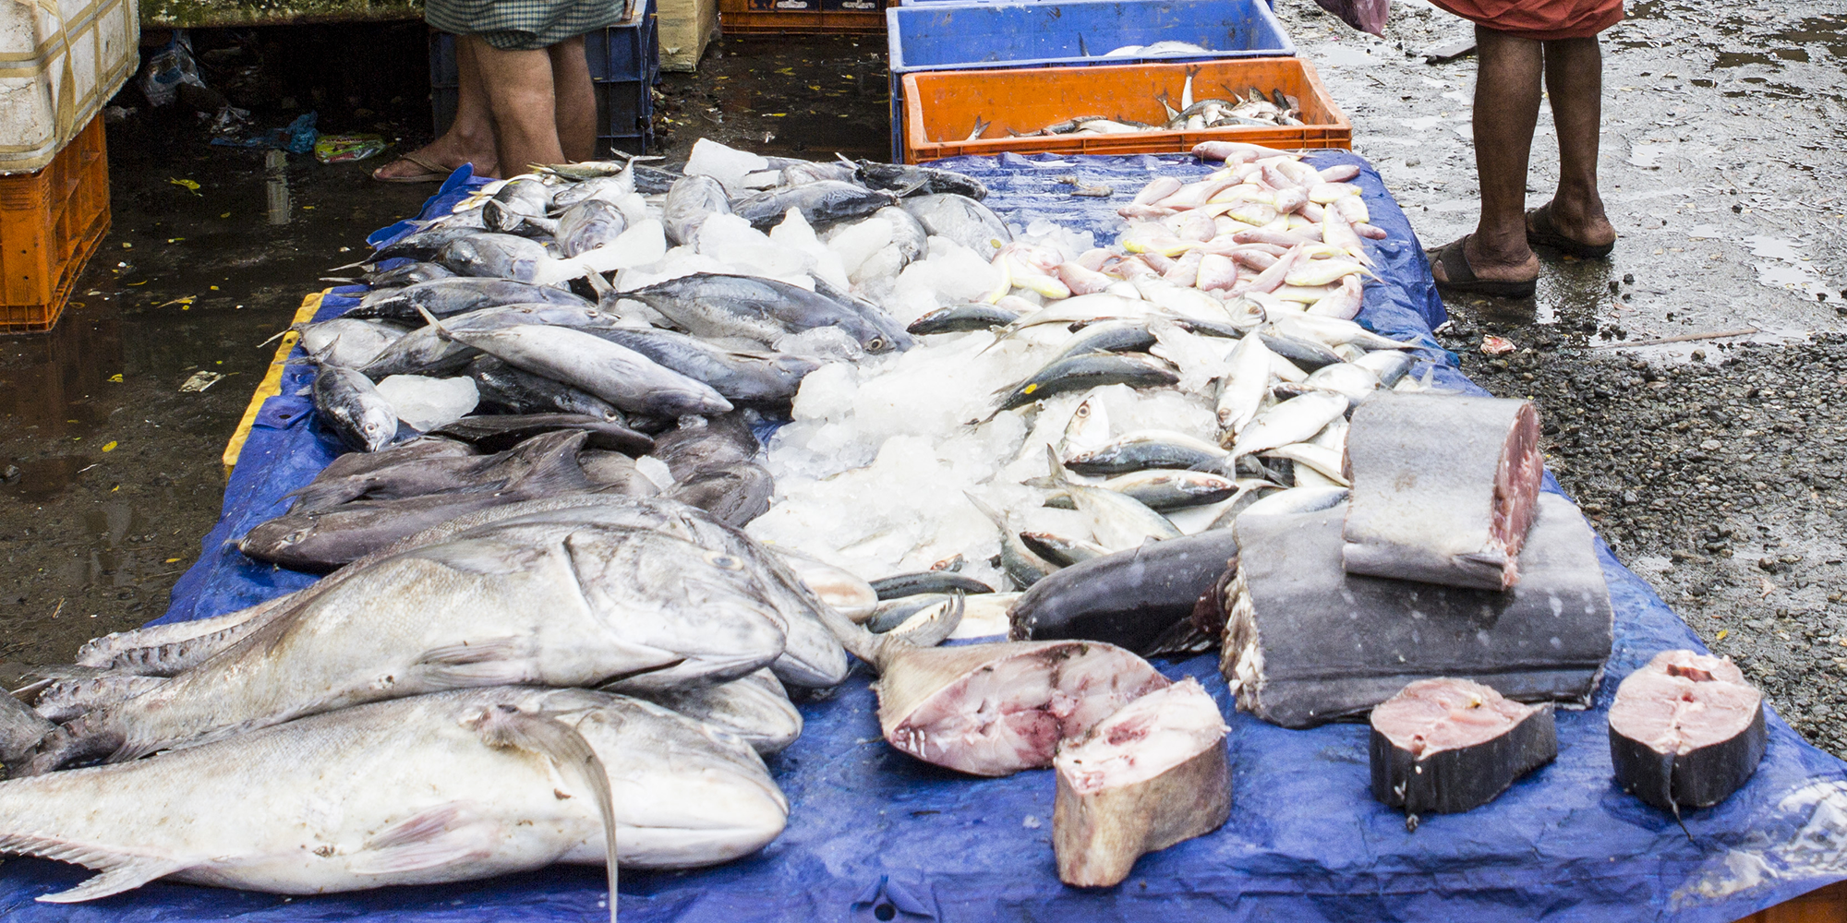
UNIT 6: PRICE

Slide 2
UNIT 6: PRICE
Know the Cost of Your Product or Service.
Reduce Costs.
Increase Prices or Sales by Adding Value.
Have More Than One Supplier

Slide 3
UNIT 6: PRICE REPORT
REPORT
Last Week’s Promises:
Business Plan: I will record my sales and expenses at the point of purchase.
I will keep an Income & Expense Log for my business.
I will create an Income Statement for my business for last month.
Home Quality of Life Plan: Choose to improve a specific area from your Home Plan.
Savings: Save money, even just a coin or two.

Slide 4
UNIT 6: PRICE REPORT
REPORT
ACT:
Business Spotlight presentation

Slide 5
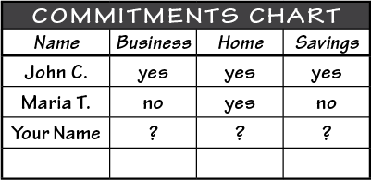
UNIT 6: PRICE REPORT
REPORT:
DISCUSS:
What did you learn last week as you kept your promises?
What problems did you have as you tried to keep your commitments?
What can we do to help everyone keep weekly promises?

Slide 6
UNIT 6: PRICE INTRODUCTION | LEARN
DISCUSS:
Would more trips to the fish market help John make more money?
Why should we find out what the full cost of our product or service is before we set the price?
ACT:
Learn the four principles of Price.

Slide 7
UNIT 6: PRICE PRINCIPLE 1 | LEARN
Principle 1
KNOW THE COST OF YOUR PRODUCT OR SERVICE
CODE:
Turn to page 20 in your workbook to discuss following four paperwork forms:
Current
Reduce Costs
Increase Prices
Reduce Costs & Increase Price

Slide 8
UNIT 6: PRICE PRINCIPLE 1 | LEARN
Principle 1
KNOW THE COST OF YOUR PRODUCT OR SERVICE
CODE:
Let’s look at the Current log and statement and answer some questions.

Slide 9
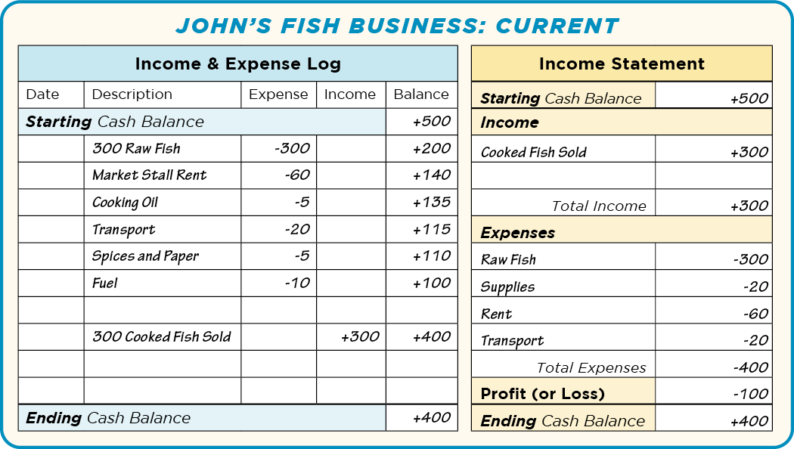
UNIT 6: PRICE PRINCIPLE 1 | LEARN
Principle 1
KNOW THE COST OF YOUR PRODUCT OR SERVICE

Slide 10
UNIT 6: PRICE PRINCIPLE 1 | LEARN
Principle 1
KNOW THE COST OF YOUR PRODUCT OR SERVICE
DISCUSS:
How much income does John earn if he sells 300 cooked fish?
How much do 300 raw fish cost John?
What are John’s other costs (or expenses)?
Is John making a profit or losing money?

Slide 11
UNIT 6: PRICE PRINCIPLE 1 | LEARN
Principle 1
KNOW THE COST OF YOUR PRODUCT OR SERVICE
ACT:
Turn to page 20 in your workbook or another notebook.
Take the next two minutes and write down as many of your business costs as you can think of.
Share with the group some of the costs you wrote down.
After hearing others’ business expenses, can you think of any more costs you should write down?

Slide 12
UNIT 6: PRICE PRINCIPLE 2 | LEARN
Principle 2
REDUCE COSTS
CODE:
As a group choose three of the costs you discussed.
Read aloud the warning on page 21 in your workbook.

Slide 13
UNIT 6: PRICE PRINCIPLE 2 | LEARN
Principle 2
REDUCE COSTS
DISCUSS:
What are some fixed costs that business owners can have?
How can you avoid or reduce these fixed costs?
CODE:
Look at the Reduce Costs form in your workbook or on the next slide.

Slide 14
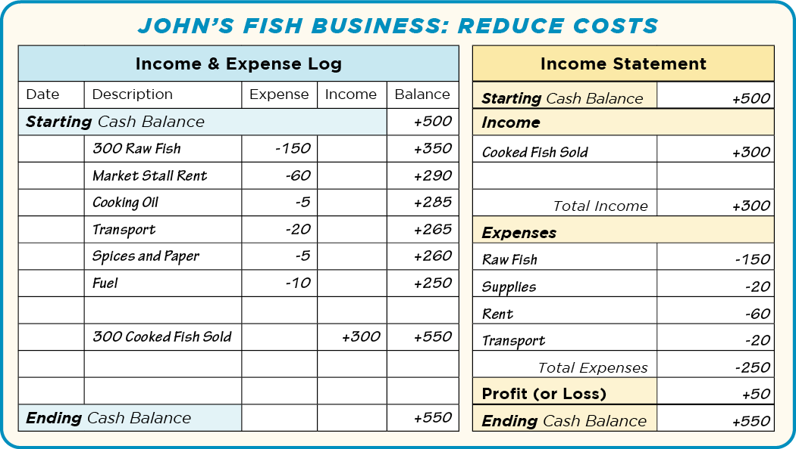
UNIT 6: PRICE PRINCIPLE 2 | LEARN
Principle 2
REDUCE COSTS

Slide 15
UNIT 6: PRICE PRINCIPLE 2 | LEARN
Principle 2
REDUCE COSTS
ACT:
Commit to look for ways to reduce your business costs.

Slide 16
UNIT 6: PRICE PRINCIPLE 3 | LEARN
Principle 3
INCREASE PRICES OR SALES BY ADDING VALUE
CODE:
Turn to page 22 in your workbook or on the next slide and look at the Increase Price form.

Slide 17
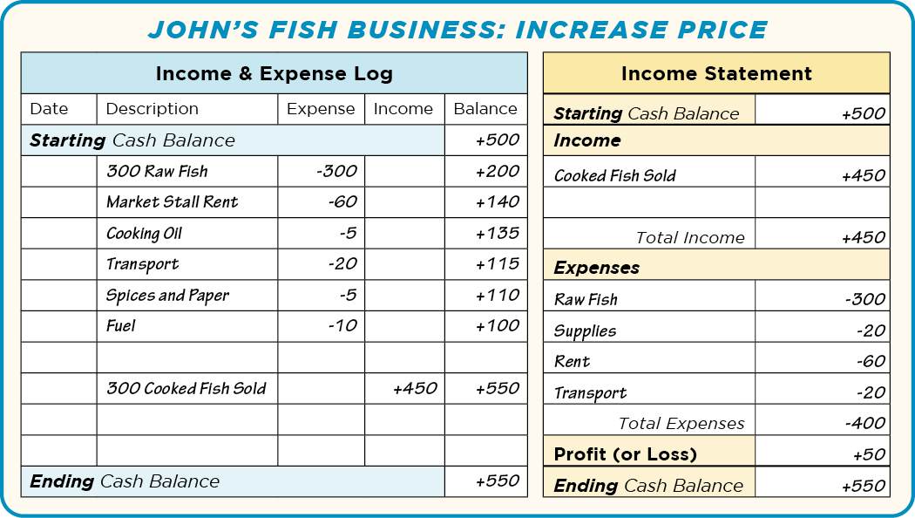
UNIT 6: PRICE PRINCIPLE 3 | LEARN
Principle 3
INCREASE PRICES OR SALES BY ADDING VALUE

Slide 18
UNIT 6: PRICE PRINCIPLE 3 | LEARN
Principle 3
INCREASE PRICES OR SALES BY ADDING VALUE
DISCUSS:
Looking at the Increase Price form in your workbook, how much did John increase the price of his cooked fish?
How much income does John get when he sells 300 cooked fish?
Is John losing money or making a profit?

Slide 19
UNIT 6: PRICE PRINCIPLE 3 | LEARN
Principle 3
INCREASE PRICES OR SALES BY ADDING VALUE
CODE:
Looking on page 22 in your workbook at the last box or on the next slide, what is John’s cost for 300 raw fish in the Reduce Cost & Increase Price box?

Slide 20
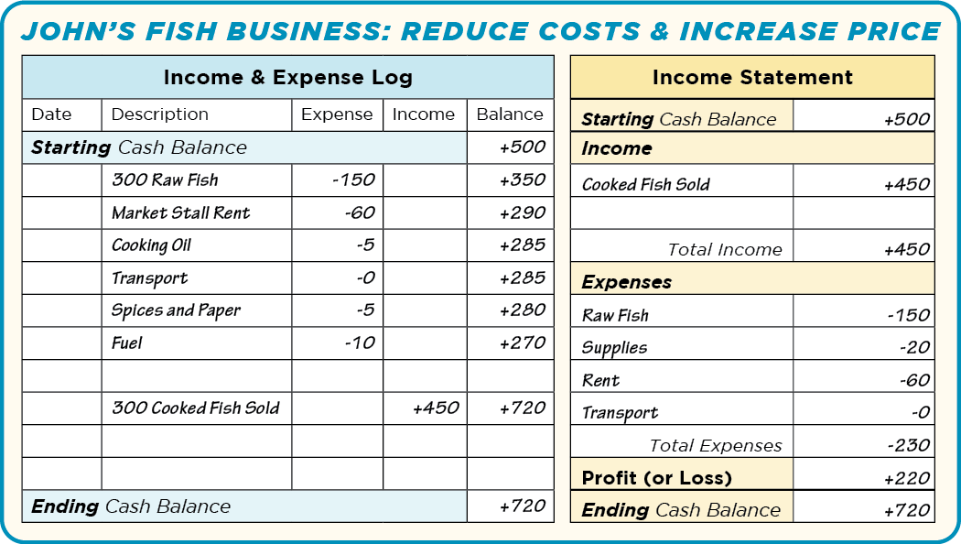
UNIT 6: PRICE PRINCIPLE 3 | LEARN
Principle 3
INCREASE PRICES OR SALES BY ADDING VALUE

Slide 21
UNIT 6: PRICE PRINCIPLE 3 | LEARN
Principle 3
INCREASE PRICES OR SALES BY ADDING VALUE
DISCUSS:
What is his cost for transport?
How much do all of John’s costs total now?
Should John accept the fisherman’s son’s offer? Why or why not?

Slide 22
UNIT 6: PRICE PRINCIPLE 3 | LEARN
Principle 3
INCREASE PRICES OR SALES BY ADDING VALUE
ACT:
Turn to page 23 in your workbook or another notebook.
Write or draw different ways you can reduce costs or increase prices for your business.

Slide 23
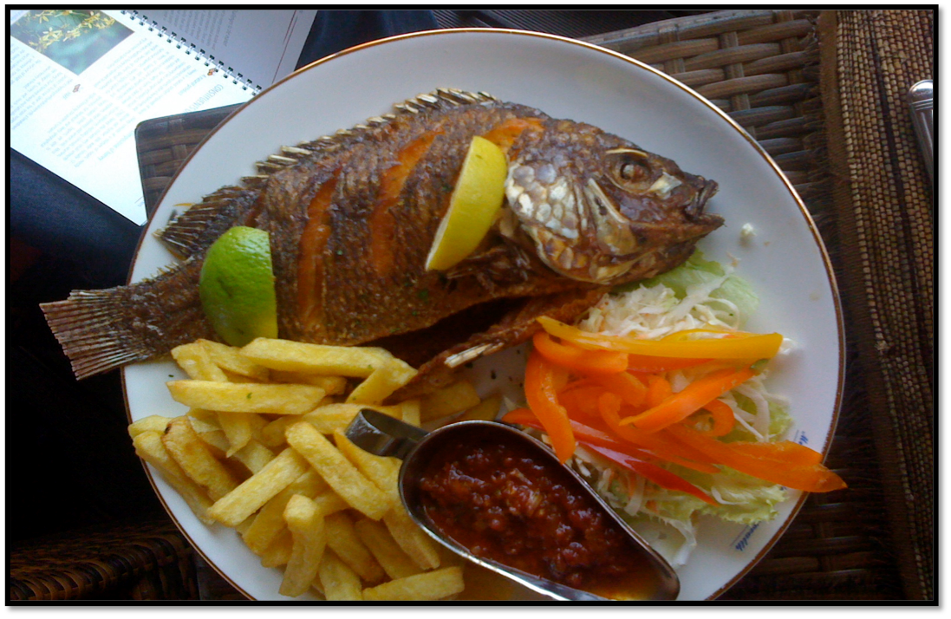
UNIT 6: PRICE PRINCIPLE 3 | LEARN
Principle 3
INCREASE PRICES OR SALES BY ADDING VALUE
CODE:

Slide 24
UNIT 6: PRICE PRINCIPLE 3 | LEARN
Principle 3
INCREASE PRICES OR SALES BY ADDING VALUE
DISCUSS:
How did John add value?
How can you add value to your product or service.
ACT:
Turn to page 23 in your workbook or another notebook. Write or draw what you can do to add value to your business.

Slide 25
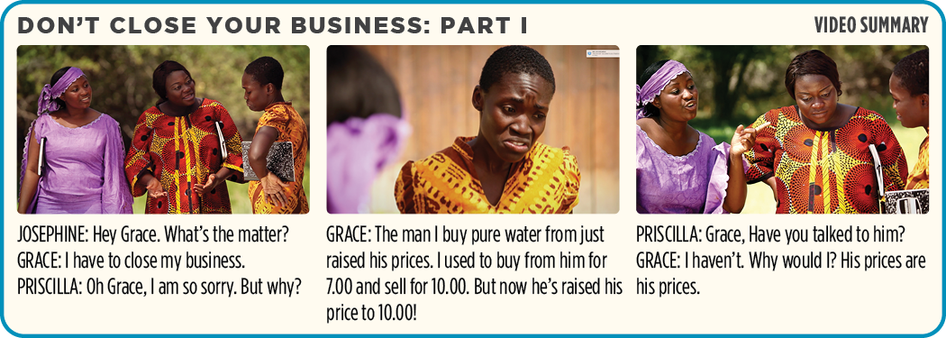
UNIT 6: PRICE PRINCIPLE 4 | LEARN
Principle 4
HAVE MORE THAN ONE SUPPLIER
CODE:

Slide 26
UNIT 6: PRICE PRINCIPLE 4 | LEARN
Principle 4
HAVE MORE THAN ONE SUPPLIER
CODE:

Slide 27
UNIT 6: PRICE PRINCIPLE 4 | LEARN
Principle 4
HAVE MORE THAN ONE SUPPLIER
DISCUSS:
Important things to ask suppliers:
How much do you charge?
Do you offer any discounts?
Do you sell on credit or cash?

Slide 28
UNIT 6: PRICE PRINCIPLE 4 | LEARN
Principle 4
HAVE MORE THAN ONE SUPPLIER
DISCUSS:
Important things to ask suppliers:
Who are your competitors?
Why are you my best option?
How much can you supply?

Slide 29
UNIT 6: PRICE PRINCIPLE 4 | LEARN
Principle 4
HAVE MORE THAN ONE SUPPLIER
ACT:
Turn to page 24 in your workbook.
Write down your current and potential suppliers ad choose some of the questions you will ask them.
Get with a partner and tell each other what your businesses are.
One of you will pretend to be the supplier of the other. Take turns practicing asking these questions.

Slide 30
UNIT 6: PRICE SUMMARY
PRICE PRINCIPLES SUMMARY
Know the Cost of Your Product or Service.
Reduce Costs.
Increase Prices or Sales by Adding Value.
Have More Than One Supplier.

Slide 31
UNIT 6: PRICE COMMIT
COMMITMENT
Business Plan Commitment:
I will calculate the true cost of my product or service this week.
I will find at least two ways to add value or reduce costs to increase my profit.

Slide 32
UNIT 6: PRICE COMMIT
COMMITMENT
Home Quality of Life Commitment
I will thoughtfully choose one or two areas of my Quality of Life Wheel and write down goals to improve this week.
I will be specific with my written goals and follow through.
Savings Commitment
I will add to my savings – even if it’s just a coin or two

Slide 33
UNIT 6: PRICE COMMIT
COMMITMENT
DISCUSS:
Who would like to share their Home Quality of Life Commitment this week?
Which commitment will be the easiest to keep for you this week?
Which commitment will be the hardest?

Slide 34
UNIT 6: PRICE COMMIT
COMMITMENT
ACT:
Meet now with your Action Partner for this week. Discuss your business ideas and decide how you will contact and encourage each other during the week to keep your commitments. Say your commitments out loud.

Slide 35
UNIT 6: PRICE

