Slide 1
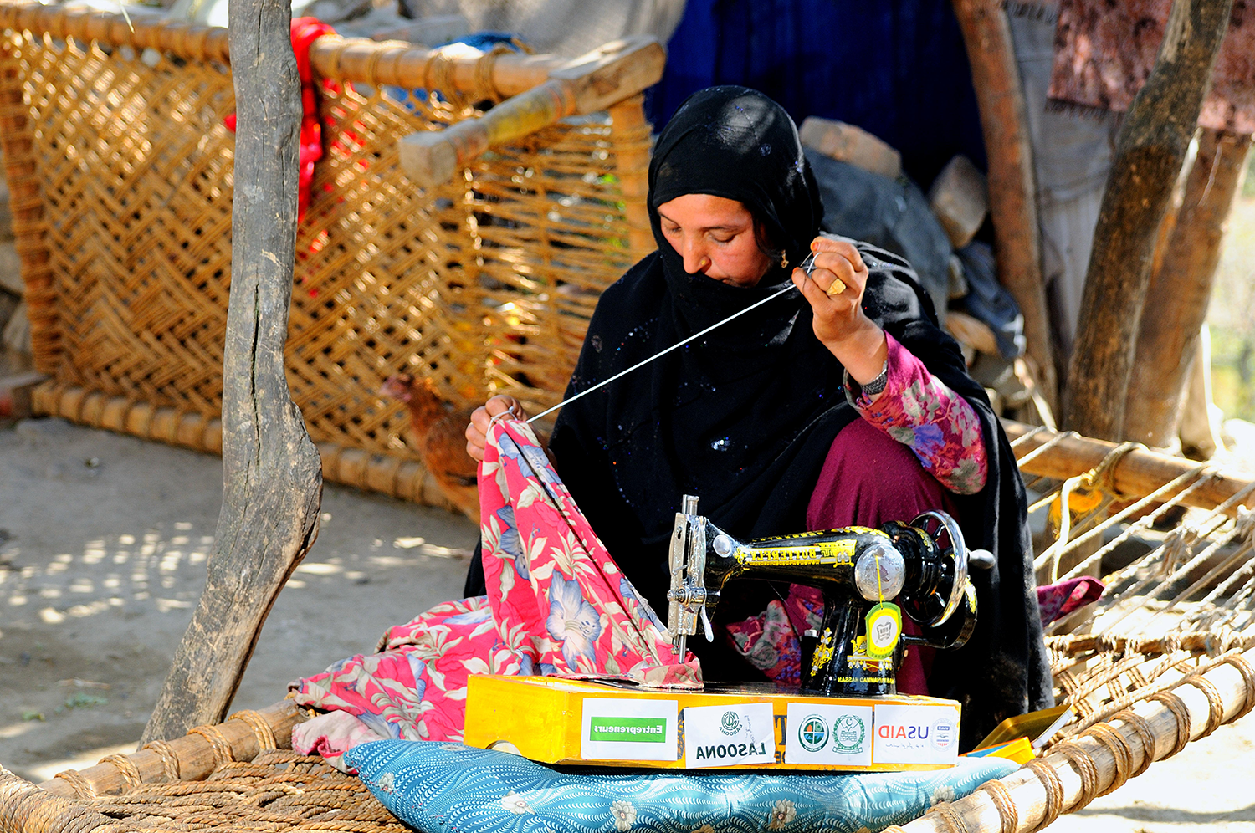
UNIT 7: PROCESS

Slide 2
UNIT 7: PROCESS
Know Your Process.
Constantly Improve Your Process.
Hire Slow & Fire When Necessary.
Use Time Wisely.

Slide 3
UNIT 7: PROCESS REPORT
REPORT
Last Week’s Promises:
Business Plan: Find at least two ways to add value or reduce costs to increase my profit.
Calculate the true cost of my product or service.
Home Quality of Life Plan: Choose to improve a specific area from your Home Plan.
Savings: Save money, even just a coin or two.
ACT:
Business Spotlight presentation

Slide 4
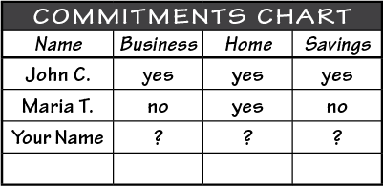
UNIT 7: PROCESS REPORT
REPORT:
DISCUSS:
What did you learn last week as you kept your promises?
What problems did you have as you tried to keep your commitments?
What can we do to help everyone keep weekly promises?

Slide 5
UNIT 7: PROCESS INTRODUCTION | LEARN
DISCUSS:
What is a business process?
How can knowing and improving our business process help us grow our business?
ACT:
In this Unit, learn to improve your Business Process.

Slide 6
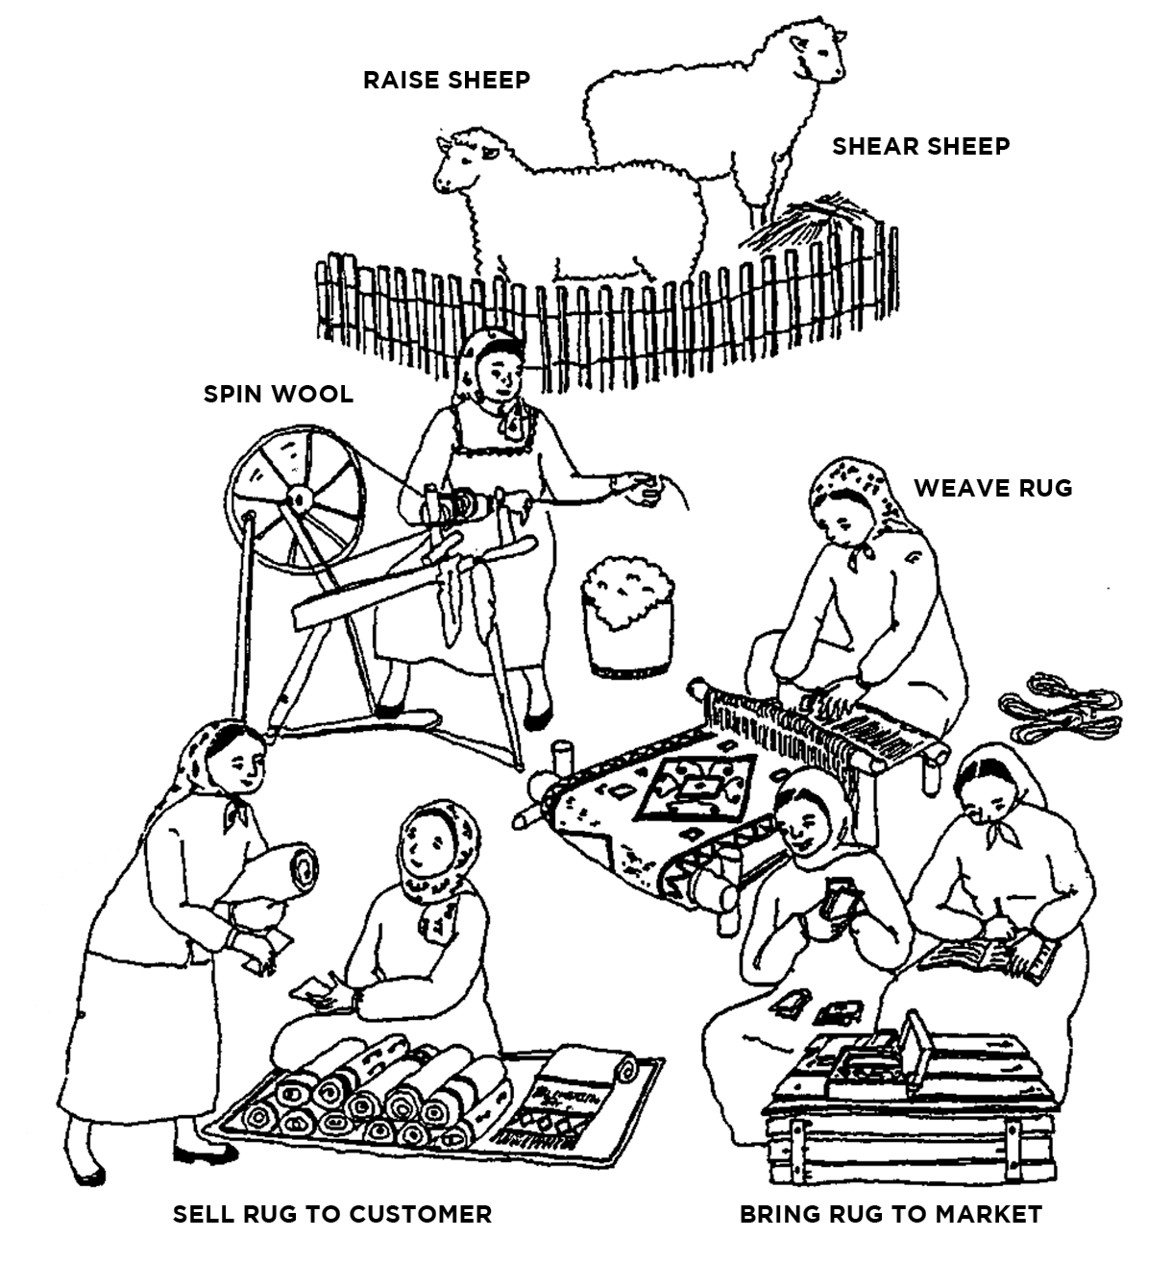
UNIT 7: PROCESS PRINCIPLE 1 | LEARN
Principle 1
KNOW YOUR PROCESS

Slide 7
UNIT 7: PROCESS PRINCIPLE 1 | LEARN
Principle 1
KNOW YOUR PROCESS

Slide 8
UNIT 7: PROCESS PRINCIPLE 1 | LEARN
Principle 1
KNOW YOUR PROCESS
DISCUSS:
What do you see in this picture?
What product do these women sell?
What are the steps they take to make & sell their product?

Slide 9
UNIT 7: PROCESS PRINCIPLE 1 | LEARN
Principle 1
KNOW YOUR PROCESS
Notes:
Cut the word “act” since they are not being asked to do anything.

Slide 10
UNIT 7: PROCESS PRINCIPLE 1 | LEARN
Principle 1
KNOW YOUR PROCESS
CODE:
Banana Chips: another example of a business process.

Slide 11
UNIT 7: PROCESS PRINCIPLE 1 | LEARN
Principle 1
KNOW YOUR PROCESS
DISCUSS:
What are the steps in the banana chips business shown?
ACT:
On page 25 of your workbook or in a notebook, write or draw your current process for getting your product or service from raw material to the market
Notes:
...or in a notebook,

Slide 12
UNIT 7: PROCESS PRINCIPLE 2 | LEARN
Principle 2
CONSTANTLY IMPROVE YOUR PROCESS
CODE:
A business has many processes.
How we make the product or service.
How we market (online, signs, face to face, etc.).
How we charge (cash, credit card, phone minutes, etc.).
How we deliver the product (online, store, house to house, etc.).
What are some other process in your business?

Slide 13
UNIT 7: PROCESS PRINCIPLE 2 | LEARN
Principle 2
CONSTANTLY IMPROVE YOUR PROCESS
DISCUSS:
For obtaining our product or service:
Do we have several suppliers?
Where do we get our raw materials?
Can we improve transportation or delivery?

Slide 14
UNIT 7: PROCESS PRINCIPLE 2 | LEARN
Principle 2
CONSTANTLY IMPROVE YOUR PROCESS
DISCUSS:
For making or improving our product or service:
How do we add value?
Are we closer, cleaner or faster for the customer than our competition?

Slide 15
UNIT 7: PROCESS PRINCIPLE 2 | LEARN
Principle 2
CONSTANTLY IMPROVE YOUR PROCESS
DISCUSS:
For promoting or marketing our product or service:
Could we package it better?
Could we sell in bulk?
Could we clean our area more?

Slide 16
UNIT 7: PROCESS PRINCIPLE 2 | LEARN
Principle 2
CONSTANTLY IMPROVE YOUR PROCESS
DISCUSS:
How do customers pay for our product or service:
Can customers use credit cards?
Can they get legal receipts?
ACT:
Turn to page 25 of your workbook or in your notebook. Pick one or two of the steps on your process and write down a way you could improve that step.

Slide 17
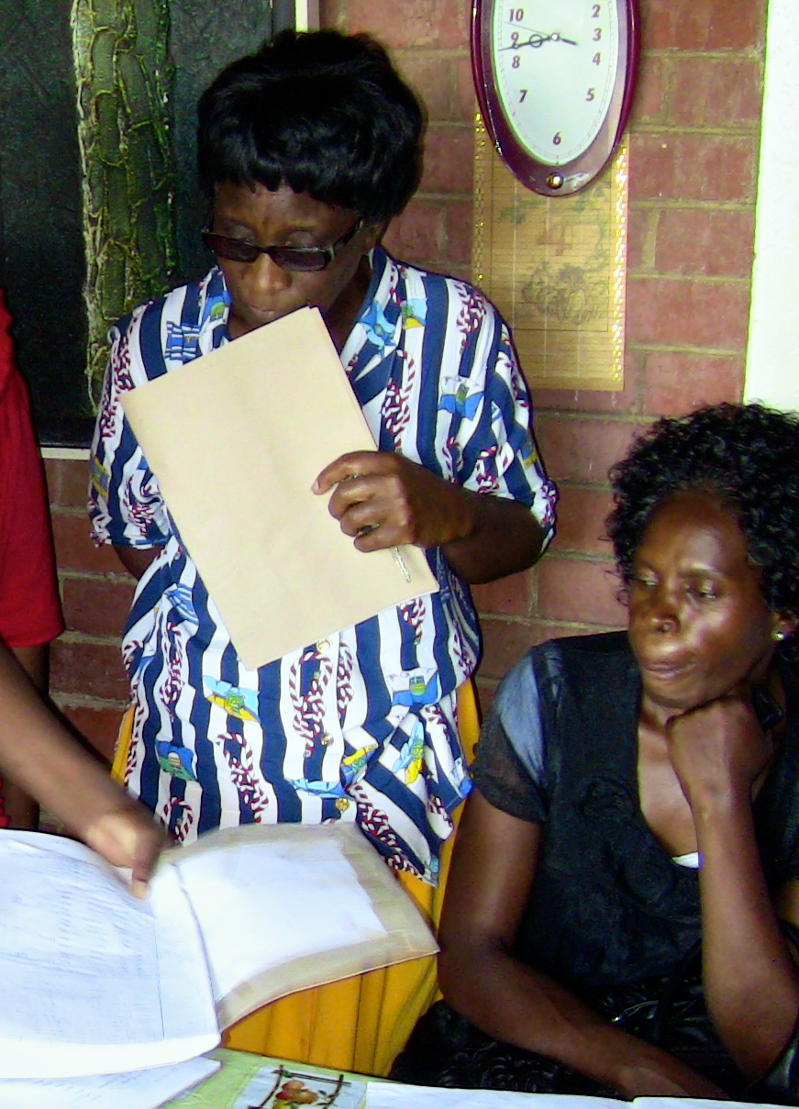
UNIT 7: PROCESS PRINCIPLE 3 | LEARN
Principle 3
HIRE SLOW & FIRE WHEN NECESSARY

Slide 18
UNIT 7: PROCESS PRINCIPLE 3 | LEARN
Principle 3
HIRE SLOW & FIRE WHEN NECESSARY
DISCUSS:
What can Sara do to resolve the problems with Rana?
When should Sara fire Rana?
Can you fire relatives and friends?
When should you hire an employee?

Slide 19
UNIT 7: PROCESS PRINCIPLE 3 | LEARN
Principle 3
HIRE SLOW & FIRE WHEN NECESSARY
ACT:
As a group make a list of things we should do or ask before hiring an employee.
Then turn to page 26 in your workbook or in your notebook and write or draw your process for hiring, training and firing employees.

Slide 20
UNIT 7: PROCESS PRINCIPLE 4 | LEARN
Principle 4
USE TIME WISELY
CODE:
List Tasks – Each morning make a list of things that need to be done.
Set Priorities – Put a 1, 2, 3, 4, etc. after each task with with 1 being the most important. If you have more than one high priority, choose the order of the most important things to get done that day.

Slide 21
UNIT 7: PROCESS PRINCIPLE 4 | LEARN
Principle 4
USE TIME WISELY
CODE:
3. Act – Do the highest priority first. Complete the task or complete it as much as you can. Then keep working down the list.

Slide 22
UNIT 7: PROCESS PRINCIPLE 4 | LEARN
Principle 4
USE TIME WISELY
DISCUSS:
Why is managing your time so important?
How can you decide what is most important each day?
ACT:
Turn to page 26 of your workbook or another notebook. Make a list of things that need to be done tomorrow. Put a 1, 2, etc. beside each item with the 1 being the most important. Make a commitment to follow the list tomorrow.

Slide 23
UNIT 7: PROCESS SUMMARY
PROCESS PRINCIPLES SUMMARY
Know Your Process.
Constantly Improve Your Process.
Hire Slow & Fire When Necessary.
Use Time Wisely.

Slide 24
UNIT 7: PROCESS COMMIT
COMMITMENT
Business Plan Commitment:
I will implement two things to improve my business process.
I will make and use a to-do list.
Home Quality of Life Commitment
I will thoughtfully choose one or two areas of my Quality of Life Wheel and write down goals to improve this week.
I will be specific with my written goals and follow through.

Slide 25
UNIT 7: PROCESS COMMIT
COMMITMENT
Savings Commitment
I will add to my savings – even if it’s just a coin or two

Slide 26
UNIT 7: PROCESS COMMIT
COMMITMENT
DISCUSS:
Who would like to share their Home Quality of Life Commitment this week?
Which commitment will be the easiest to keep for you this week?
Which commitment will be the hardest?

Slide 27
UNIT 7: PROCESS COMMIT
COMMITMENT
ACT:
Meet now with your Action Partner for this week. Discuss your business ideas and decide how you will contact and encourage each other during the week to keep your commitments. Say your commitments out loud.

Slide 28
UNIT 7: PROCESS

