Slide 1
UNIT 8: PROMOTION

Slide 2
UNIT 8: PROMOTION
State Your Business in 30 Seconds.
Brand Your Business.
Put Your Customers First.
Keep It Clean & Fresh.
Constantly Improve Sales.

Slide 3
UNIT 8: PROMOTION REPORT
REPORT
Last Week’s Promises:
Business Plan: I will implement two things to improve my business process.
I will make and use a to-do list.
Home Quality of Life Plan: Choose to improve a specific area from your Home Plan.
Savings: Save money, even just a coin or two.
ACT:
Business Spotlight presentation

Slide 4
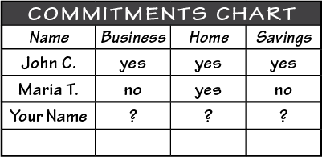
UNIT 8: PROMOTION REPORT
REPORT:
DISCUSS:
What did you learn last week as you kept your promises?
What problems did you have as you tried to keep your commitments?
What can we do to help everyone keep weekly promises?

Slide 5
UNIT 8: PROMOTION INTRODUCTION | LEARN
DISCUSS:
What suggestions would you give to Violet to improve her sales?
How could Violet apply the five principles of Promotion to improve sales?
ACT:
Keep in mind that at the end of the unit you will implement two ways to promote your business.

Slide 6
UNIT 8: PROMOTION PRINCIPLE 1 | LEARN
Principle 1
STATE YOUR BUSINESS IN 30 SECONDS
CODE:
State the name of your business.
Identify your product or service.
Tell why your product or service is better than others.
BAGS BY BERNICE
BANANA DELIGHTS

Slide 7
UNIT 8: PROMOTION PRINCIPLE 1 | LEARN
Principle 1
STATE YOUR BUSINESS IN 30 SECONDS

Slide 8
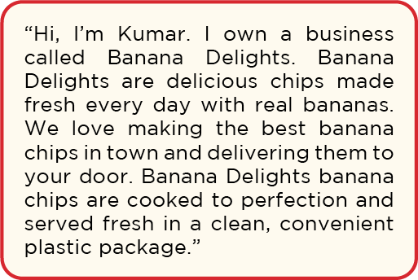
UNIT 8: PROMOTION PRINCIPLE 1 | LEARN
Principle 1
STATE YOUR BUSINESS IN 30 SECONDS

Slide 9
UNIT 8: PROMOTION PRINCIPLE 1 | LEARN
Principle 1
STATE YOUR BUSINESS IN 30 SECONDS
DISCUSS:
What is the name of Bernice’s business?
What is Bernice’s product?
What is Kumar’s business name?
What is Kumar’s product?
Why are their products better than their competitors?

Slide 10
UNIT 8: PROMOTION PRINCIPLE 1 | LEARN
Principle 1
STATE YOUR BUSINESS IN 30 SECONDS
ACT:
Using the three key parts, write your own 30-Second Business Statement in your workbook or another notebook.
Stand in groups of three and share your 30-second statement with each other.
Listen to each other and give feedback.
Take a few minutes to consider the feedback you got and rewrite your 30-second business statement.

Slide 11
UNIT 8: PROMOTION PRINCIPLE 2 | LEARN
Principle 2
BRAND YOUR BUSINESS
CODE:
Bernice’s Brand:
Quality Products
Friendly Service
New Pattern Choices
Logo
Sign
Business Cards
Pleasant Display Area
BAGS BY BERNICE

Slide 12
UNIT 8: PROMOTION PRINCIPLE 2 | LEARN
Principle 2
BRAND YOUR BUSINESS
CODE:
Kumar’s Brand:
Taste
Freshness
Convenient Delivery
BANANA DELIGHTS

Slide 13
UNIT 8: PROMOTION PRINCIPLE 2 | LEARN
Principle 2
BRAND YOUR BUSINESS
DISCUSS:
How would you improve Kumar’s brand for Banana Delights?
Consider drawing or designing the following to improve Kumar’s brand:
Logo
T-Shirt
Labels
Signs
BANANA DELIGHTS

Slide 14
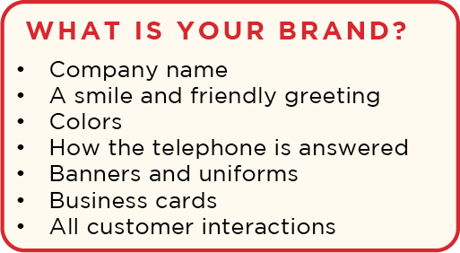
UNIT 8: PROMOTION PRINCIPLE 2 | LEARN
Principle 2
BRAND YOUR BUSINESS
DISCUSS:
What is branding?
How can you brand your company using these ideas we just read?

Slide 15
UNIT 8: PROMOTION PRINCIPLE 2 | LEARN
Principle 2
BRAND YOUR BUSINESS
ACT:
Turn in your workbook to page 27 or go to your notebook.
Write or draw some branding ideas down and share them with the person next to you.
Notes:
Add: “or copy these in your notebook”

Slide 16
UNIT 8: PROMOTION PRINCIPLE 3 | LEARN
Principle 3
PUT YOUR CUSTOMERS FIRST
CODE:
DISCUSS:
Why is it important to make customers your first priority?
Notes:
If placeholder where we don’t have picture from the manual, let’s use the word code.

Slide 17
UNIT 8: PROMOTION PRINCIPLE 3 | LEARN
Principle 3
PUT YOUR CUSTOMERS FIRST
ACT:
On a board or piece of paper, discuss a list of ways to have positive customer interactions.
Ask yourself: “What are some ways you can help your customers feel good about you and your business?”

Slide 18
UNIT 8: PROMOTION PRINCIPLE 3 | LEARN
Principle 3
PUT YOUR CUSTOMERS FIRST
ACT:
You may want to include:
Listen to their needs & interests
Kindness & respect
Treat as an individual & friend
Great customer service
Discounts for regulars
Offer additional services
Offer ideas using your product
Greet your customer

Slide 19
UNIT 8: PROMOTION PRINCIPLE 3 | LEARN
Principle 3
PUT YOUR CUSTOMERS FIRST
ACT:
Make a list of how you can put the customer first.
Turn to page 27 in your workbook or in your notebook and write or draw ways to put your customers first.

Slide 20
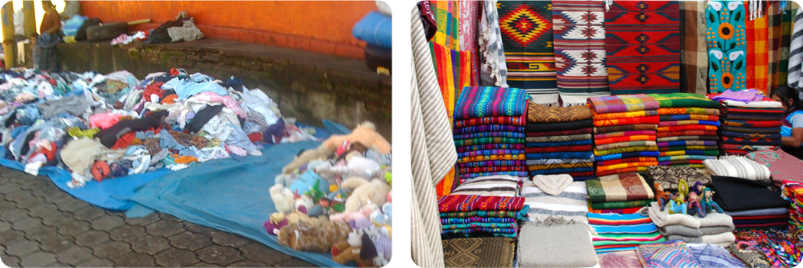
UNIT 8: PROMOTION PRINCIPLE 4 | LEARN
Principle 4
KEEP IT CLEAN AND FRESH

Slide 21
UNIT 8: PROMOTION PRINCIPLE 4 | LEARN
Principle 4
KEEP IT CLEAN AND FRESH
DISCUSS:
Which of the two shops would you buy from?
Would you pay more to get clothes at the cleaner shop?
How much more?
Is your business clean and attractive?

Slide 22
UNIT 8: PROMOTION PRINCIPLE 4 | LEARN
Principle 4
KEEP IT CLEAN AND FRESH
ACT:
Turn to page 28 in your workbook or use a notebook. Write or draw what you can do to make your product look newer, cleaner, or fresher. Then, share your ideas with the group.

Slide 23
UNIT 8: PROMOTION PRINCIPLE 5 | LEARN
Principle 5
CONSTANTLY IMPROVE SALES
CODE:
How can we increase sales?
Social Media
Customer loyalty cards (9 purchases, the 10th is free)
Relocation
Selling old inventory at discounts
Placing best product at eye level
Offer different or additional products or services

Slide 24
UNIT 8: PROMOTION PRINCIPLE 5 | LEARN
Principle 5
CONSTANTLY IMPROVE SALES
DISCUSS:
Which of these ideas would you like to know more about?
How can we learn more about some of these ideas?
Are there any of these ideas that we should plan an additional class to discuss such as marketing with social media?

Slide 25
UNIT 8: PROMOTION PRINCIPLE 5 | LEARN
Principle 5
CONSTANTLY IMPROVE SALES
ACT:
Decide if you want to devote an extra class to increase sales.
Turn to page 28 in your workbook.
Review the promotion principles and write or draw at least two new ideas to help more customers find your business and buy what you sell.

Slide 26
UNIT 8: PROMOTION SUMMARY
PROMOTION PRINCIPLES SUMMARY
State Your Business in 30 Seconds.
Brand Your Business.
Put Your Customers First.
Keep It Clean & Fresh.
Constantly Improve Sales.

Slide 27
UNIT 8: PROMOTION COMMIT
COMMITMENT
Business Plan Commitment:
I will identify and implement at least two new ways to increase sales.
Home Quality of Life Commitment
I will thoughtfully choose one or two areas of my Quality of Life Wheel and write down goals to improve this week.
I will be specific with my written goals and follow through.

Slide 28
UNIT 8: PROMOTION COMMIT
COMMITMENT
Savings Commitment
I will add to my savings – even if it’s just a coin or two

Slide 29
UNIT 8: PROMOTION COMMIT
COMMITMENT
DISCUSS:
Who would like to share their Home Quality of Life Commitment this week?
Which commitment will be the easiest to keep for you this week?
Which commitment will be the hardest?

Slide 30
UNIT 8: PROMOTION COMMIT
COMMITMENT
ACT:
Meet now with your Action Partner for this week. Discuss your business ideas and decide how you will contact and encourage each other during the week to keep your commitments. Share your commitments out loud.

Slide 31
UNIT 8: PROMOTION

