Slide 1
UNIT 9: PAPERWORK – ASSETS & LOANS

Slide 2
UNIT 9: PAPERWORK – ASSET & LOANS
Build Productive Assets.
Put Your Skin in the Game.
Beware of Fixed Costs.
Know If & When to Get a Loan.

Slide 3
UNIT 9: PAPERWORK – ASSETS & LOANS REPORT
REPORT
Last Week’s Promises:
Business Plan: Identify and implement at least two new ways to increase sales.
Home Quality of Life Plan: Choose to improve a specific area from your Home Plan.
Savings: Save money, even just a coin or two.
ACT:
Business Spotlight presentation

Slide 4
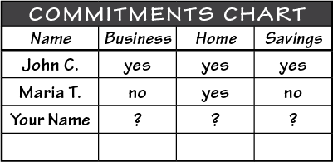
UNIT 9: PAPERWORK – ASSETS & LOANS REPORT
REPORT:
DISCUSS:
What did you learn last week as you kept your promises?
What problems did you have as you tried to keep your commitments?
What can we do to help everyone keep weekly promises?

Slide 5
UNIT 9: PAPERWORK – ASSETS & LOANS INTRODUCTION | LEARN
DISCUSS:
What do you see in this picture?
If your business was this boat, what would you do?
What are some of the costs that could sink your business?
ACT:
Learn and implement the four principles discussed.

Slide 6
UNIT 9: PAPERWORK – ASSETS & LOANS PRINCIPLE 1 | LEARN
Principle 1
BUILD PRODUCTIVE ASSETS
CODE:
Which of these assets on the following slide are productive assets.
Why or why not?

Slide 7
UNIT 9: PAPERWORK – ASSETS & LOANS PRINCIPLE 1 | LEARN
Principle 1
BUILD PRODUCTIVE ASSETS

Slide 8
UNIT 9: PAPERWORK – ASSETS & LOANS PRINCIPLE 1 | LEARN
Principle 1
BUILD PRODUCTIVE ASSETS
DISCUSS:
What are some of the assets that you have in your business?
What is the difference between an asset and a productive asset?

Slide 9
UNIT 9: PAPERWORK – ASSETS & LOANS PRINCIPLE 1 | LEARN
Principle 1
BUILD PRODUCTIVE ASSETS
CODE:

Slide 10
UNIT 9: PAPERWORK – ASSETS & LOANS PRINCIPLE 1 | LEARN
Principle 1
BUILD PRODUCTIVE ASSETS
DISCUSS:
In what ways does Betsi avoid sinking her business by getting the most out of her assets?
How can you make your assets more productive?

Slide 11
UNIT 9: PAPERWORK – ASSETS & LOANS PRINCIPLE 1 | LEARN
Principle 1
BUILD PRODUCTIVE ASSETS
ACT:
In your workbook or another notebook turn to page 29.
Write or draw a few assets you have or think you need to help your business.
In groups of two or three, share how you can make your assets more productive.
Are there any other additional assets your business needs?

Slide 12
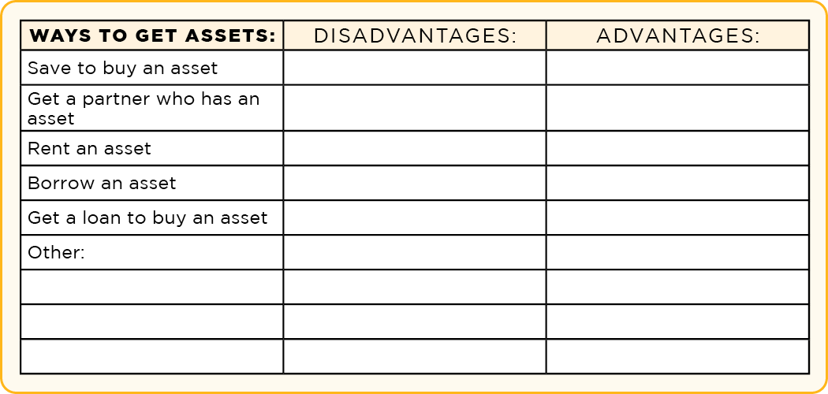
UNIT 9: PAPERWORK – ASSETS & LOANS PRINCIPLE 1 | LEARN
Principle 1
BUILD PRODUCTIVE ASSETS

Slide 13
UNIT 9: PAPERWORK – ASSETS & LOANS PRINCIPLE 1 | LEARN
Principle 1
BUILD PRODUCTIVE ASSETS
DISCUSS:
Look again in your workbook or notebook on page 29 at your list of assets that you just created.
Use the Ways to Get Assets box or draw your own in a notebook. Discuss the advantages and disadvantages of the various ways you can obtain those assets.
What are the advantages and disadvantages of each of the methods suggested by your group?

Slide 14
UNIT 9: PAPERWORK – ASSETS & LOANS PRINCIPLE 2 | LEARN
Principle 2
PUT YOUR SKIN IN THE GAME

Slide 15
UNIT 9: PAPERWORK – ASSETS & LOANS PRINCIPLE 2 | LEARN
DISCUSS:
What do you see in this picture?
If they play hard, do you think some of the players may get skinned, scratched, or hurt in the game?
Why do they play if they can get skinned or hurt?

Slide 16
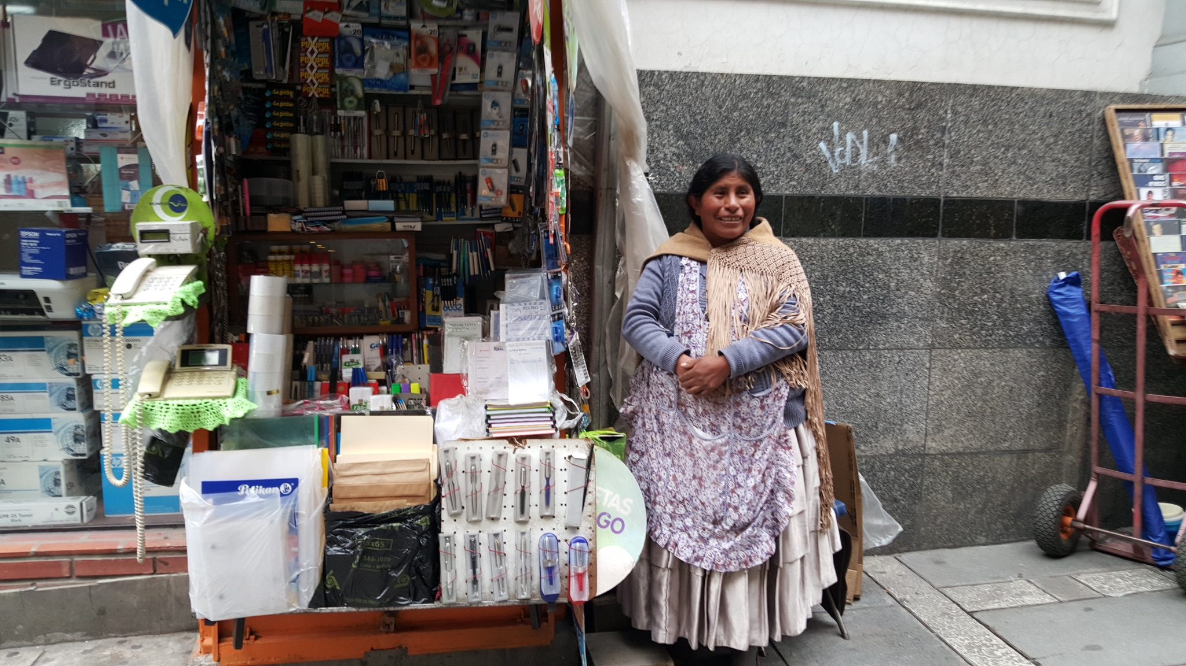
UNIT 9: PAPERWORK – ASSETS & LOANS PRINCIPLE 2 | LEARN
Principle 2
PUT YOUR SKIN IN THE GAME
CODE:

Slide 17
UNIT 9: PAPERWORK – ASSETS & LOANS PRINCIPLE 2 | LEARN
Principle 2
PUT YOUR SKIN IN THE GAME
DISCUSS:
Why is it important to have your skin in the game?
What does this mean for you and your business?
ACT:
Turn to page 30 in your workbook or another notebook. Write or draw what you can do to “put your skin in the game” for your business.

Slide 18
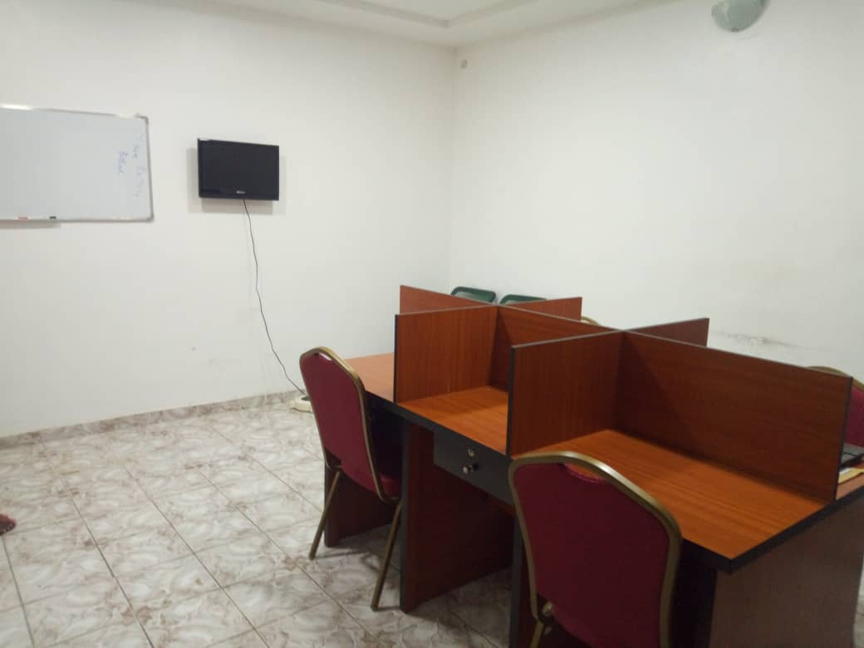
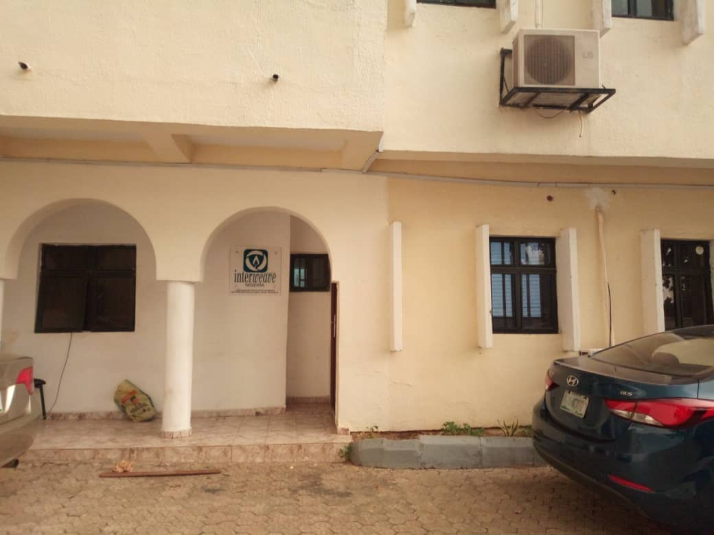
UNIT 9: PAPERWORK – ASSETS & LOANS PRINCIPLE 3 | LEARN
Principle 3
BEWARE OF FIXED COSTS
CODE:

Slide 19
UNIT 9: PAPERWORK – ASSETS & LOANS PRINCIPLE 3 | LEARN
Principle 3
BEWARE OF FIXED COSTS
DISCUSS:
What is a fixed cost?
When is a fixed cost useful and when is it not useful for your business?
How can we be careful of fixed costs?
ACT:
Write your policy on fixed costs for your business in your workbook on page 30 or in another notebook.

Slide 20
UNIT 9: PAPERWORK – ASSETS & LOANS PRINCIPLE 3 | LEARN
Principle 3
BEWARE OF FIXED COSTS

Slide 21
UNIT 9: PAPERWORK – ASSETS & LOANS PRINCIPLE 4 | LEARN
Principle 4
KNOW IF & WHEN TO GET A LOAN
CODE:
Motive – The motive is the reason why you want a loan.
Warning – Loans should only be used for productive business assets, not personal items.

Slide 22
UNIT 9: PAPERWORK – ASSETS & LOANS PRINCIPLE 4 | LEARN
Principle 4
KNOW IF & WHEN TO GET A LOAN
CODE:
Terms – The terms include the interest rate, origination fees, and length of the loan.
Warning – You should compare terms of at least three loan sources to find the most favorable loan for you. Terms vary greatly between banks and micro-finance institutions.

Slide 23
UNIT 9: PAPERWORK – ASSETS & LOANS PRINCIPLE 4 | LEARN
Principle 4
KNOW IF & WHEN TO GET A LOAN
CODE:
Timing – The timing helps you know when you need to pay back the loan and how often you need to make payments.
Warning – Make sure you have the cash flow and are ready for a loan. Keep good financial records.

Slide 24
UNIT 9: PAPERWORK – ASSETS & LOANS PRINCIPLE 4 | LEARN
Principle 4
KNOW IF & WHEN TO GET A LOAN
CODE:
Amount – The amount is the size of the loan.
Ask only for the money you need to get productive assets. Make sure the payments can be made. Don’t borrow extra money for personal spending.

Slide 25
UNIT 9: PAPERWORK – ASSETS & LOANS PRINCIPLE 4 | LEARN
Principle 4
KNOW IF & WHEN TO GET A LOAN
DISCUSS:
What are the four warnings you should consider before deciding to get a loan?
Why are these concepts so important?
ACT:
If you think you should get a loan, make sure to fill out the Loan Warning Checklist and Loan Terms Worksheet on page 54-55. Or fill answers in another notebook while following along in the next slides.

Slide 26
UNIT 9: PAPERWORK – ASSETS & LOANS PRINCIPLE 4 | LEARN
Principle 4
KNOW IF & WHEN TO GET A LOAN

Slide 27
UNIT 9: PAPERWORK – ASSETS & LOANS PRINCIPLE 4 | LEARN
Principle 4
KNOW IF & WHEN TO GET A LOAN

Slide 28
UNIT 9: PAPERWORK – ASSETS & LOANS SUMMARY
PAPERWORK – ASSETS & LOANS PRINCIPLES SUMMARY
Build Productive Assets.
Put Your Skin in the Game.
Beware of Fixed Costs.
Know If & When to Get a Loan.

Slide 29
UNIT 9: PAPERWORK – ASSETS & LOANS COMMIT
COMMITMENT
Business Plan Commitment:
I will implement two idea to improve or increase my productive assets.
I will consider the four loan warnings if I choose to take out a loan.

Slide 30
UNIT 9: PAPERWORK – ASSETS & LOANS COMMIT
COMMITMENT
Home Quality of Life Commitment:
I will thoughtfully choose one or two areas of my Quality of Life Wheel and write down goals to improve this week.
I will be specific with my written goals and follow through.
Savings Commitment:
I will add to my savings – even if it’s just a coin or two.

Slide 31
UNIT 9: PAPERWORK – ASSETS & LOANS COMMIT
COMMITMENT
DISCUSS:
Who would like to share their Home Quality of Life Commitment this week?
Which commitment will be the easiest to keep for you this week?
Which commitment will be the hardest?

Slide 32
UNIT 9: PAPERWORK – ASSETS & LOANS COMMIT
COMMITMENT
ACT:
Meet now with your Action Partner for this week. Discuss your business ideas and decide how you will contact and encourage each other during the week to keep your commitments.

Slide 33
UNIT 9: PAPERWORK – ASSETS & LOANS

